Slide 1
A Look at National Board Certification for Teachers
and Candidate Support for MS Teachers
Presented by:
The World Class Teaching Program

Slide 2
Curious About National Boards?
Unraveling the Mystery of
National Board Certification

Slide 3
National Board Certification
Maintain high and rigorous standards for what accomplished teachers should know and be able to do.
Provide a national voluntary system certifying teachers who meet these standards. (Mississippi’s merit pay system for teachers.)

Slide 4
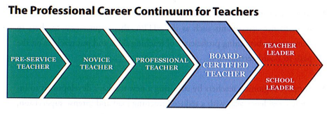
The Professional Career Continuum
National Board Certification is the next step.

Slide 5
Eligibility Prerequisites
The Candidate must:
Possess a baccalaureate degree from an accredited institution except CTE.
NEW – 2022, Teachers may begin their National Board journey during their 1st or 2nd year of teaching, but cannot complete it until they have finished their 3rd year of teaching. Time spent on alternate route does count.
Hold a valid state teaching license for each of these three years.

Slide 6
Renewal has been replaced with Maintenance of Certification
The National Board revised its policy for Maintenance of Certification, which requires NBCTs to demonstrate their knowledge and skills every five years. (Adopted February 2015)
This new policy is aligned with the movement of 40 state licensure systems to a five-year renewal period, but also reflects efforts to make certification more affordable and efficient for all teachers, so that that it can become the norm in the profession. Renews your license if your window is open.
$495 plus $75 National Board registration fee. The WCTP does have independent MOC mentors.

Slide 7
Why Should I Pursue becoming a National Board Certified Teacher?
Professional Incentives: improve your practice, increase student growth, professional recognition
Financial Incentives: $6000 yearly stipend ($500 a month), MS will reimburse each first time candidate
Retirement Incentive: Keep in mind, MS teacher’s retirement pay is based on the average of their four highest paid years so National Board Certification could increase your retirement pay.

Slide 8
$10,000
Incentive for the Following Counties
Adams, Amite, Bolivar, Claiborne, Coahoma, Issaquena, Jefferson, Leflore, Quitman, Sharkey, Sunflower, Washington, Wilkinson, Yazoo, Tallahatchie, and Holmes
NBCT must remain in one of these counties to continue to receive the additional $4000 stipend
Additional District Stipends: Oxford School District $3K committed to match the 6K, Madison $2K, Pontotoc County $1025 & City $1000

Slide 9

At the Center of it All:
Improved Student Learning

Slide 10
Where do I start?
Choose your certificate area (There are 25 available)
Your choice is not based on your areas of certification but who your students are and the content that you currently teach
Notice the Student Age Range on the next slide

Slide 11
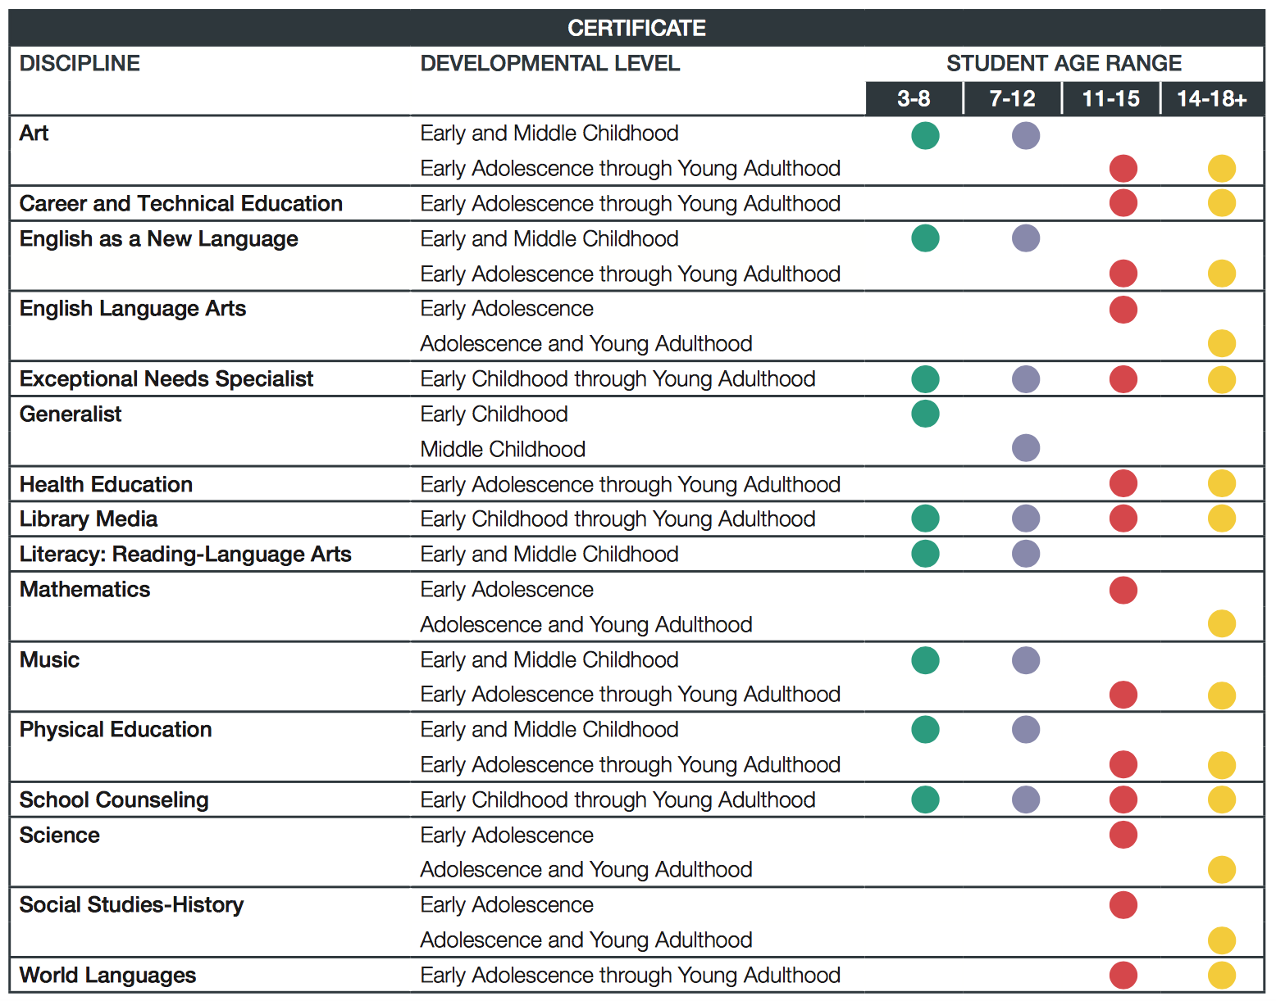

Slide 12
What will I be asked to do?
The certification process requires that teachers demonstrate standards-based evidence of the positive effect they have on student learning in alignment with the Five Core Propositions.
Teachers…
Are committed to students and their learning.
Know the subjects they teach and how to teach those subjects to students.
Are responsible for managing and monitoring student learning.
Think systematically about their practice and learn from experience.
Are members of learning communities

Slide 13

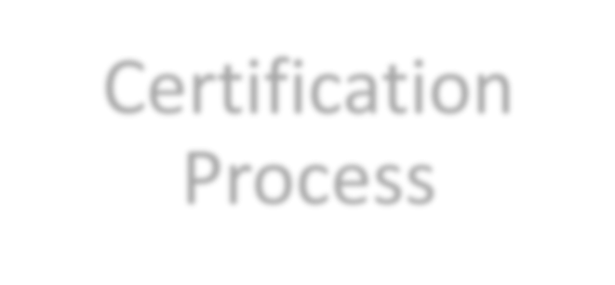



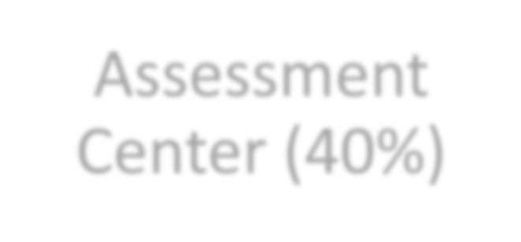
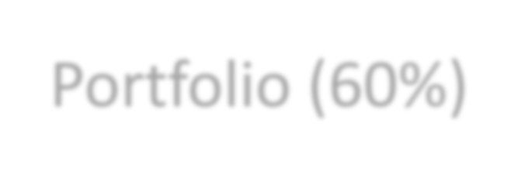

Certification
Process
Assessment
Center (40%)
Portfolio (60%)
Performance based and peer-reviewed!

Slide 14
What is the process? Four Components
You do NOT have to go in order of 1, 2, 3, 4
C1: Content Knowledge
C2: Differentiation in Instruction
C3: Teaching Practice and Learning Environment
C4: Effective and Reflective Practitioner

Slide 15
Weighted Components
Component 1: Content Knowledge
Component 2: Differentiation in
Instruction
Component 3: Teaching Practice &
Learning Environment
Component 4: Effective and
Reflective Practitioner

Slide 16
Newest & Most Successful Trend
Complete the process in TWO years
Only ONE component per semester
Use Pay As You Go and pay for the two components in year 1 then use your reimburse from MDE to pay for the final two components!
Eliminates the stress often associated with National Boards. Teachers LOVE this plan!

Slide 17
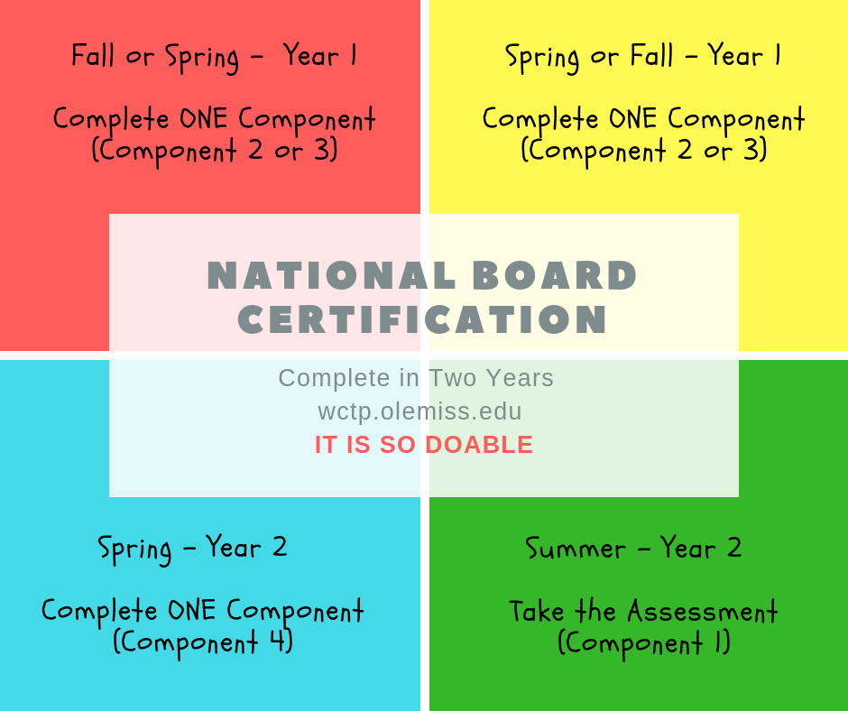
1 (year) + 1 (year) = 4 (components completed)

Slide 18

You may complete the process in
one, two, or three years
Your choice
Your pace
We even have suggested timelines
and suggested assignments.

Slide 19
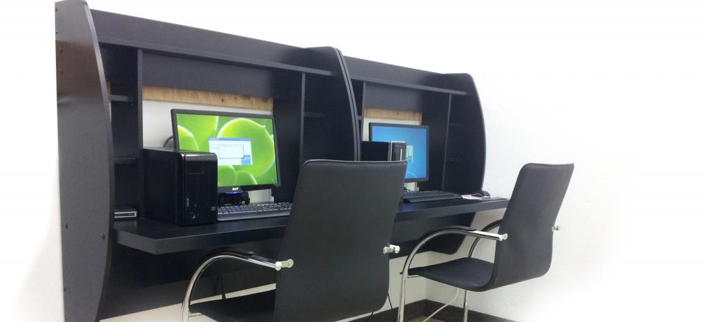
Component 1:
Content Knowledge
Computer-based assessment measuring developmentally appropriate content knowledge and pedagogical practices in the chosen certificate area
  Three constructed response items – 30 minutes to complete each
  45 selected response items – the time allotted varies by certificate area, but will be no fewer than 60 minutes.
  We mentor for the Assessment Center

Slide 20
Component 2:
Differentiation in Instruction
Highlights ability to evaluate learning strengths and needs for individual students; plan and implement appropriate instruction; and analyze and modify strategies and materials based on ongoing assessment.
Classroom-based portfolio entry:
  Samples of student work that demonstrate the students’ growth
  over time
  An accompanying written commentary that analyzes the
  candidate’s instructional choices and what you do based on your knowledge of student (differentiate) to help them meet their goal.

Slide 21
Component 3:
Teaching Practice and Learning Environment
Highlights how candidates engage students and impact their learning
Classroom-based portfolio entry:
  Video recordings of interactions between candidates and their students.
  Two written commentaries, in which the candidate describes, analyzes and reflects on their teaching and interactions
  The video focus is on lessons rather than a unit.
  Each video should demonstrate a different teaching strategy/grouping. Eg. Cooperative group/whole group/partner…etc.

Slide 22
Component 4:
Effective and Reflective Practitioner
Highlights understanding of assessments and assessment practices to plan for/positively impact student learning
Portfolio entry information gathered from many sources:
  Demonstrating practices with a class of students
  Evidence of collaboration with families, community, and colleagues
  Candidate’s contributions to learning communities to
  advance student growth.
  Four Parts: Knowledge of Students, Generation and Use of Assessment Data, Participation in Learning Communities.
  Focus: Using knowledge of your students to demonstrate data driven instruction and decision making that impact student learning.

Slide 23
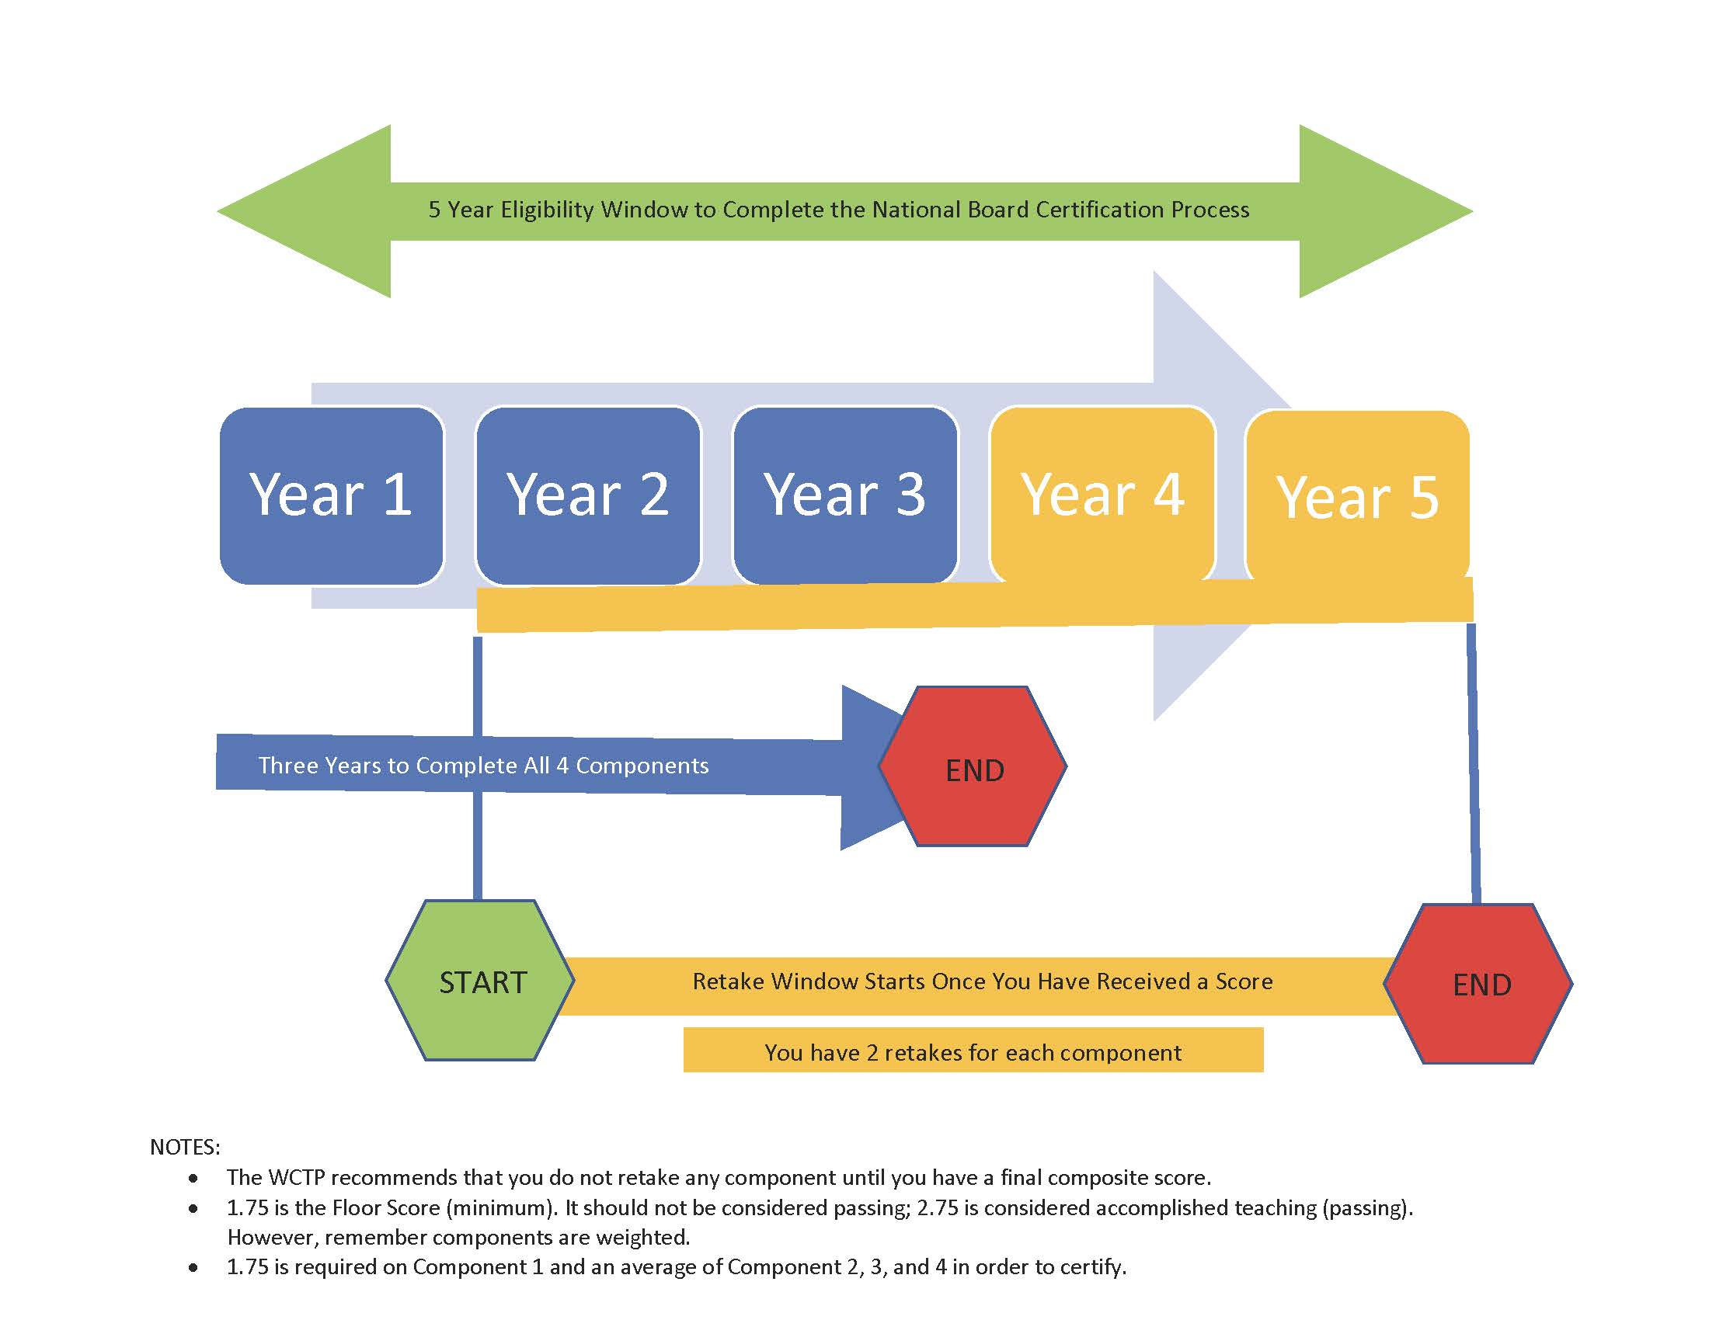

Slide 24
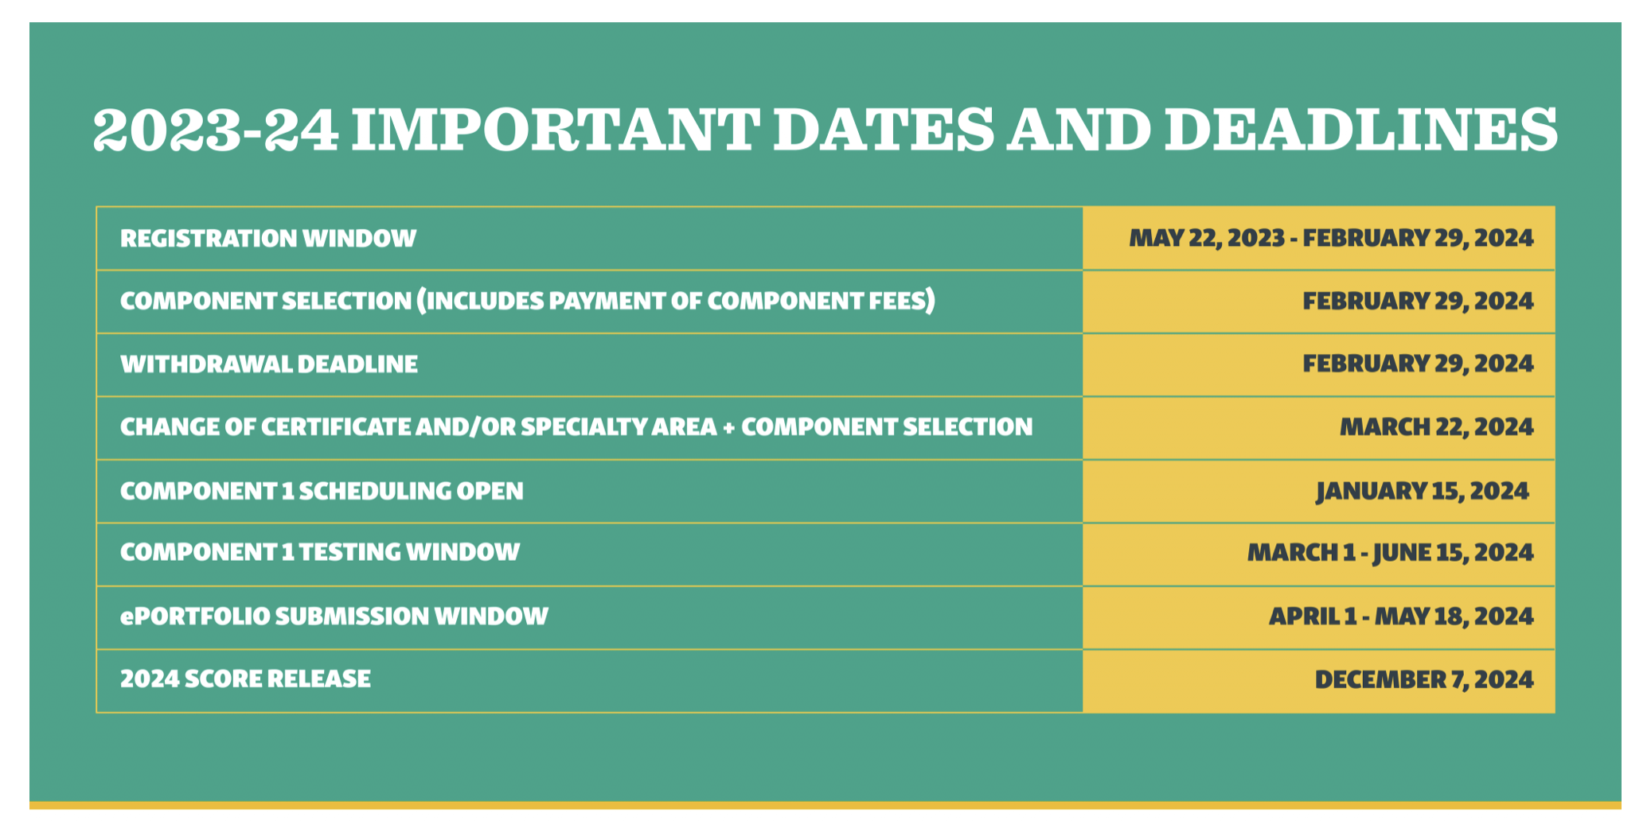
The General Cadence

Slide 25
COST
The total cost of certification decreased from $2500 to
$1,900, with each of the four components costing $475.
Important price points
$475 for each component
$75 annual registration fee

Slide 26
Financial Help and Assistance
Mississippi will reimburse EVERY candidate after they complete components.
Candidates submit in May and receive scores the following fall. The state will reimburse once candidates receive a score report.
State reimbursement is provided whether certification is achieved or not.

Slide 27
Other Avenues of Financial Support
Local Banks: assistance varies by bank. Visit your local bank and talk to your personal banker.
National Board Scholarships: are often awarded in the fall. They are presented on first come first served basis sometimes to specific certificates. Candidates must be registered to be eligible for a scholarship.
Pay as You Go – Payment plan provided by the National Board
MPE Scholarship

Slide 28

All Your Resources in One Place
Located on the WCTP website, lower right-hand corner.
Includes: Standards, Components, Guide to National Board Certification, Scoring Guide, and more!
Take a look at what you’ll be asked to do.
The National Board provides examples and exemplars of components

Slide 29
The World Class Teaching Program:
How Can We Help You?

Slide 30
When can I start the process?
Is it too late?
Mentoring starts the second week in September.
Candidates join us all year long until registration closes, which is February 28.
If you join in the fall, you have time to complete the entire process in one year.
If you join after Christmas, you have time to complete one component.

Slide 31
Who are we?
The World Class Teaching Program at the University of Mississippi is a candidate support program that assists teachers in understanding National Board Certification and provides high quality candidate support mentors and resources to aid candidates in their certification journey.
We annually certify 45 to 50% of the states new NBCTs!

Slide 32
World Class Teacher Program
A Candidate Support System
The University of Mississippi *
Delta State University
Mississippi State University
Jackson State University
The University of Southern Mississippi

Slide 33
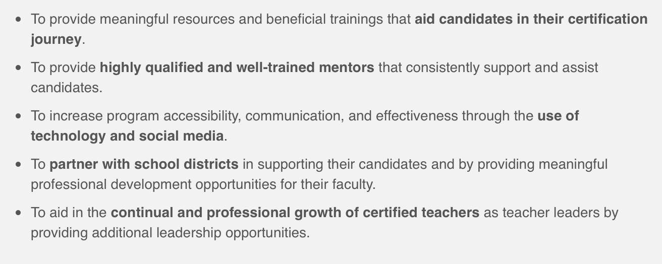
The Mission of the WCTP

Slide 34

You don’t want to do this alone!

Slide 35
Mentoring – Two Types
Traditional, Face–to–Face includes placement in the WCTP 601 Self-paced Blackboard Course (available for most certificates)
Meets twice a month on Tuesdays from 5:00 to 7:00 p.m.
Available at Tupelo, Oxford, DeSoto, and Grenada
Online (Location do NOT matter)
WCTP 601 Includes modules for all four components, syllabus,
discussion board, course outline, assignments will be
submitted electronically to an NBCT mentor for feedback
Specifically designed for: the busy teacher who is unable to attend face-to-face meetings, the teacher who lives too far to drive to mentoring, or the teacher that wants to go at their own pace.
Due to Covid, we now offer more online mentoring. We use Zoom so even our online is Face-to-Face!
We have been offering online mentoring since 2016!

Slide 36
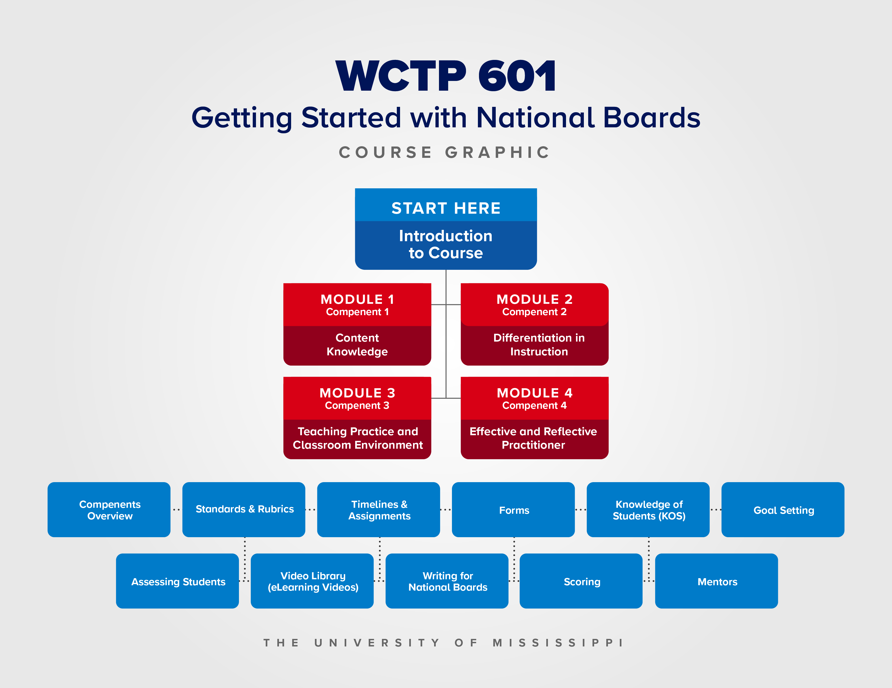

Slide 37
NEW
We’ve added a Video Library!
What’s that? Instructional videos that you can watch about all topics National Boards!!! If you don’t see a video about a topic, ask us, and we’ll create one for you!
UPDATED Modules and New Mini-Modules

Slide 38
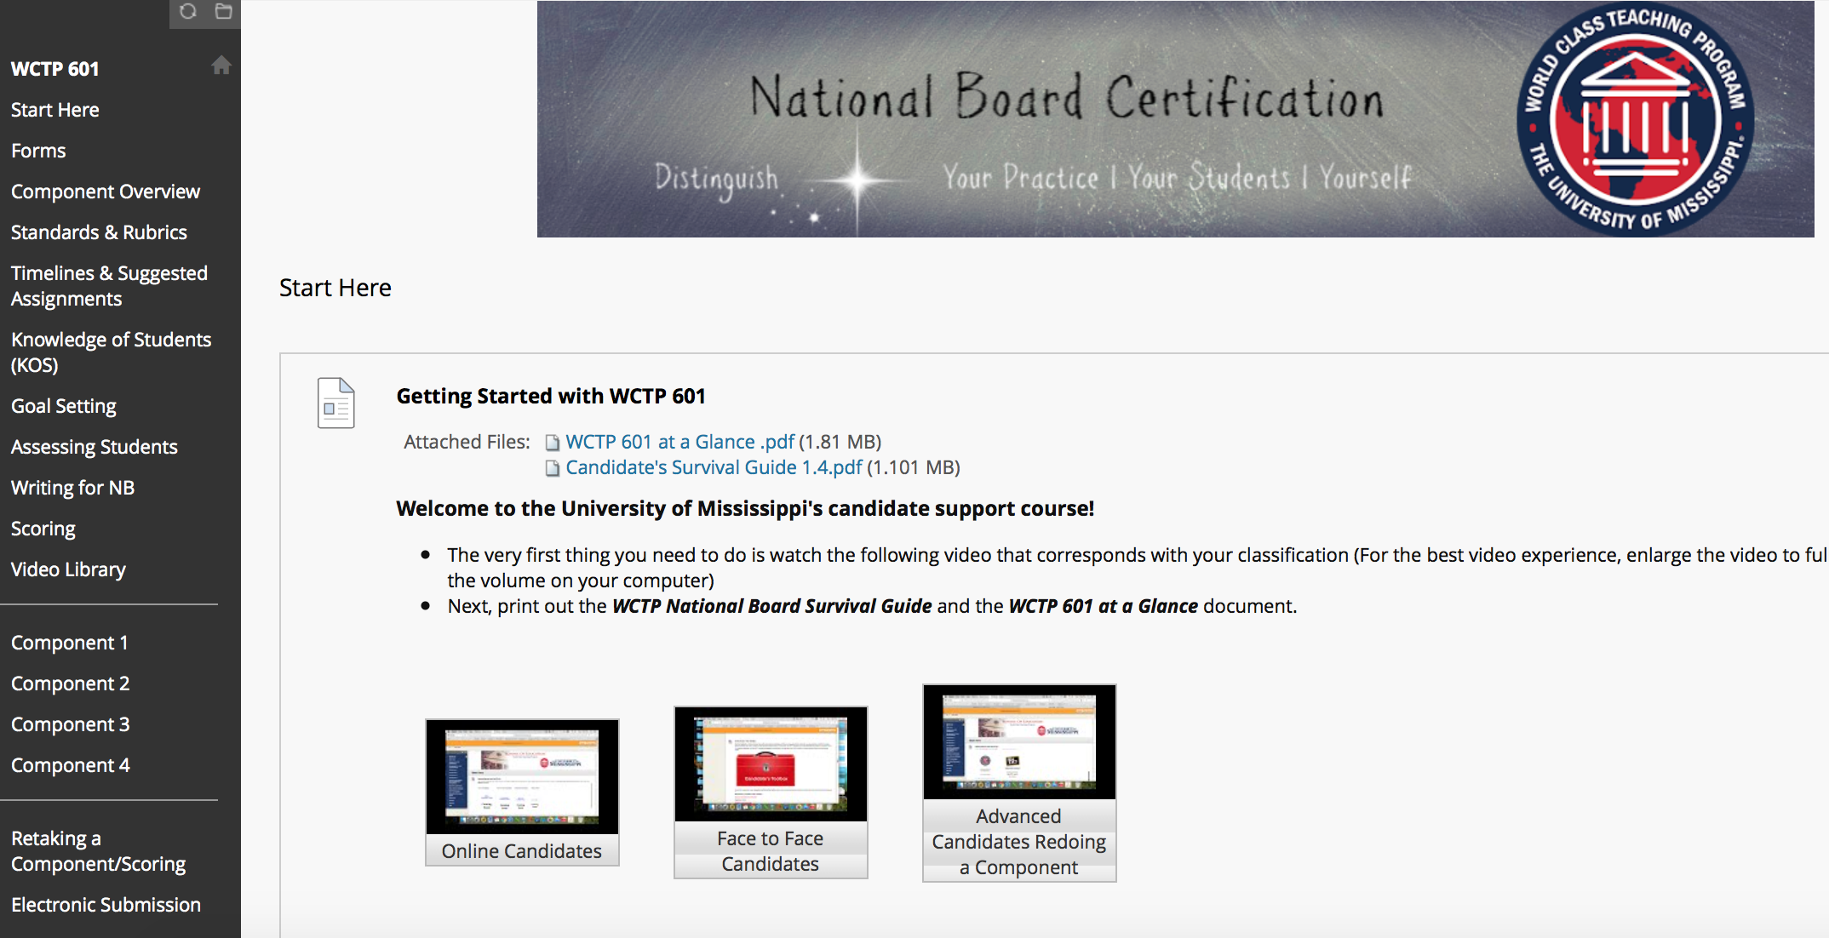
WCTP 601

Slide 39
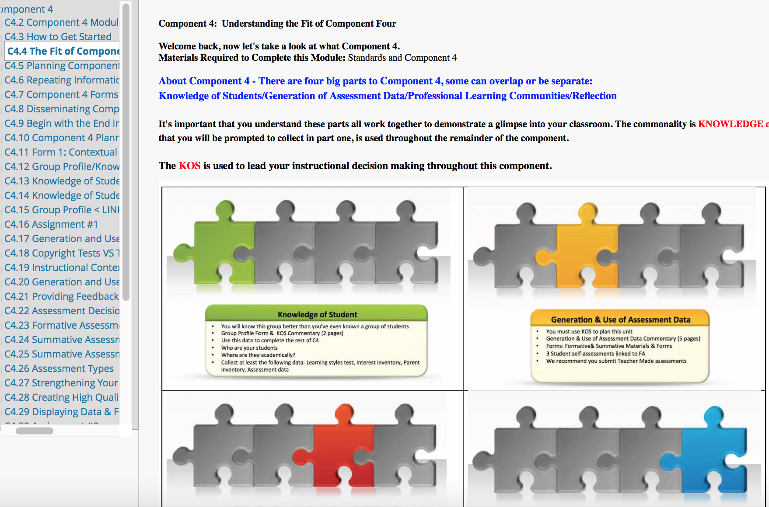
A Glimpse at a Component

Slide 40
WCTP 601
Blackboard Course
Step-by-Step
Self-paced
Includes a module on each component
Includes embedded: Professional development, PowerPoints, Videos, Pedagogical building activities, Semester timelines, Suggested assignments, suggested deadlines, and more
ALL our candidates are enrolled
Only available at The University of Mississippi. Developed in partnership with Stanford University.

Slide 41
What Does Candidate Support
Cost at Ole Miss?
NEW for 2022! $50 enrollment fee
Enrollment Scholarships for: Teachers in the identified 16 10K counties, per senate request, TIME cohort members, Advanced candidates, UM Specialist Independent study participates,
The University of Mississippi’s World Class Teaching Program annual enrollment fee includes ALL our resources: a certified NBCT mentor, placement in WCTP 601, access to a closed Facebook group (WCTP Candidates & Mentors), a Remind group, and admittance to Super Saturday.

Slide 42
Next Steps
Register for a Summer Trainings
http://wctp.olemiss.edu
Look under Workshops

Slide 43
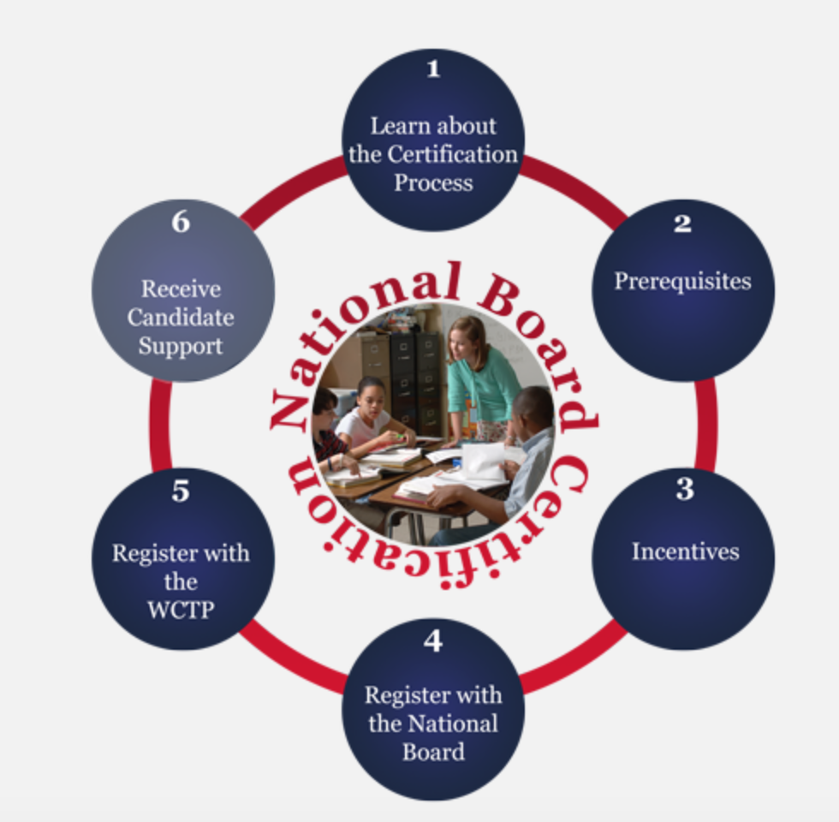
What Next? Now What?
Visit the WCTP website and use the interactive graphic to learn more about the certification process and us.
This graphic will lead you through the entire process of registering for National Boards
http://wctp.olemiss.edu

Slide 44
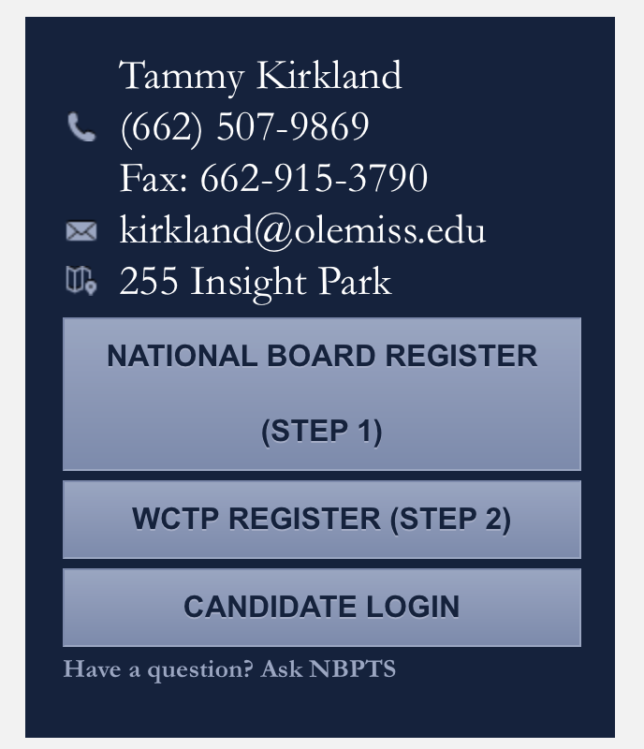
Registering
You must separately register for the National Boards and the World Class Teaching Program (candidate support)
Visit wctp.olemiss.edu
The registration links are provided for you on the right-side of the screen.

Slide 45
Who Can Join us?
ANY teacher that teaches in the state of Mississippi. (If you do not live near our face-to-face mentoring sites, we can still provide strong online candidate support).
Any Mississippi teacher that meets the requisites set forth by the National Board

Slide 46
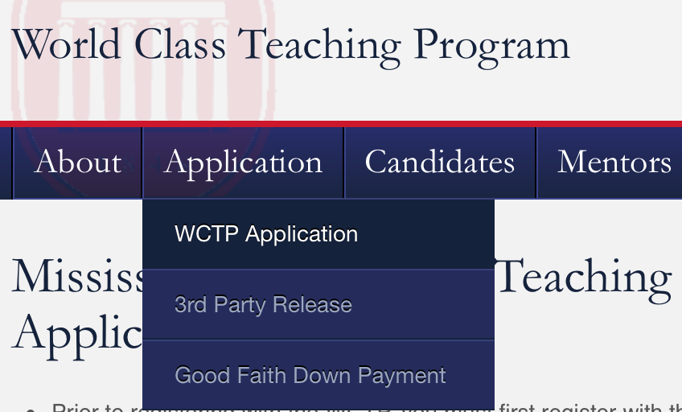
Next Steps: Join US
Register for National Boards
Go to our website: http://wctp.olemiss.edu
Click Applications/WCTP Application (MS). Complete the steps listed in red.
Once we receive your application and verify that you have met the WCTP participation terms, we will email you with your WCTP 601 login and enroll you in a mentoring group.

Slide 47
Contact us for additional information
Tammy Kirkland, NBCT, program coordinator
Email: kirkland@olemiss.edu
Website: http://wctp.olemiss.edu
Facebook: Ole Miss – World Class Teaching Program
Workshops are held each summer in Oxford, Southaven, Grenada, Tupelo, and Madison, MS.

Slide 48
Thank you for interest and allowing us to share about the certification journey and how we can help you.

