Slide 1
A Look at National Board Certification for Teachers
and Candidate Support for MS Teachers
Presented by:
The World Class Teaching Program

Slide 2
Video Objectives
Answer your questions about the National Board process
Explain how to register for National Boards
Explain how the World Class Teaching Program, WCTP, at the University of Mississippi can help you achieve certification
Explain how to register for candidate support with the WCTP

Slide 3
Curious About National Boards?
Unraveling the Mystery of
National Board Certification

Slide 4
What is The National Boards Certification Process?
National Board Certification is the most respected professional certification available in K-12 education. The process was created by teachers, for teachers, the National Board Standards represent a consensus among educators about what accomplished teachers should know and be able to do. Board certification is available in 25 certificate areas.

Slide 5
The Mission of NBPTS
Maintain high and rigorous standards for what accomplished teachers should know and be able to do.
Provide a national voluntary system certifying teachers who meet these standards. (Mississippi’s merit pay system for teachers.)
Advocate related education reforms to integrate National Board Certification in American education and capitalize on the expertise of National Board Certified Teachers.

Slide 6
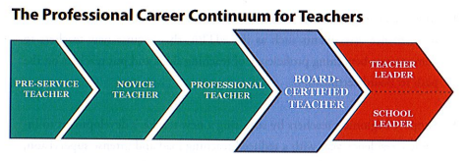
The Professional Career Continuum
National Board Certification is the next step.

Slide 7
Eligibility Prerequisites
The Candidate must:
Possess a baccalaureate degree from an accredited institution except CTE.
Have completed three years of successful teaching at one or more early childhood, elementary, middle or secondary school(s). Time spent on alternate route does count.
Hold a valid state teaching license for each of these three years.

Slide 8
Renewal has been replaced with Maintenance of Certification
The National Board recently revised its policy for Maintenance of Certification, and will require Board- certified teachers to demonstrate their knowledge and skills every five years. (Adopted February 2015)
This new policy is aligned with the movement of 40 state licensure systems to a five-year renewal period, but also reflects efforts to make certification more affordable and efficient for all teachers, so that that it can become the norm in the profession.
It will be less to do than renewal and a lesser cost than renewal.

Slide 9
Why should I pursue becoming a National Board Certified Teacher?
Professional Incentives: improve your practice, increase student growth, professional recognition
Financial Incentives: $6000 yearly stipend ($500 a month), MS will reimburse each first time candidate
Retirement: Keep in mind, MS teacher’s retirement pay is based on the average of their four highest paid years so National Board Certification could increase your retirement pay.

Slide 10
$10,000
Incentive for the Following Counties
Adams, Amite, Bolviar, Claiborne, Coahoma, Issaquena, Jefferson, Leflore, Quitman, Sharkey, Sunflower, Washington, Wilkinson, Yazoo, Tallahatchie, and Holmes

Slide 11

At the Center of it All:
Improved Student Learning

Slide 12
What are my odds of certifying?
Is this really a possibility?
In 2018 and 2019, our program certified over 50% of the state’s candidates. Over 60% of our candidates certified the first attempt; the national average is ~ 35%. Our advanced candidate certification rate is over 90%.
Certification is based on candidate’s individual effort, but is increased when they utilize the provided resources.

Slide 13
What will I be asked to do?
The certification process requires that teachers demonstrate standards-based evidence of the positive effect they have on student learning in alignment with the Five Core Propositions.
Teachers…
Are committed to students and their learning.
Know the subjects they teach and how to teach those subjects to students.
Are responsible for managing and monitoring student learning.
Think systematically about their practice and learn from experience.
Are members of learning communities

Slide 14

You may complete the process in
one, two, or three years
Your choice
Your pace
We even have suggested timelines
and suggested assignments.

Slide 15
Newest & Most Successful Trend
Complete the process in TWO years
Only ONE component per semester
Use Pay As You Go and pay for the two components in year 1 then use your reimburse from MDE to pay for the final two components!
Eliminates the stress often associated with National Boards. Teachers LOVE this plan!

Slide 16
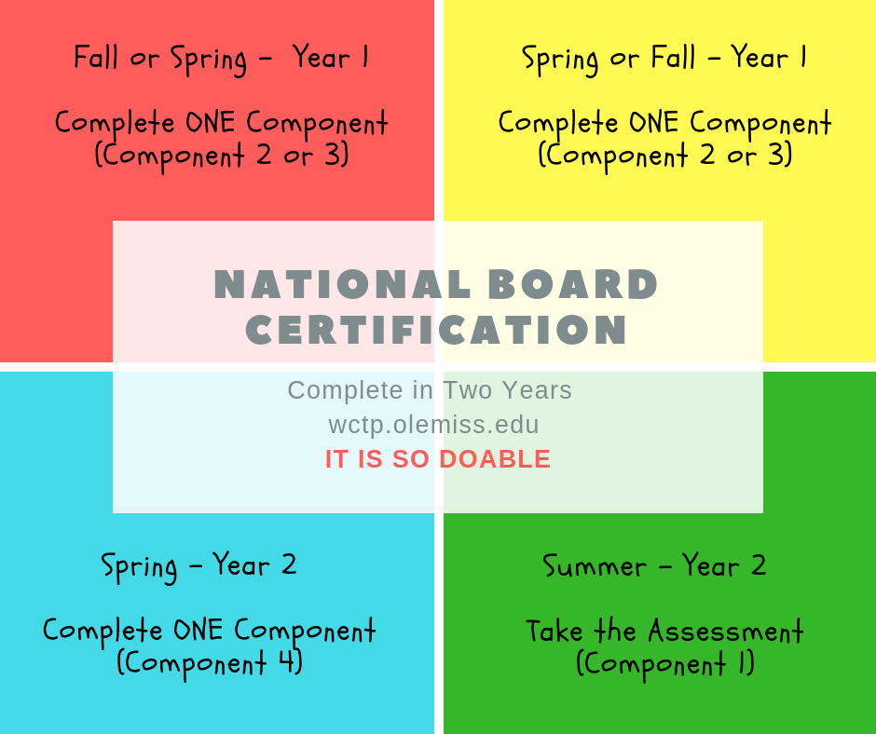
1 (year) + 1 (year) = 4 (components completed)

Slide 17
What is the process?
You do NOT have to go in order of 1, 2, 3, 4
C1: Content Knowledge
C2: Differentiation in Instruction
C3: Teaching Practice and Learning Environment
C4: Effective and Reflective Practitioner

Slide 18
Where Should I Start?
If you do it in two or three years, we always recommend that you save Component 1, the assessment for last. It’s worth 40%, and we want to help prepare you!
Component 4 is our program’s highest scoring component, BUT do not do it until you understand it!
We always suggest that you start with Component 2 or Component 3 – your choice!

Slide 19
Completing National Board
1 to 5 years
You must attempt each of the four components within the first three years of your candidacy.
You have up to two retake attempts for each component and you can retake at any time during the five-year window; retake years do not have to be concurrent or consecutive.
The highest score received for an individual component will always be used for total score calculation.

Slide 20
Where do I start?
Choose your certificate area (There are 25 available)
Your choice is not based on your areas of certification but who your students are and the content that you currently teach
Notice the Student Age Range on the next slide

Slide 21
25 Certificate Areas
Elementary
Middle
High School
Specific Developmental Ages
A VERY Important
Decision

Slide 22
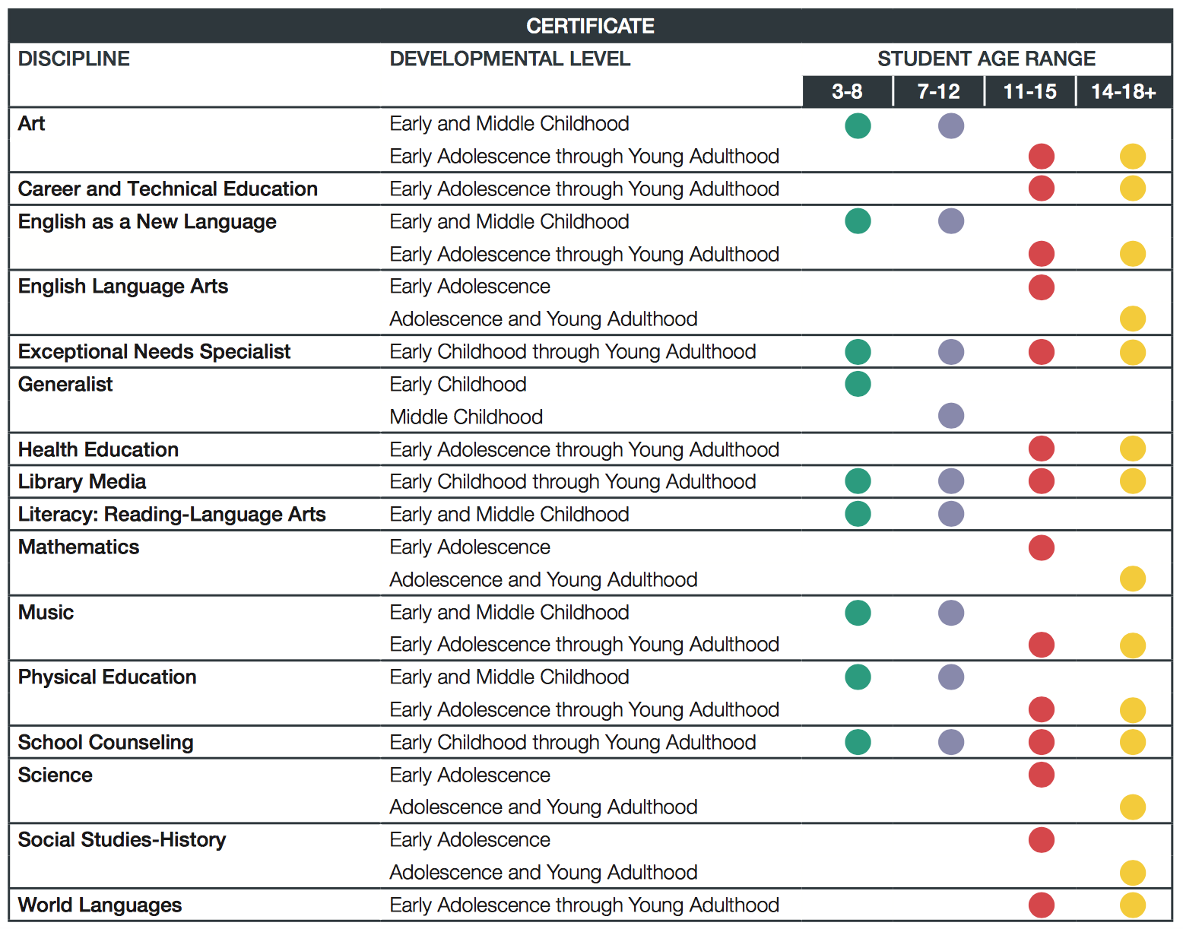

Slide 23
The Components
There are four
Three portfolio entries (Components 2, 3, and 4)
One assessment (Component 1)
Each Component requires the integration of identified standards.
No single Component requires the integration of all the certificate standards

Slide 24
The Standards
Each certificate has its own standards, typically 10 to 13
National Board Candidates teach to their certificate’s standards and their state standards
The standards are detailed descriptions (examples) of what accomplished teaching looks like
Evidence = Standards
All the rubrics align with the standards identified in that component
ARE VERY IMPORTANT!!

Slide 25

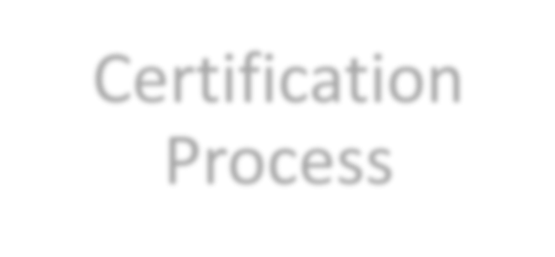



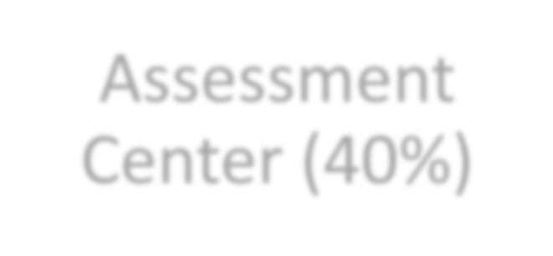
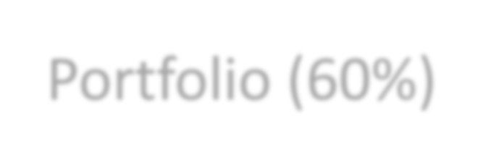

Certification
Process
Assessment
Center (40%)
Portfolio (60%)
Performance based and peer-reviewed!

Slide 26
Weighted Components
Component 1: Content Knowledge
Component 2: Differentiation in
Instruction
Component 3: Teaching Practice &
Learning Environment
Component 4: Effective and
Reflective Practitioner

Slide 27
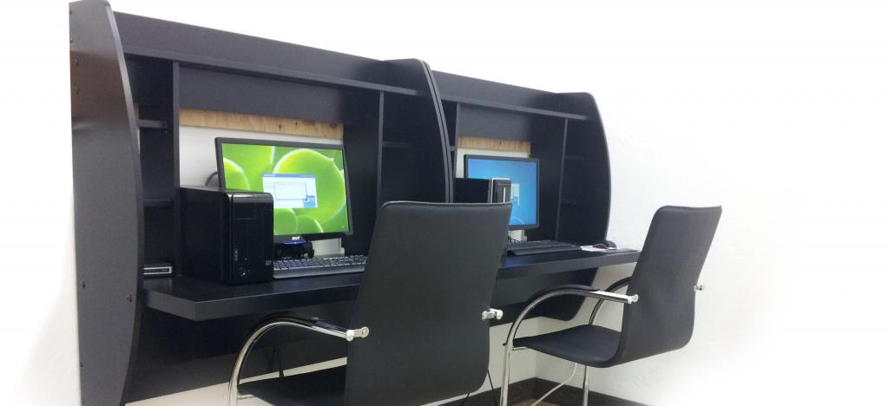
Component 1: Content Knowledge
A computer-based assessment to demonstrate knowledge and pedagogical practices for their certificate area.
3 constructed response exercises
Approximately 45 selected response items (SRIs)
We mentor for the assessment center

Slide 28
Component 2
Differentiation in Instruction
This classroom-based portfolio entry is primarily comprised of samples of student work and an accompanying written commentary. You will submit selected work samples that demonstrate the students’ growth over time and a written commentary that analyzes your instructional choices and what you do based on your knowledge of student (differentiate) to help them meet their goal.
The same goals/lessons will be taught to your whole class but for most certificates you will choose two students to focus your attention on by showing how you use your knowledge of students to differentiate for their individual needs.

Slide 29
Component 3
Teaching Practice & Learning Environment
This is a classroom-based portfolio entry that requires video recordings (two 10-15 minutes) of interactions between you and your students. A written commentary in which you describe, analyze and reflect on your teaching and interactions will also be submitted. Both the video and the written commentary should demonstrate how you engage students and impact their learning.
The video focus is on lessons rather than a unit.
Each video should demonstrate a different teaching strategy/grouping. Eg. Cooperative group/whole group/partner…etc.

Slide 30
Component 4
Effective and Reflective Practitioner
This is a portfolio entry provides you with the opportunity to highlight your abilities an an effective and reflective practitioner in developing and applying your knowledge of your students.
Four Parts: Knowledge of Students, Generation and Use of Assessment Data, Participation in Learning Communities.
Focus: Using knowledge of your students to demonstrate data driven instruction and decision making that impact student learning.

Slide 31

All Your Resources in One Place
Located on the WCTP website, lower right-hand corner. Includes: Standards, Components, Guide to National Board Certification, Scoring Guide, Timelines, Assignments with Deadlines, Pay as You Go Schedule,
and more!
Take a look at what you’ll be asked to do!

Slide 32
The General Cadence
Application deadline: February 28
Full payment due: February 28
Withdrawal and refund deadline: February 28
ePortfolio Submission: April – May
Assessment Center: Late May – Early June
Scores released: On or before December 31

Slide 33
COST
The total cost of certification decreased from $2500 to
$1,900, with each of the four components costing $475.
Important price points
$475 for each component
$75 annual registration fee

Slide 34
Financial Help and Assistance
Mississippi will reimburse EVERY candidate after they complete components.
Candidates submit in May and receive scores the following fall. The state will reimburse once candidates receive a score report.
State reimbursement is provided whether certification is achieved or not.

Slide 35
Other Avenues of Financial Support
Local Banks: assistance varies by bank. Visit your local bank and talk to your personal banker.
National Board Scholarships: are often awarded in the fall. They are presented on first come first served basis sometimes to specific certificates. Candidates must be registered to be eligible for a scholarship.
Pay as You Go (next slide)
MPE Scholarship

Slide 36
Pay as You Go!
Another Option
You may pay as you go on your components this makes it easy and affordable.
If you do two components the first year ($475 x 2 = $950), you can get reimbursed for those two when your scores come in next year, and then use your reimbursement money to pay for the remaining two components, which will also be reimbursed.
If you do want to commit to two components the first you,

Slide 37
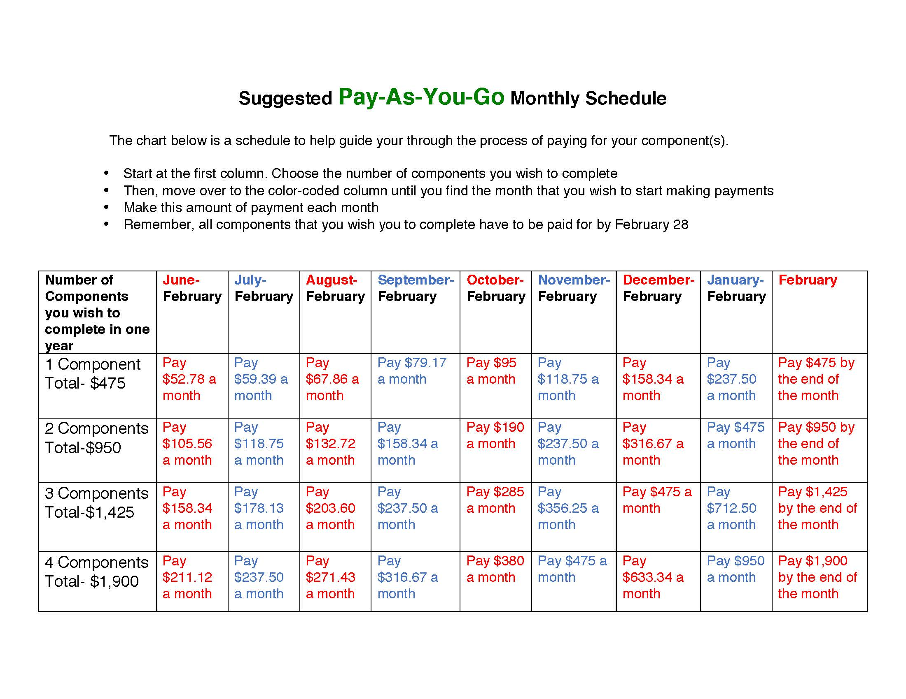
Available in the Candidate’s Toolbox

Slide 38
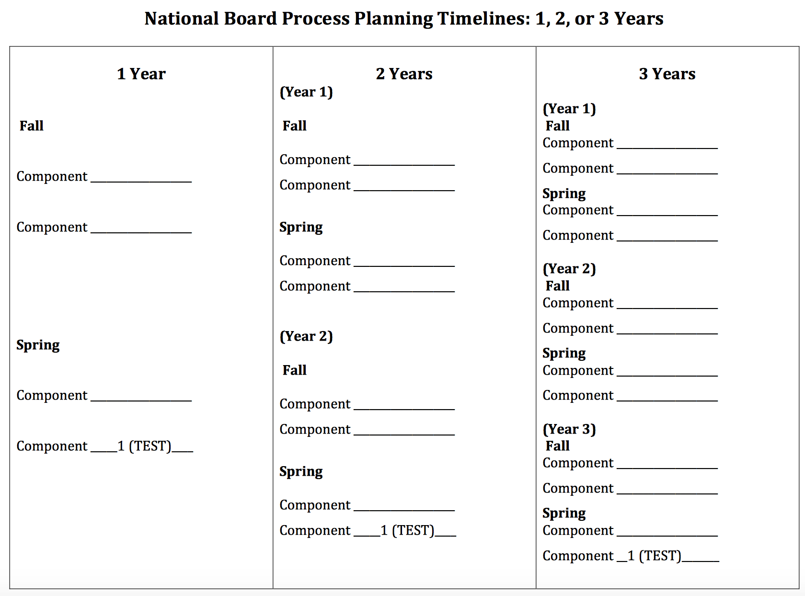
Suggested Component Timelines

Slide 39
The World Class Teaching Program:
How Can We Help You?

Slide 40
When can I start the process?
Is it too late?
Mentoring starts the second week in September.
Candidates join us all year long until registration closes, which is February 28.
If you join in the fall, you have time to complete the entire process in one year.
If you join after Christmas, you have time to complete one component.

Slide 41
Who are we?
The World Class Teaching Program at the University of Mississippi is a candidate support program that assists teachers in understanding National Board Certification and provides high quality candidate support mentors and resources to aid candidates in their certification journey.
In 2018 & 2019, we certified over 50% of the state’s candidates
Our certification rate is 60%. The national rate is ~35%
Advanced candidates certification rate is over 90%

Slide 42
World Class Teacher Program
A Candidate Support System
The University of Mississippi *
Delta State University
Mississippi State University
Jackson State University
The University of Southern Mississippi

Slide 43
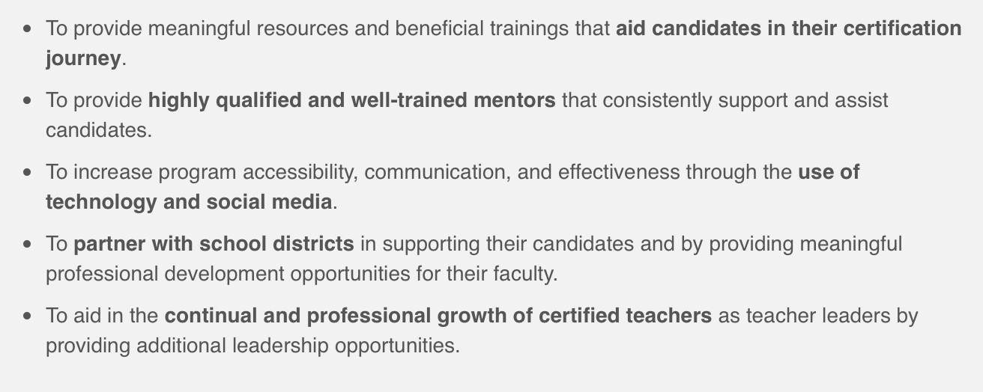
The Mission of the WCTP

Slide 44

You don’t want to do this alone!

Slide 45
Mentoring – Two Types
Traditional, Face–to–Face includes placement in the WCTP 601 Self-paced Blackboard Course (available for most certificates)
Meets twice a month on Tuesdays from 5:00 to 7:00 p.m.
Available at Tupelo, Oxford, DeSoto, and Grenada
Online (Location do NOT matter)
WCTP 601 Includes modules for all four components, syllabus,
discussion board, course outline, assignments will be
submitted electronically to an NBCT mentor for feedback
Specifically designed for: the busy teacher who is unable to attend face-to-face meetings, the teacher who lives too far to drive to mentoring, or the teacher that wants to go at their own pace.

Slide 46
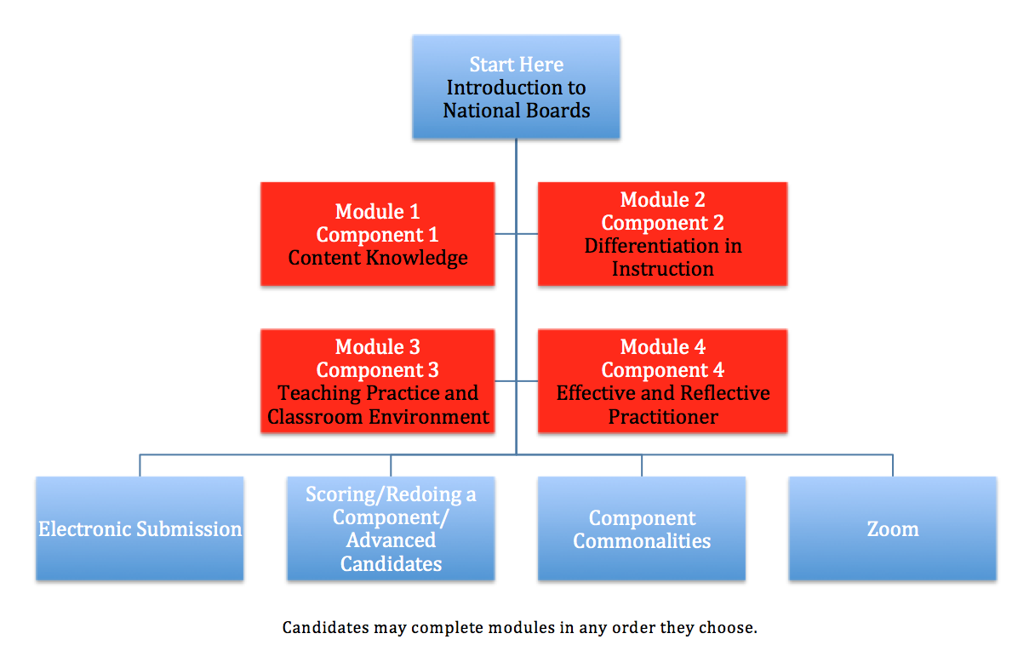
ONLY Available at The University of Mississippi
WCTP 601

Slide 47
NEW
We’ve added a Zoom Library!
What’s that? Instructional videos that you can watch about all topics National Boards!!! If you don’t see a video about a topic, ask us, and we’ll create one for you!

Slide 48
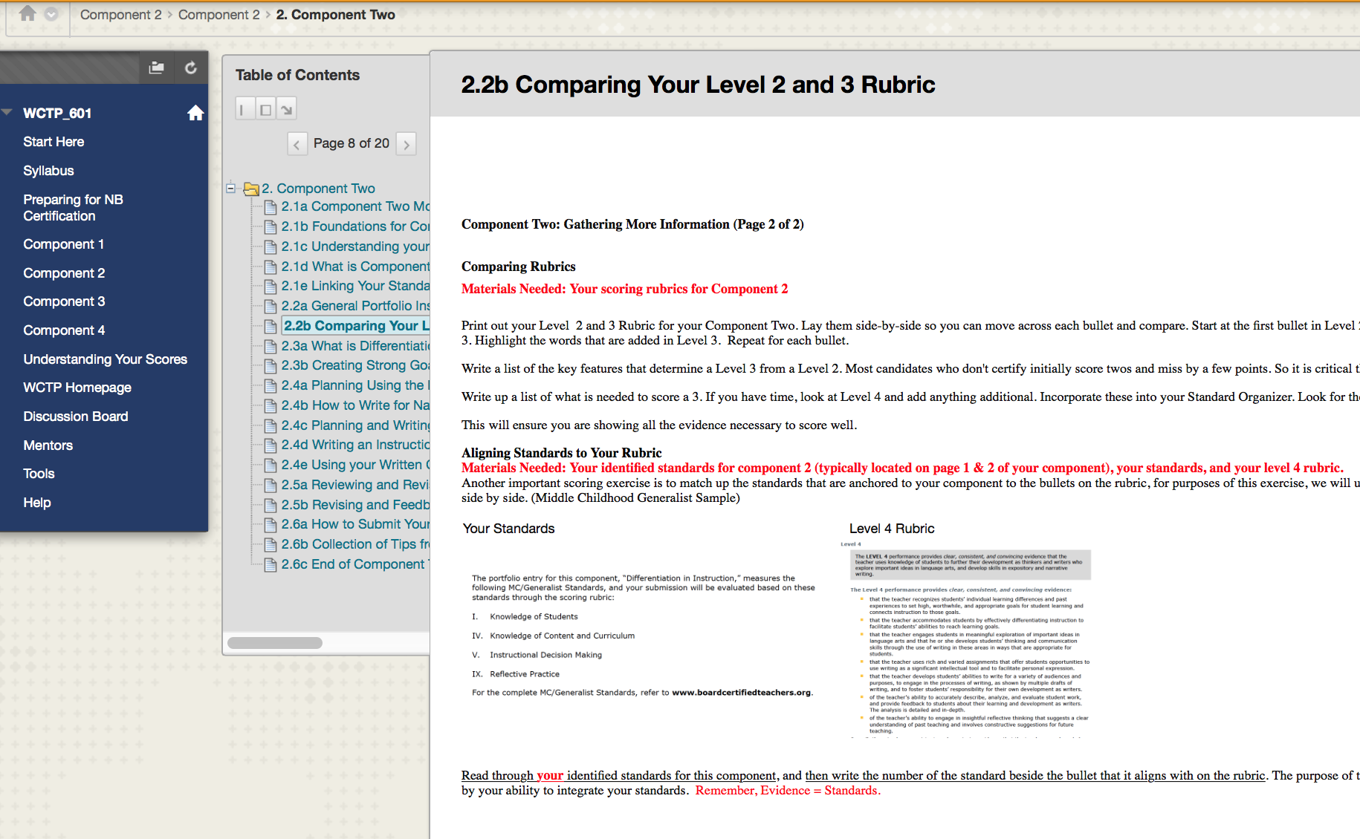
WCTP 601

Slide 49
WCTP 601
Blackboard Course
Step-by-Step
Self-paced
Includes a module on each component
Includes embedded: Professional development, PowerPoints, Videos, Pedagogical building activities, Semester timelines, Suggested assignments, suggested deadlines, and more
ALL our candidates are enrolled
Only available at The University of Mississippi. Developed in partnership with Stanford University.

Slide 50
Getting Started with WCTP 601
When you first receive your WCTP login information, login and watch the short video that corresponds with the type of candidate that you are: Face-to-Face, Online, or Advanced.
Print out the Candidate’s Survival Guide and the WCTP 601 at a Glance, the course’s Table of Contents
It’s ESSENTIONAL that you start off
by watching this video.

Slide 51
What is Online Mentoring http://wctp.olemiss.edu/online-candidates-3/
Candidate support provided in the comfort of your home at your speed and pace
Candidates follow an online protocol in order to assure they still receive high quality candidate support (Candidates complete the outlined assignments and submit them to their mentors. Mentors complete the feedback forms and return the assignments)
WCTP 601 and National Board documents are used as the curriculum. There is a module for each component in WCTP 601. Each module contains five assignments.
Candidates and mentors meet via Zoom and exchange work and notes through email. This starts fall 2019.
What Online Mentoring is Not
Candidates work all alone, complete a whole component, and then email it to their mentor

Slide 52
Face-to-Face Mentoring http://wctp.olemiss.edu/face-to-face-candidates-2/
Meets twice a month for two hours
Groups typically range in size from 3 to 10 people
Group discussion and sharing of ideas
Candidates also use WCTP 601
Meetings for most certificate areas in Tupelo, Oxford, Southaven, Madison (Madison County only mentors Madison County teachers), and Grenada.

Slide 53
Zoom Webinars
NEW resource staring in spring 2019! Webinars
Create a FREE account at https://zoom.us
Once you are accepted as a candidate by the WCTP (we accept all Mississippi teachers that complete all our participation terms), you will be given a Zoom meeting number
You simply will login, click “Join Meeting”, enter the number and you’ll find us there sharing important resources and information

Slide 54
What is a Webinar?
A virtual meeting
There is a host or a presenter, the WCTP, and we will lead a presentation by sharing our screen.
You basically attend training in the comfort of your home. (Online mentoring also uses Zoom!)

Slide 55
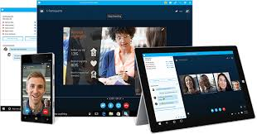


Login and watch ANYWHERE on a computer, tablet or phone
Webinars take place on Monday evening from 5:00 – 6:00. Topics and dates will provided by your mentor.

Slide 56
What Does Candidate Support
Cost at Ole Miss?
$100 enrollment fee, Nah!!! We’re still FREE
The University of Mississippi’s World Class Teaching Program is growing, growing, growing, but are working hard to find ways to remain free to our candidates.

Slide 57
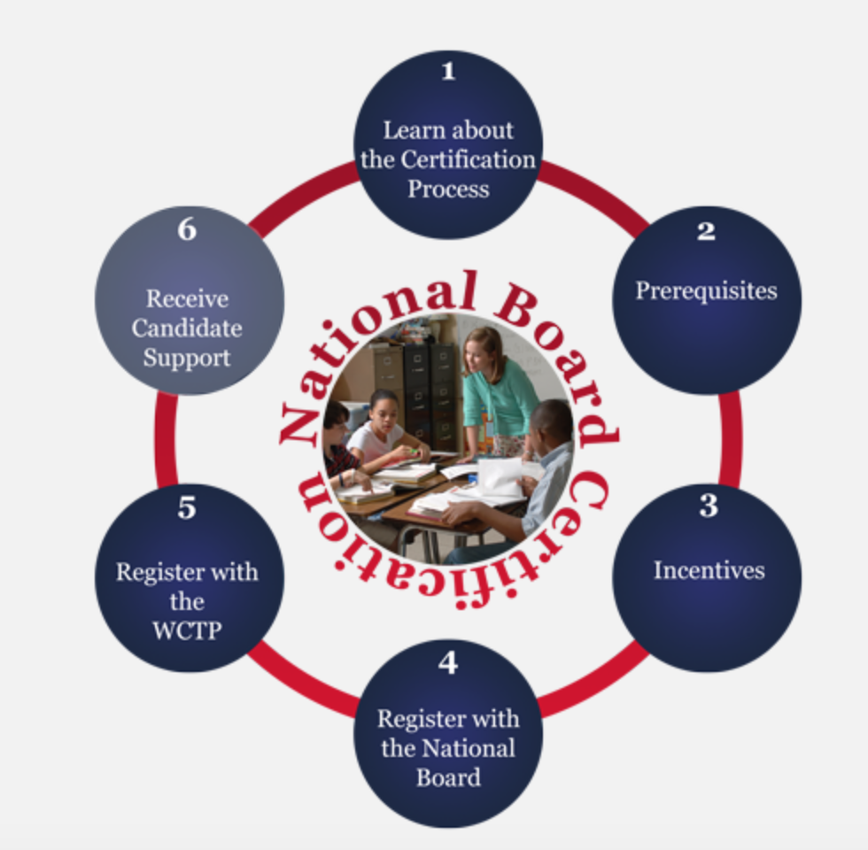
What Next? Now What?
Visit the WCTP website and use the interactive graphic to learn more about the certification process and us.
This graphic will lead you through the entire process of registering for National Boards
http://wctp.olemiss.edu

Slide 58
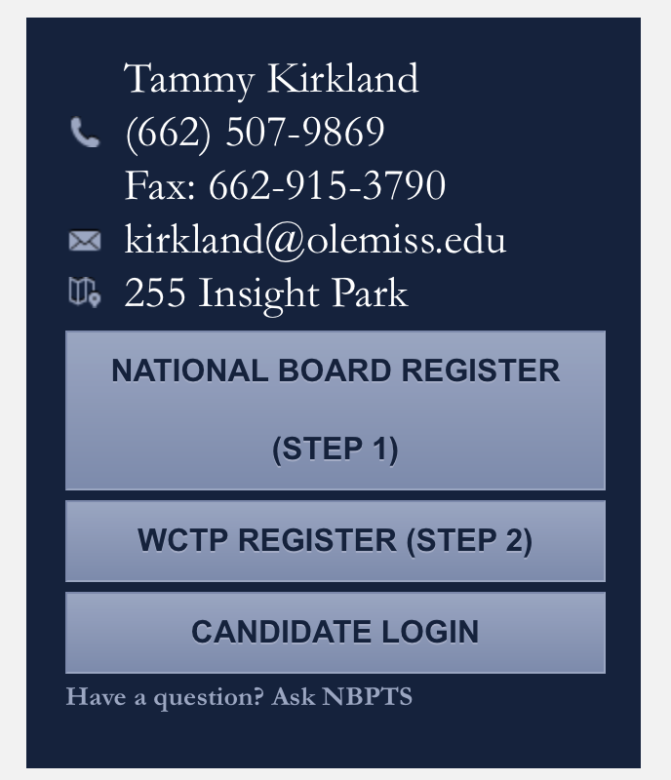
Registering
You must separately register for the National Boards and the World Class Teaching Program (candidate support)
Visit wctp.olemiss.edu
The registration links are provided for you on the right-side of the screen.

Slide 59
WCTP Participation Terms
Terms were necessary due to changes in the National Board process and changes made in funding at MDE
Full explanations and examples are provided on our website to help you through
Once your terms are completed, and we receive your application, we will enroll you in WCTP 601 and immediately assign you a mentor.

Slide 60
WCTP Participation Terms
Release to 3rd Party (National Board Database). This is step 4 of the National Board registration process.
Pay your $75 National Board registration fee. This is step 7 of the National Board registration process.
Make a “Good Faith Down Payment” on a component, any component, any amount.
Agree to only participate in the University of Mississippi’s WCTP. MDE can only provide funding for candidate support to one program. (Double Dipping is unethical)

Slide 61
Why the Participation Terms?
Due to changes in the National Board program and funding changes at the state level.
The participation terms ensure the WCTP receives the financial help from the MDE that is necessary to keep the program running.

Slide 62
Who Can Join us?
ANY teacher that teaches in the state of Mississippi. (If you do not live near our face-to-face mentoring sites, we can still provide strong online candidate support).
Any Mississippi teacher that meets the requisites set forth by the National Board

Slide 63
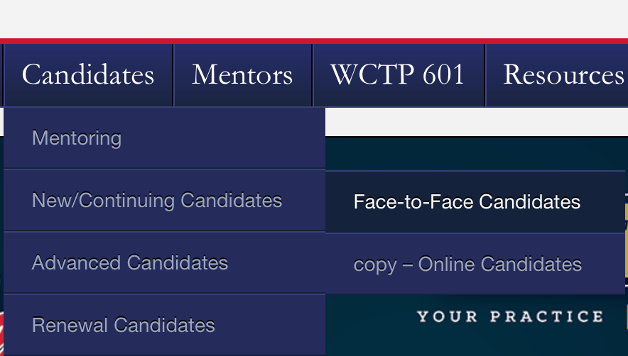
Next Steps: Learn More
Visit our website http://wctp.olemiss.edu
Click Candidates/New & Continuing/then choose either Face-to-Face or Online

Slide 64
Attend a Summer Standard Workshop
This workshop is highly recommended for teachers considering or seeking certification. The workshop allows teachers to consider how their practice aligns with the National Board’s standards, introduces the process, standards, and all components.
Summer workshops are held in various places: Tupelo, Oxford, Southaven, Grenada, and Madison
There are 4 days (2.0 CEUs), 2 days (1.0 CEUs), and a 1 day (.5 CEUs) overview workshops offered to meet your needs.
Visit our site for more information: http://wctp.olemiss.edu/standard-study-workshops/

Slide 65
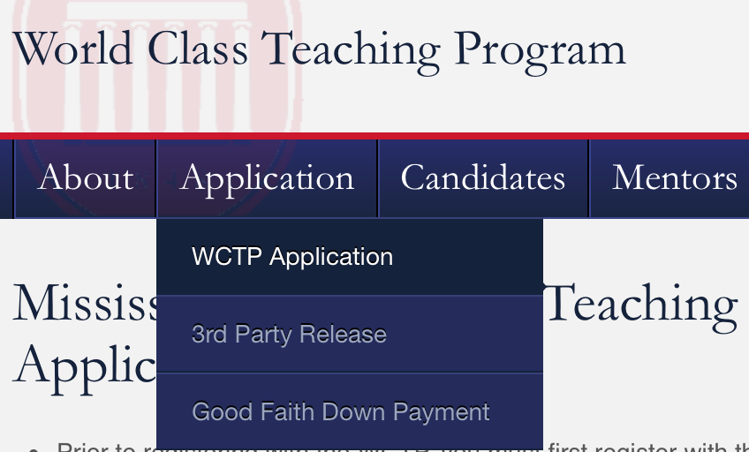
Next Steps: Join US
Go to our website: http://wctp.olemiss.edu
Click Applications/WCTP Application. Complete the steps listed in red.
Once we receive your application and verify that you have met the WCTP participation terms, we will email you with your WCTP 601 login and enroll you in a mentoring group.

Slide 66
Contact us for additional information
Tammy Kirkland, NBCT, program coordinator
Email: kirkland@olemiss.edu
Website: http://wctp.olemiss.edu
Facebook: Ole Miss – World Class Teaching Program
Workshops are held each summer in Oxford, Southaven, Grenada, Tupelo, and Madison, MS.

Slide 67
Thank you for interest and allowing us to share about the certification journey and how we can help you.

