Slide 1
Next Steps: National Board Certification
Presented by:
The World Class Teaching Program
Tammy Kirkland, NBCT

Slide 2
Part I: You’re not a NEW teacher anymore, now what?

Slide 3
Consider National Board Teacher Certification?
National Board Certification (NBC) is a voluntary, advanced teaching credential that goes beyond state licensure. NBC has national standards for what accomplished teachers should know and be able to do. The National Board certifies teachers who successfully complete its rigorous certification process.

Slide 4
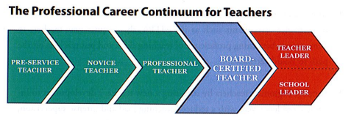
The Professional Career Continuum

Slide 5
Reasons to Certify
Students Grow
Teachers improve their practice. Board Certification allows teachers to hone their practice, showcase their talent in the classroom and demonstrate their dedication to their students and their profession.
Demonstrate a commitment to excellence.
Financial incentive in Mississippi: $6000 a year/$500 a month increase ($10,000 in 13 delta area counties)

Slide 6
Eligibility Prerequisites
The Candidate must:
Possess a baccalaureate degree or higher from an accredited institution. (Not so for CTE)
Have completed three years of successful teaching at one or more early childhood, elementary, middle or secondary school(s).
Hold a valid state teaching license for each of these three years. (Time spent on an emergency certificate counts)

Slide 7
25 Certificate Areas Elementary Middle High School Specific Developmental Ages

Slide 8
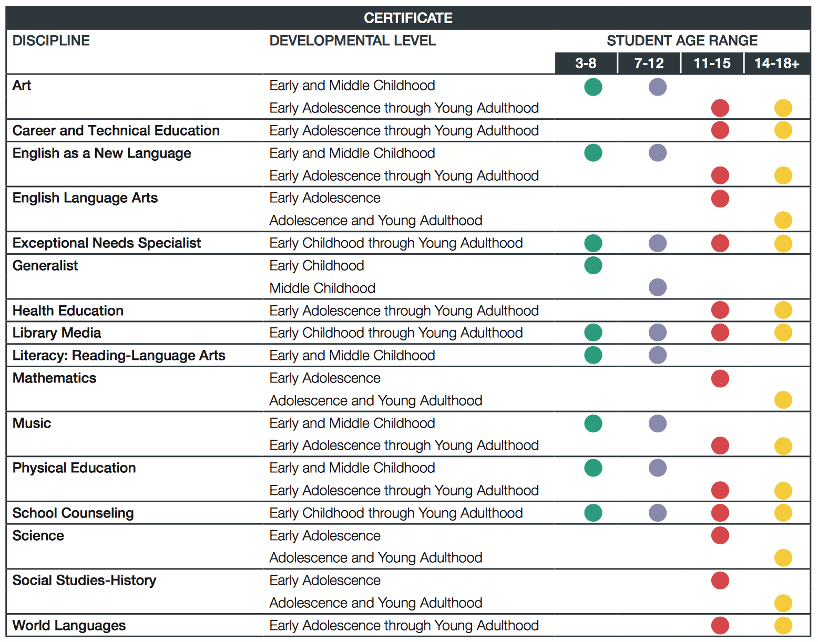

Slide 9
National Board 3.0 is Here!
You may complete the process in one, two, or three years
Your choice
Your pace

Slide 10
What is the process?
You do NOT have to go in order of 1, 2, 3, 4
C1: Content Knowledge
C2: Differentiation in Instruction
C3: Teaching Practice and Learning Environment
C4: Effective and Reflective Practitioner

Slide 11
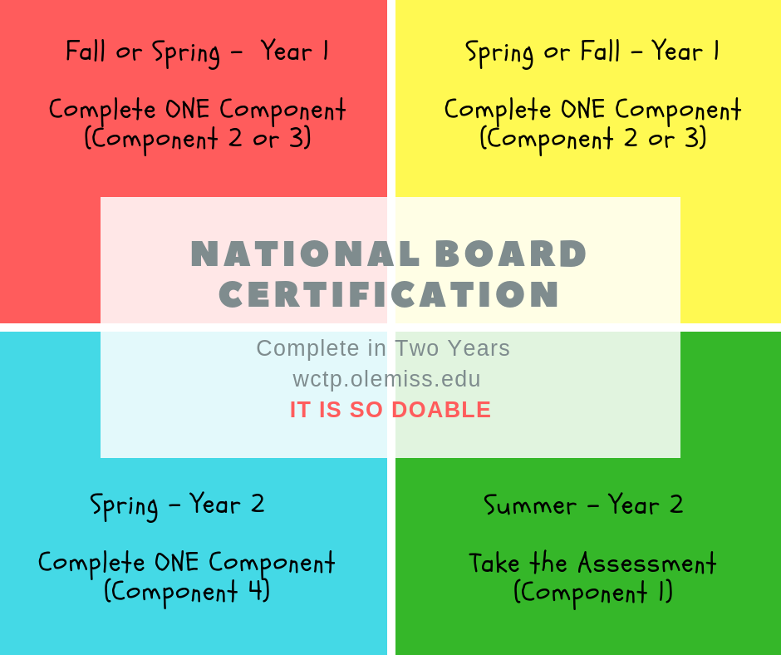

Slide 12
Certification
Process
Assessment
Center (40%)
Portfolio (60%)
Performance based and peer-reviewed!

Slide 13
Weighting
Though the weights across the Assessment Center (40%) and Portfolio (60%) Sections remain the same, the weights for the individual components were necessarily revised to reflect the new composition of these sections:
Assessment Center (Component 1) – 40%
split equally between CRI and SRI
Portfolio (Components 2, 3, and 4) – 60%
Differentiation in Instruction (C2) – 15%
Teaching Practice and Learning Environment (C3) – 30%
Reflective and Effective Practitioner (C4) – 15%

Slide 14
COST
The total cost of certification decreased from $2500 to
$1,900, with each of the four components costing $475.
Important price points
$475 for each component
$75 annual registration fee

Slide 15
Financial Help and Assistance Mississippi has it GOOD!
Mississippi will now reimburse EVERY candidate after they complete components not the process.
Candidates submit in May and receive scores the following fall. The state will reimburse once candidates receive a score report.
State reimbursement is provided whether certification is achieved or not.
Instructions can be found at wctp.olemiss.edu

Slide 16
Pay as You Go!
Login to your account.
Select a Component (NB calls this purchase). Put it in your cart.
Select “Make a Payment” on the left side of the screen.
$475 is the default amount to pay, BUT you can change this to ANY amount.

Slide 17
National Board Certification is Anchored in the Candidates Knowledge of and Ability to Demonstrate the…
Five Core Propositions and the
The Standards

Slide 18
Part II: Teaching like an Accomplished Teacher
The Five Core Propositions. Teachers…
Are committed to students and their learning.
Know the subjects they teach and how to teach those subjects to students.
Are responsible for managing and monitoring student learning.
Think systematically about their practice and learn from experience.
Are members of learning communities.

Slide 19
The Standards
Each certificate has its own standards, typically 10 to 13
Each Component addresses a set of specified standards
National Board Candidates teach to their certificate’s standards and their state standards
The standards are detailed descriptions (examples) of what accomplished teaching looks like
Evidence = Standards
All the rubrics align with the standards identified in that component
ARE VERY IMPORTANT!!

Slide 21
All the standards are anchored back to one of the Five Core Propositions
Teachers…
Are committed to students and their learning.
Know the subjects they teach and how to teach those subjects to students.
Are responsible for managing and monitoring student learning.
Think systematically about their practice and learn from experience.
Are members of learning communities.

Slide 22
Accomplished Teacher
What Teachers Should Know and Be Able to Do
http://accomplishedteacher.org/introduction/

Slide 23
Part III: How Can We Help You?

Slide 24
How do we do?
Over 50% of newly certified NBCTs in MS participated in our program.
70% of our candidates certified on the first attempt.
Nationally only 45% of candidates certify on the first attempt.
12.55% of MS teachers are Nationally Board Certified (4th Nationally)

Slide 25
The World Class Teaching Program is Candidate Support Program for Teachers Who Are Going through the National Board Process.
We…
Provide Summer Standard Workshops to help you get a head start and a good understanding of the certification process
Provide a mentor, an NBCT in your certificate area.
Provide access to our online step-by-step, self-passed Blackboard candidate support course, WCTP 601 and bi-weekly online Zoom meetings
Embed specific professional development into the mentoring process
Offer CEUs for all workshops and participating in mentoring
Have a spring Super Saturday event that helps you successfully finish
Recognize all newly certified NBCTs at an annual Pinning Ceremony
Annual enrollment fee of $100

Slide 26
If you know you want to pursue National Boards, but do not meet the Eligibility Prerequisites yet. GET READY!

Slide 27
Download your standards
Highlight what you do NOT do
The standards provide EXAMPLES of an accomplished teacher, which is great for a new teachers and experienced teachers!

Slide 28
Read through your components, check out what you will be asked to do
All of this material is available to you at no cost from the National Board

Slide 29
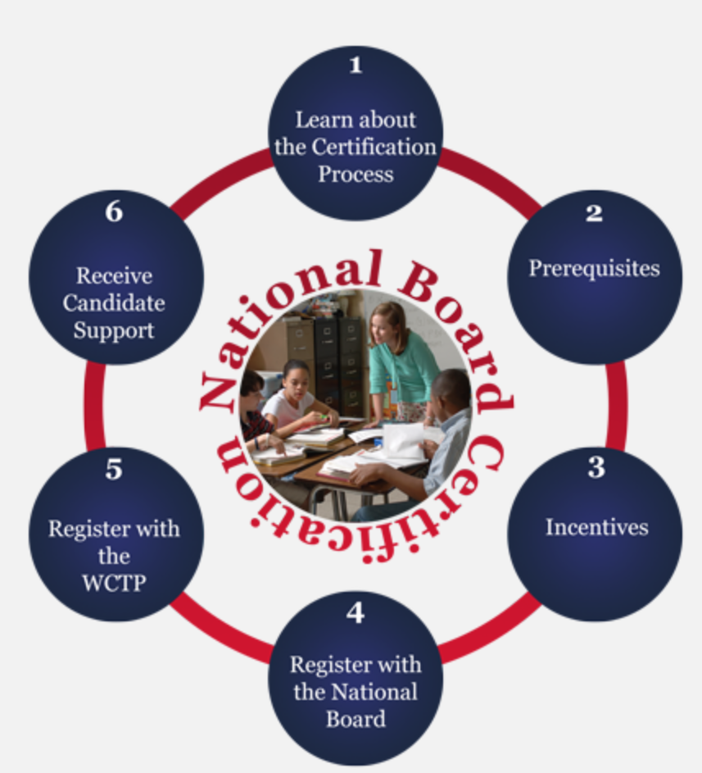
If you have taught your three years and are ready to start the journey, what should you do?
Attend a Summer Standard Workshop
Visit the WCTP website

Slide 30
Mentoring – Two Types
Traditional, Face–to–Face includes placement in the WCTP 601 Self-paced Blackboard Course
Meets twice a month on Tuesdays from 5:00 to 7:00 p.m.
Available at Tupelo, Oxford, DeSoto, and Grenada
WCTP 601 Self-paced Blackboard Course Includes modules for all four components, syllabus, discussion board, course outline, assignments will be submitted electronically to an NBCT mentor for feedback
Specifically designed for: the busy teacher who is unable to attend face-to-face meetings, the teacher who lives too far to drive to mentoring, or the teacher that wants to go at their own pace.
ONLY available at Ole Miss!!
wctp.olemiss.edu/resources/wctp601

Slide 31
WCTP Website
http://wctp.olemiss.edu

