Slide 1
A Look at National Board Certification for Teachers
Presented by:
The World Class Teaching Program

Slide 2
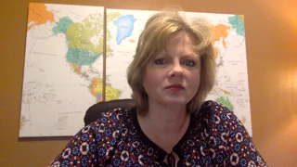
Welcome

Slide 3
Video Objectives
Answer your questions about the National Board process
Explain how to register for National Boards
Explain how the World Class Teaching Program, WCTP, at the University of Mississippi can help you achieve certification
Explain how to register for candidate support with the WCTP

Slide 4
Curious About National Boards?
Unraveling the Mystery of
National Board Certification

Slide 5
What is The National Boards Certification Process?
National Board Certification is the most respected professional certification available in K-12 education. The process was created by teachers, for teachers, the National Board Standards represent a consensus among educators about what accomplished teachers should know and be able to do. Board certification is available in 25 certificate areas.

Slide 6
The Mission of NBPTS
Maintain high and rigorous standards for what accomplished teachers should know and be able to do.
Provide a national voluntary system certifying teachers who meet these standards. (Mississippi’s merit pay system for teachers.)
Advocate related education reforms to integrate National Board Certification in American education and capitalize on the expertise of National Board Certified Teachers.

Slide 7
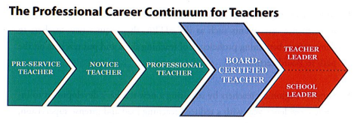
The Professional Career Continuum
National Board Certification is the next step.

Slide 8
Eligibility Prerequisites
The Candidate must:
Possess a baccalaureate degree from an accredited institution except CTE.
Have completed three years of successful teaching at one or more early childhood, elementary, middle or secondary school(s). Time spent on alternate route does count.
Hold a valid state teaching license for each of these three years.

Slide 9
Renewal has been replaced with Maintenance of Certification
The National Board recently revised its policy for Maintenance of Certification, and will require Board- certified teachers to demonstrate their knowledge and skills every five years. (Adopted February 2015)
This new policy is aligned with the movement of 40 state licensure systems to a five-year renewal period, but also reflects efforts to make certification more affordable and efficient for all teachers, so that that it can become the norm in the profession.
It will be less to do than renewal and a lesser cost than renewal.

Slide 10
Why should I pursue becoming a National Board Certified Teacher?
Professional Incentives: improve your practice, increase student growth, professional recognition
Financial Incentives: $6000 yearly stipend ($500 a month), MS will reimburse each first time candidate
Retirement: Keep in mind, MS teacher’s retirement pay is based on the average of their four highest paid years so National Board Certification could increase your retirement pay.

Slide 11

At the Center of it All:
Improved Student Learning

Slide 12
What are my odds of certifying?
Is this really a possibility?
In 2018, our program certified 59% of the newly certified NBCTs in MS. 70% of our candidates certified the first attempt. Our advanced candidate certification rate is over 90%.
Certification is based on candidate’s individual effort, but is increased when they utilize the provided resources.

Slide 13
What will I be asked to do?
The certification process requires that teachers demonstrate standards-based evidence of the positive effect they have on student learning in alignment with the Five Core Propositions.
Teachers…
Are committed to students and their learning.
Know the subjects they teach and how to teach those subjects to students.
Are responsible for managing and monitoring student learning.
Think systematically about their practice and learn from experience.
Are members of learning communities

Slide 14

You may complete the process in
one, two, or three years
Your choice
Your pace
We even have suggested timelines
and suggested assignments.

Slide 15
What is the process?
You do NOT have to go in order of 1, 2, 3, 4
C1: Content Knowledge
C2: Differentiation in Instruction
C3: Teaching Practice and Learning Environment
C4: Effective and Reflective Practitioner

Slide 16
Completing National Board
1 to 5 years
You must attempt each of the four components within the first three years of your candidacy.
You have up to two retake attempts for each component and you can retake at any time during the five-year window; retake years do not have to be concurrent or consecutive.
The highest score received for an individual component will always be used for total score calculation.

Slide 17
Where do I start?
Choose your certificate area (There are 25 available)
Your choice is not based on your areas of certification but who your students are and the content that you currently teach
Notice the Student Age Range on the next slide

Slide 18
25 Certificate Areas
Elementary
Middle
High School
Specific Developmental Ages
A VERY Important
Decision

Slide 19
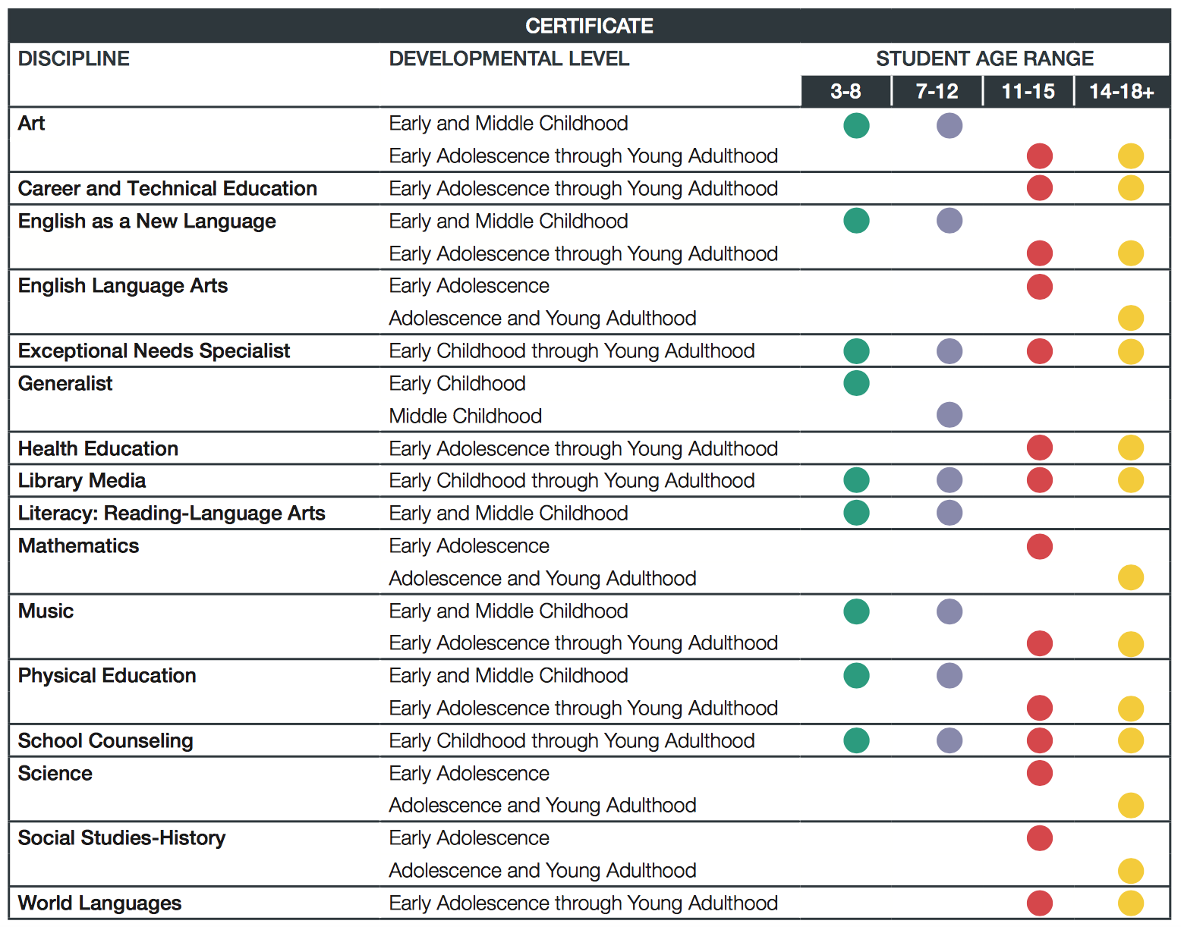

Slide 20
The Components
There are four
Three portfolio entries (Components 2, 3, and 4)
One assessment (Component 1)
Each Component requires the integration of identified standards.
No single Component requires the integration of all the certificate standards

Slide 21
The Standards
Each certificate has its own standards, typically 10 to 13
National Board Candidates teach to their certificate’s standards and their state standards
The standards are detailed descriptions (examples) of what accomplished teaching looks like
Evidence = Standards
All the rubrics align with the standards identified in that component
ARE VERY IMPORTANT!!

Slide 22

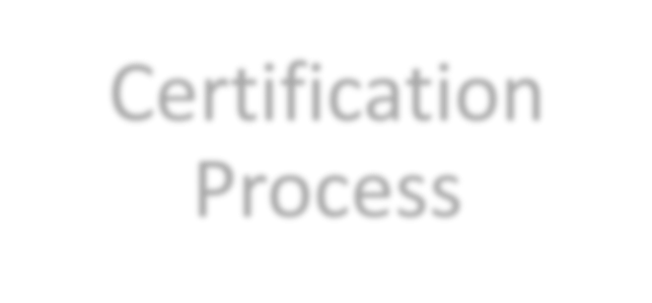

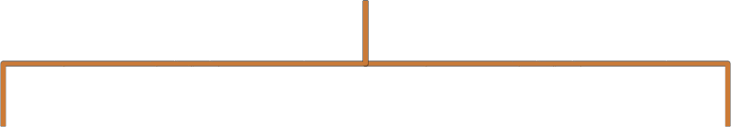

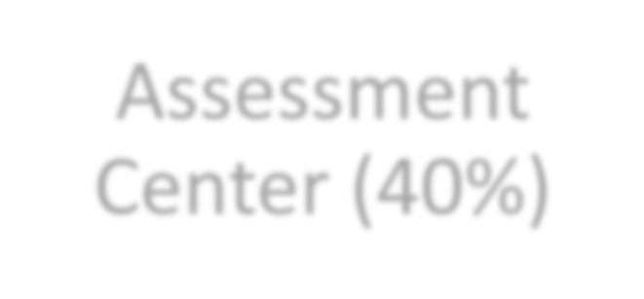
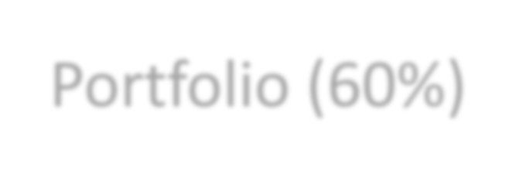

Certification
Process
Assessment
Center (40%)
Portfolio (60%)
Performance based and peer-reviewed!

Slide 23
Weighted Components
Component 1: Content Knowledge
Component 2: Differentiation in
Instruction
Component 3: Teaching Practice &
Learning Environment
Component 4: Effective and
Reflective Practitioner

Slide 24
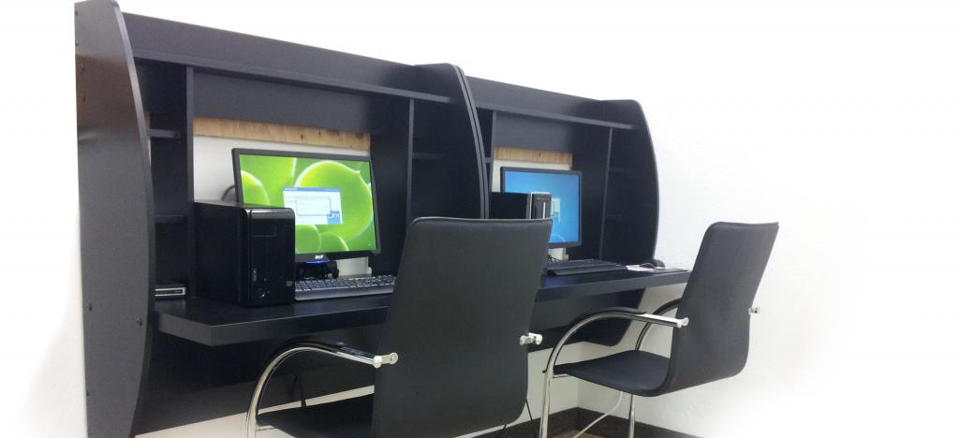
Component 1: Content Knowledge
A computer-based assessment to demonstrate knowledge and pedagogical practices for their certificate area.
3 constructed response exercises
Approximately 45 selected response items (SRIs)
We mentor for the assessment center

Slide 25
Component 2
Differentiation in Instruction
This classroom-based portfolio entry is primarily comprised of samples of student work and an accompanying written commentary. You will submit selected work samples that demonstrate the students’ growth over time and a written commentary that analyzes your instructional choices and what you do based on your knowledge of student (differentiate) to help them meet their goal.
The same goals/lessons will be taught to your whole class but for most certificates you will choose two students to focus your attention on by showing how you use your knowledge of students to differentiate for their individual needs.

Slide 26
Component 3
Teaching Practice & Learning Environment
This is a classroom-based portfolio entry that requires video recordings (two 10-15 minutes) of interactions between you and your students. A written commentary in which you describe, analyze and reflect on your teaching and interactions will also be submitted. Both the video and the written commentary should demonstrate how you engage students and impact their learning.
The video focus is on lessons rather than a unit.
Each video should demonstrate a different teaching strategy/grouping. Eg. Cooperative group/whole group/partner…etc.

Slide 27
Component 4
Effective and Reflective Practitioner
This is a portfolio entry provides you with the opportunity to highlight your abilities an an effective and reflective practitioner in developing and applying your knowledge of your students.
Four Parts: Knowledge of Students, Generation and Use of Assessment Data, Participation in Learning Communities.
Focus: Using knowledge of your students to demonstrate data driven instruction and decision making that impact student learning.

Slide 28

All Your Resources in One Place
Located on the WCTP website, lower right-hand corner. Includes: Standards, Components, Guide to National Board Certification, Scoring Guide, Timelines, Assignments with Deadlines, and more!
Take a look at what you’ll be asked to do!

Slide 29
The General Cadence – 2018/2019
Application deadline: February 28
Full payment due: Feburary 28
Withdrawal and refund deadline: Febuary 28
ePortfolio Submission: April – May
Assessment Center: Late May – Early June
Scores released: On or before December 31

Slide 30
COST
The total cost of certification decreased from $2500 to
$1,900, with each of the four components costing $475.
Important price points
$475 for each component
$75 annual registration fee

Slide 31
Financial Help and Assistance
Mississippi will reimburse EVERY candidate after they complete components.
Candidates submit in May and receive scores the following fall. The state will reimburse once candidates receive a score report.
State reimbursement is provided whether certification is achieved or not.

Slide 32
Other Avenues of Financial Support
Local Banks: assistance varies by bank. Visit your local bank and talk to your personal banker.
National Board Scholarships: are often awarded in the fall. They are presented on first come first served basis sometimes to specific certificates. Candidates must be registered to be eligible for a scholarship.
Pay as You Go (next slide)
MPE Scholarship

Slide 33
Pay as You Go!
Another Option
You may pay as you go on your components this makes it easy and affordable.
If you do two components the first year ($475 x 2 = $950), you can get reimbursed for those two when your scores come in next year, and then use your reimbursement money to pay for the remaining two components, which will also be reimbursed.
If you do want to commit to two components the first you,

Slide 34
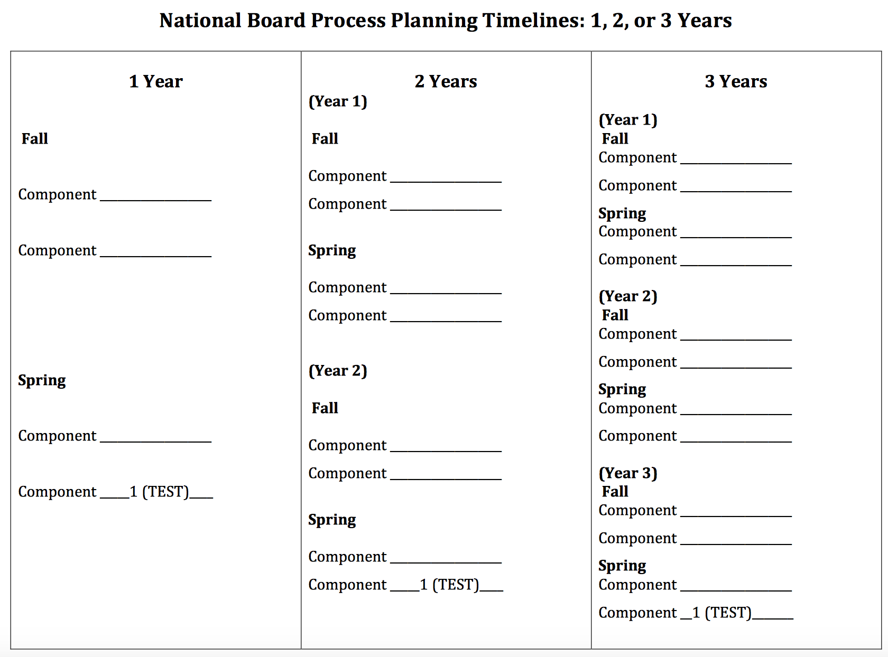
Suggested Component Timelines

Slide 35
Possible Scenarios
Complete the entire process in one year. You can either do two components in the fall and one in the spring or reverse it.
Complete the process in two years. Do two components this year and two components next year or do one component this year and three components next year. By completing only one component this year, you would still only have two classroom components to do the following year – one in the fall and one in the spring. You would study for your assessment both years.
Two years is a popular choice because it makes the process completely manageable. Teachers do not feel rushed, and it still leaves time for other activities.
You can also spread it out over three years if your are really busy.

Slide 36
The World Class Teaching Program:
How Can We Help You?

Slide 37
When can I start the process?
Is it too late?
Mentoring starts the second week in September.
Candidates join us all year long until registration closes, which is February 28.
If you join in the fall, you have time to complete the entire process in one year.
If you join after Christmas, you have time to complete one component.

Slide 38
Who are we?
The World Class Teaching Program at the University of Mississippi is a candidate support program that assists teachers in understanding National Board Certification and provides high quality candidate support mentors and resources to aid candidates in their certification journey.
In 2018, we certified 59% of the state’s candidates
Our certification rate is 70%. The national rate is ~45%
Advanced candidates certification rate is over 90%

Slide 39
World Class Teacher Program
A Candidate Support System
The University of Mississippi *
Delta State University
Mississippi State University
Alcorn State University
Jackson State University
The University of Southern Mississippi

Slide 40
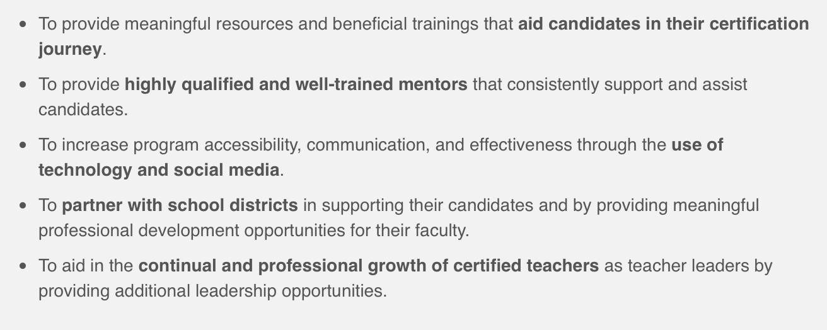
The Mission of the WCTP

Slide 41

You don’t want to do this alone!

Slide 42
Mentoring – Two Types
Traditional, Face–to–Face includes placement in the WCTP 601 Self-paced Blackboard Course (available for most certificates)
Meets twice a month on Tuesdays from 5:00 to 7:00 p.m.
Available at Tupelo, Oxford, DeSoto, and Grenada
WCTP 601 Self-paced Blackboard Course
Includes modules for all four components, syllabus,
discussion board, course outline, assignments will be
submitted electronically to an NBCT mentor for feedback
Specifically designed for: the busy teacher who is unable to attend face-to-face meetings, the teacher who lives too far to drive to mentoring, or the teacher that wants to go at their own pace.

Slide 43
WCTP 601
Blackboard Course
Step-by-Step
Self-paced
Includes a module on each component
Includes embedded: Professional development, Powerpoints, Videos, Pedagogical building activities, Semester timelines, Suggested assignments, suggested deadlines, and more
FREE to ALL our candidates
Only available at The University of Mississippi. Developed in partnership with Stanford University.

Slide 44
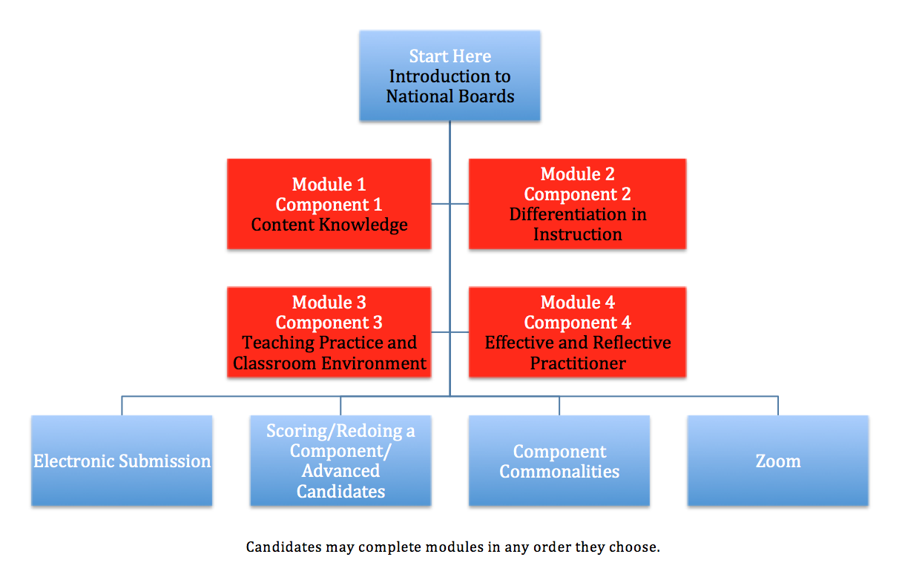
WCTP 601

Slide 45
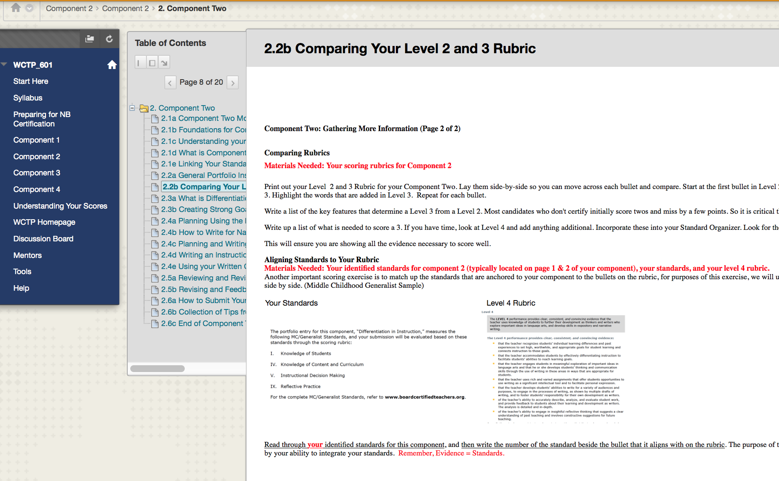
WCTP 601

Slide 46
Online Mentoring
There is a module for each component in WCTP 601.
Each module contains five assignments
Online candidates work through the module, complete an assignment, and email it to their mentor.
The mentor uses aligned feedback forms to provide feedback.
Online candidates may email their mentor at anytime.

Slide 47
Face-to-Face Mentoring
Meets twice a month for two hours
Groups typically range in size from 3 to 8 people
Group discussion and sharing of ideas
Meetings for most certificate areas in Tupelo, Oxford, Southaven, Madison (Madison County only mentors Madison County teachers), and Grenada.

Slide 48
Cost of mentoring is
FREE at the University of Mississippi!
Join us at any time of the year!
There is a place for you.
Help and support are waiting.

Slide 49
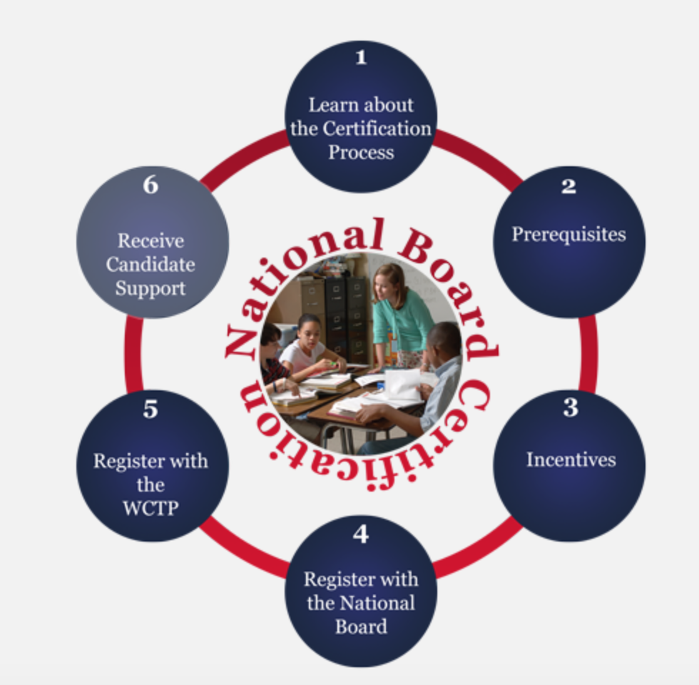
What Next? Now What?
Visit the WCTP website and use the interactive graphic to learn more about the certification process and us.
This graphic will lead you through the entire process of registering for National Boards
http://wctp.olemiss.edu

Slide 50
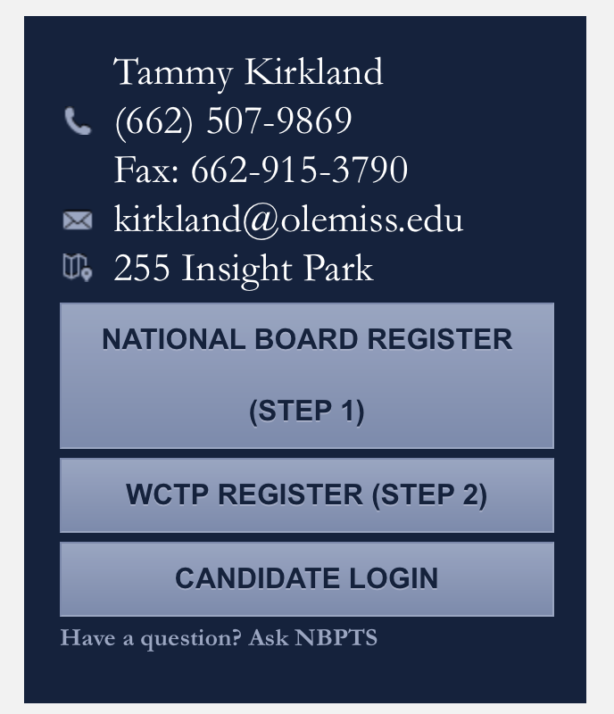
Registering
You must separately register for the National Boards and the World Class Teaching Program (candidate support)
Visit wctp.olemiss.edu
The registration links are provided for you on the right-side of the screen.

Slide 51
WCTP Participation Terms
We are still FREE
Terms were necessary due to changes made in funding at MDE
Full explanations and examples are provided on our website to help you through
Once your terms are completed, and we receive your application, we will immediately assign you a mentor.

Slide 52
WCTP Participation Terms
Release to 3rd Party (National Board Database). This is step 4 of the National Board registration process.
Pay your $75 National Board registration fee. This is step 7 of the National Board registration process.
Make a “Good Faith Down Payment” on a component, any component, any amount.
Agree to only participate in the University of Mississippi’s WCTP. MDE can only provide funding for candidate support to one program.

Slide 53
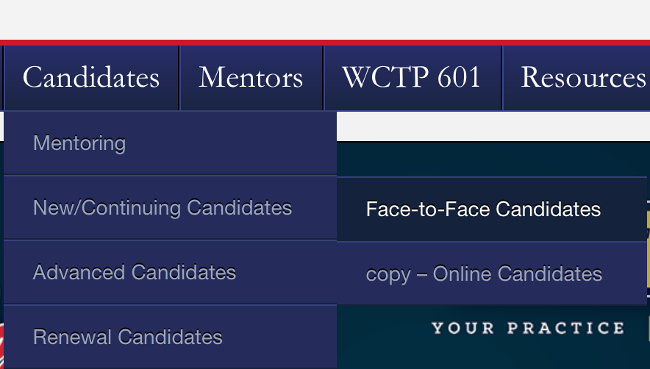
To Learn More about our Mentoring
Visit our website http://wctp.olemiss.edu
Click Candidates/New & Continuing/then choose either Face-to-Face or Online

Slide 54
Our WCTP application is available on our website
Contact us for additional information
Tammy Kirkland, NBCT, program coordinator
Email: kirkland@olemiss.edu
Website: http://wctp.olemiss.edu
Facebook: Ole Miss – World Class Teaching Program
Workshops are held each summer in Oxford, Southaven, Grenada, Tupelo, and Madison, MS.

Slide 55
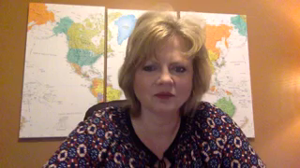
Next Steps

Slide 56
Thank you for interest and allowing us to share about the certification journey and how we can help you.

