Slide 1
A Look at National Board Certification for Teachers
Presented by:
The World Class Teaching Program

Slide 2
Curious About National Boards?
Unraveling the Mystery of
National Board Certification

Slide 3
Part I:
The National Board Process:
What is it?

Slide 4
What is The National Boards Certification Process?
Created by teachers, for teachers, National Board Certification is the profession’s mark of accomplished teaching it is: Built upon the National Board Standards and the Five Core Propositions, rigorous and performance-based, based on multiple measure, peer-reviewed, voluntary, valid and reliable

Slide 5
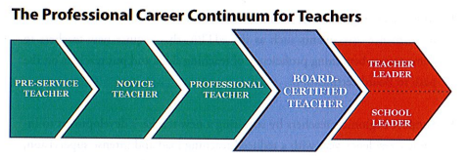
The Professional Career Continuum

Slide 6
The Mission of NBPTS
Maintain high and rigorous standards for what accomplished teachers should know and be able to do.
Provide a national voluntary system certifying teachers who meet these standards.
Advocate related education reforms to integrate National Board Certification in American education and capitalize on the expertise of National Board Certified Teachers.

Slide 7

At the Center of it All:
Improved Student Learning

Slide 8
How Can National Board Certification®
Help Teachers ?
The highest acknowledgement of accomplished teaching
An opportunity to grow and be challenged as a professional
An opportunity for teachers to affirm that they are accomplished teachers

Slide 9
Eligibility Prerequisites
The Candidate must:
Possess a baccalaureate degree from an accredited institution.
Have completed three years of successful teaching at one or more early childhood, elementary, middle or secondary school(s).
Hold a valid state teaching license for each of these three years.

Slide 10
25 Certificate Areas
Elementary
Middle
High School
Specific Developmental Ages

Slide 11
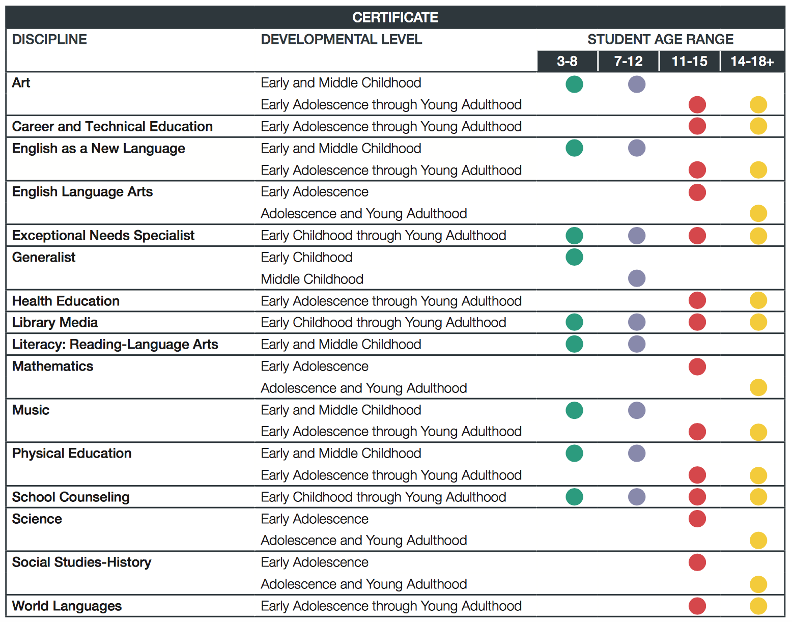

Slide 12

This year, you will have the the ability to choose which Components you complete.

Slide 13
The Rollout is OUT!
You may complete the process in
one, two, or three years
Your choice
Your pace

Slide 14
What is the process?
You do NOT have to go in order of 1, 2, 3, 4
C1: Content Knowledge
C2: Differentiation in Instruction
C3: Teaching Practice and Learning Environment
C4: Effective and Reflective Practitioner

Slide 15
The Five Core Propositions
Teachers…
Are committed to students and their learning.
Know the subjects they teach and how to teach those subjects to students.
Are responsible for managing and monitoring student learning.
Think systematically about their practice and learn from experience.
Are members of learning communities.

Slide 16
The General Cadence
Typical Deadlines
Registration opens in late spring always by May 1
Application deadline: February 28
Full payment due: Feburary 28
Withdrawal and refund deadline: Febuary 28
ePortfolio Submission: April – May
Assessment Center: Late May – Early June
Scores released: On or before December 31

Slide 17

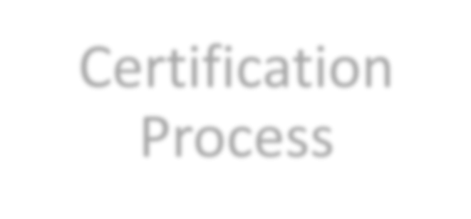



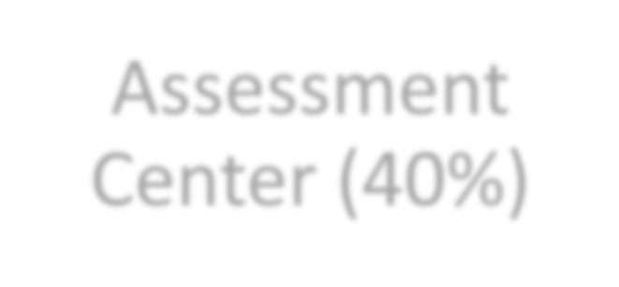


Certification
Process
Assessment
Center (40%)
Portfolio (60%)
Performance based and peer-reviewed!

Slide 18
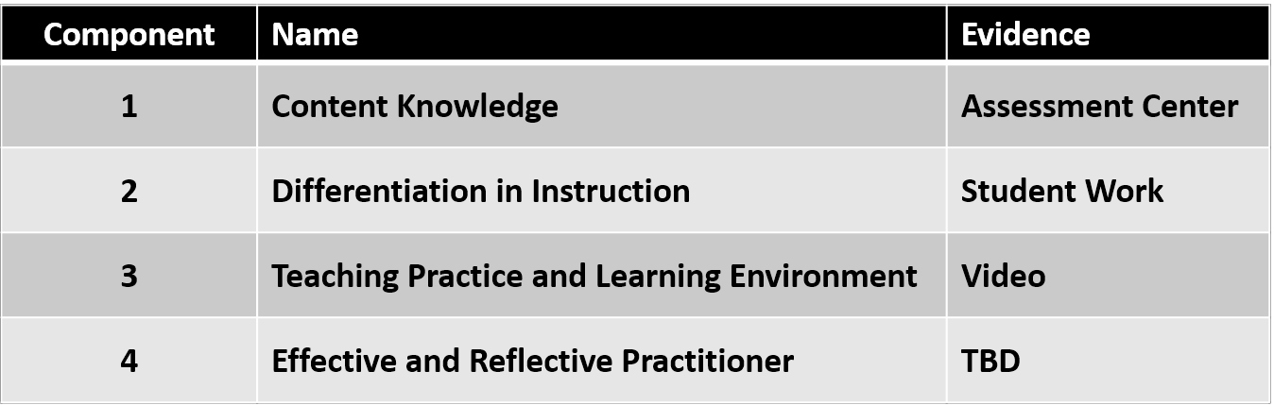
Common Names Across ALL Four Components

Slide 19
COST
The total cost of certification decreased from $2500 to
$1,900, with each of the four components costing $475.
Important price points
$475 for each component
$75 annual registration fee

Slide 20
Financial Help and Assistance
Mississippi will reimburse EVERY candidate after they complete components.
Candidates submit in May and receive scores the following fall. The state will reimburse once candidates receive a score report.
State reimbursement is provided whether certification is achieved or not.

Slide 21
Other Avenues of Financial Support
Local Banks: assistance varies by bank. Visit your local bank and talk to your personal banker.
National Board Scholarships: are often awarded in the fall. They are presented on first come first served basis sometimes to specific certificates. Candidates must be registered to be eligible for a scholarship.
MPE Scholarship

Slide 22
The Components
There are four
Three portfolio entries (Components 2, 3, and 4)
One assessment (Component 1)
Each Component requires the integration of identified standards.
No single Component requires the integration of all the certificate standards

Slide 23
The Standards
Each certificate has its own standards, typically 10 to 13
National Board Candidates teach to their certificate’s standards and their state standards
The standards are detailed descriptions (examples) of what accomplished teaching looks like
Evidence = Standards
All the rubrics align with the standards identified in that component
ARE VERY IMPORTANT!!

Slide 24
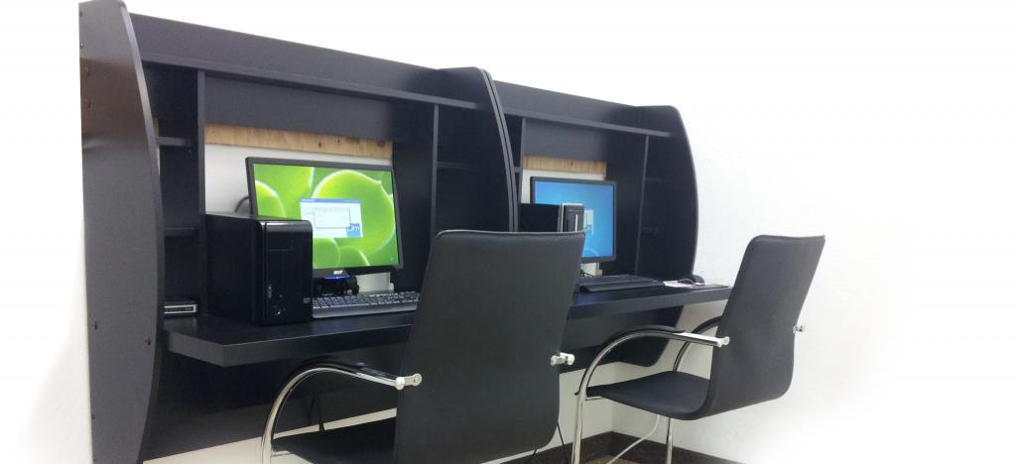
Component 1: Content Knowledge
A computer-based assessment to demonstrate knowledge and pedagogical practices for their certificate area.
3 constructed response exercises
Approximately 45 selected response items (SRIs)

Slide 25
Component 2
Differentiation in Instruction
This classroom-based portfolio entry is primarily comprised of samples of student work and an accompanying written commentary. You will submit selected work samples that demonstrate the students’ growth over time and a written commentary that analyzes your instructional choices.

Slide 26
Component 3
Teaching Practice & Learning Environment
This is a classroom-based portfolio entry that requires video recordings (two 10-15 minutes) of interactions between you and your students. A written commentary in which you describe, analyze and reflect on your teaching and interactions will also be submitted. Both the video and the written commentary should demonstrate how you engage students and impact their learning.
The video focus is a lesson rather than a unit.

Slide 27
Component 4
Effective and Reflective Practitioner
This is a portfolio entry provides you with the opportunity to highlight your abilities an an effective and reflective practitioner in developing and applying your knowledge of your students.
Focus: Data driven instruction and decision making to impact student learning centered around an identified student need.

Slide 28
Completing National Board
1 to 5 years
You must attempt each of the four components within the first three years of your candidacy.
You have up to two retake attempts for each component and you can retake at any time during the five-year window; retake years do not have to be concurrent or consecutive.
The highest score received for an individual component will always be used for total score calculation.

Slide 29
What has changed?
Maintenance of Certification
The National Board recently revised its policy for maintenance of certification, and will require Board- certified teachers to demonstrate their knowledge and skills every five years. (Adopted February 2015)
This new policy is aligned with the movement of 40 state licensure systems to a five-year renewal period, but also reflects efforts to make certification more affordable and efficient for all teachers, so that that it can become the norm in the profession.

Slide 30
Part II:
The World Class Teaching Program:
How Can We Help You?

Slide 31
Who are we?
The World Class Teaching Program at the University of Mississippi is a candidate support program that assists teachers in understanding National Board Certification and provides high quality candidate support mentors and resources to aid candidates in their certification journey.
In 2018, we certified 59% of the state’s candidates
Our certification rate is 70%. The national rate is ~45%
Advanced candidates certification rate is over 90%

Slide 32
World Class Teacher Program
A Candidate Support System
The University of Mississippi *
Delta State University
Mississippi State University
Alcorn State University
Jackson State University
The University of Southern Mississippi

Slide 33
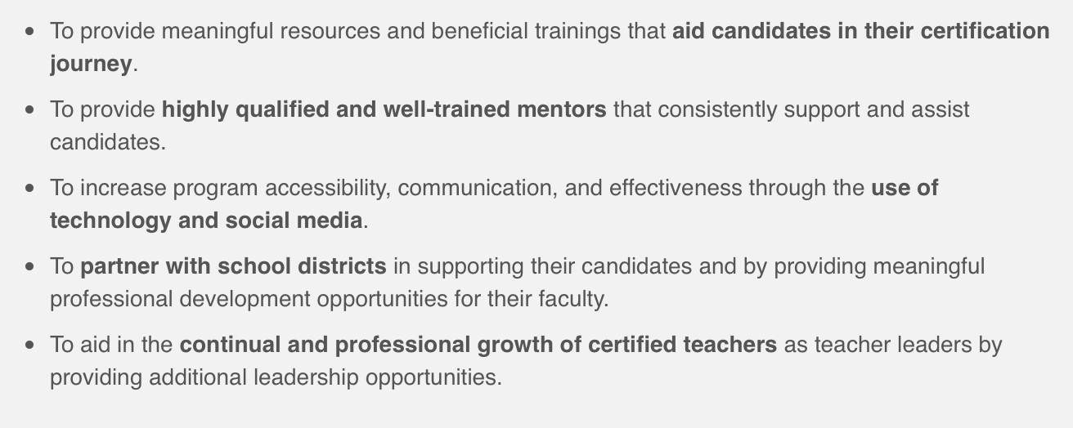
The Mission of the WCTP

Slide 34

You don’t want to do this alone!

Slide 35
Mentoring – Two Types
Traditional, Face–to–Face includes placement in the WCTP 601 Self-paced Blackboard Course
Meets twice a month on Tuesdays from 5:00 to 7:00 p.m.
Available at Tupelo, Oxford, DeSoto, and Grenada
WCTP 601 Self-paced Blackboard Course
Includes modules for all four components, syllabus,
discussion board, course outline, assignments will be
submitted electronically to an NBCT mentor for feedback
Specifically designed for: the busy teacher who is unable to attend face-to-face meetings, the teacher who lives too far to drive to mentoring, or the teacher that
wants to go at their own pace.

Slide 36
WCTP 601
Blackboard Course
Step-by-Step
Self-paced
Includes a module on each component
Includes embedded: Professional development, Powerpoints, Videos, Pedagogical building activities, Semester timelines, Suggested assignments, suggested deadlines, and more
FREE to ALL our candidates
Only available at The University of Mississippi

Slide 37
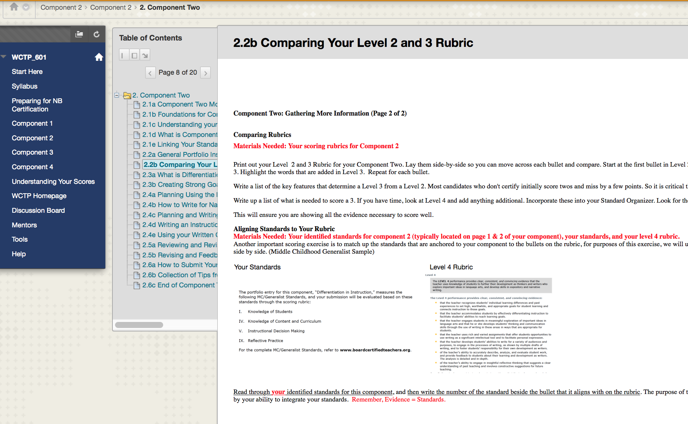
WCTP 601

Slide 38
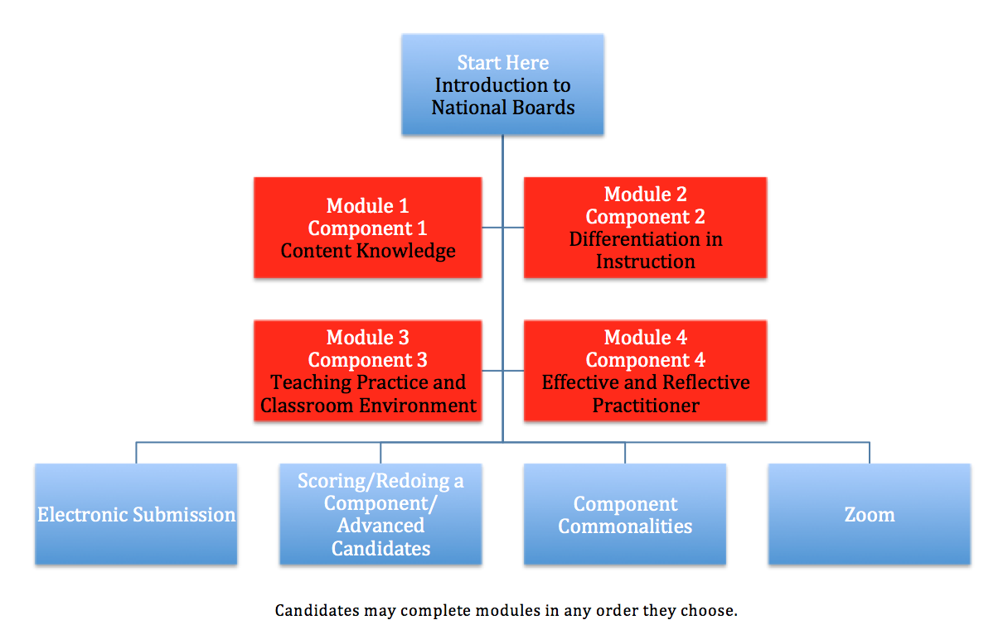
WCTP 601

Slide 39
Cost of mentoring is
FREE at the University of Mississippi!
Join us at any time of the year!
There is a place for you.
Help and support are waiting.

Slide 40
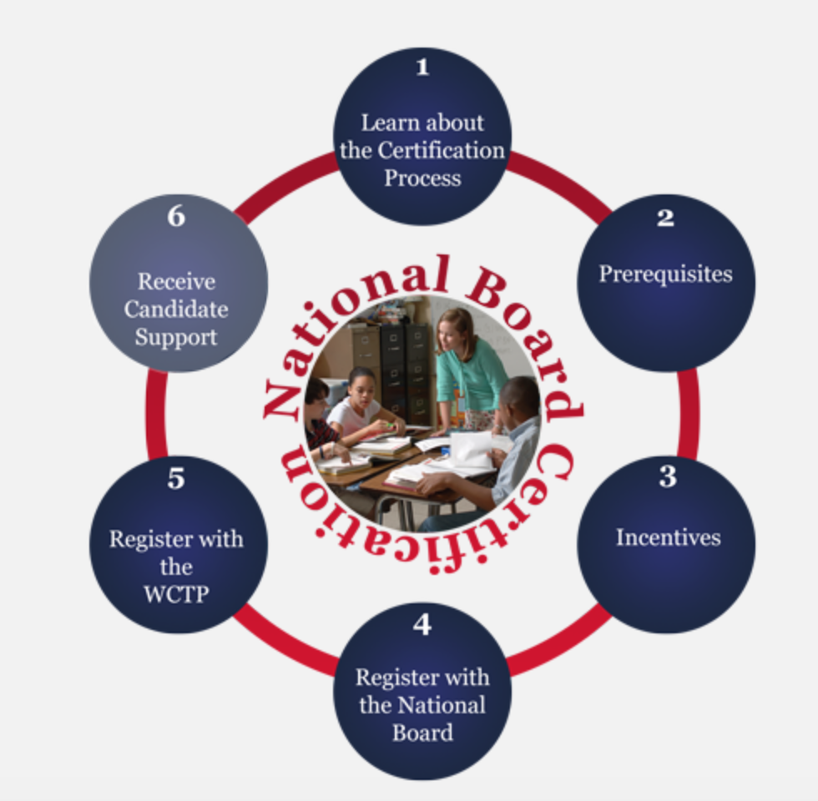
What Next? Now What?
Attend a Summer Standard Workshop. Workshops will be
offered at Tupelo, Oxford,
Southaven, and Madison. Registration information will be posted in late spring on the WCTP website/Workshops or visit the
WCTP website and use the interactive graphic to learn more about the certification process and us.
http://wctp.olemiss.edu

Slide 41

All Your Resources in One Place
Located on the WCTP website, lower right-hand corner. Includes: Standards, Components, Guide to National Board Certification, Scoring Guide, Timelines, Assignments with Deadlines, and more!

Slide 42
Our WCTP application is available on our website
Contact us for additional information
Tammy Kirkland, NBCT, program coordinator
Email: kirkland@olemiss.edu
Website: http://wctp.olemiss.edu
Facebook: Ole Miss – World Class Teaching Program

Slide 43
WCTP Website Tour
http://wctp.olemiss.edu

