Slide 1
Mentor Training 2018
By: Tammy Kirkland, NBCT

Slide 2
Agenda
Welcome
Mentoring Handbook/WCTP National Board Survival Guide/WCTP 601 At a Glance
Changes (WCTP application/MDE Funding/WCTP Participation Terms)
Feedback
WCTP 601 Mentoring
Grand Discussion

Slide 3
Mentor Handbook
Checklist/Password
Required Meetings
Documenting Attendance
Scope of Work
Providing Feedback to Candidates
Mentoring Online and Face-to-Face Candidates
WCTP Participation Terms
Application/Miscellaneous

Slide 4
NB Survival Guide
WCTP Registration, two pages
Candidate Protocol for Face-to-Face Candidates
Candidate Protocol for Online Candidates, two pages
National Board Process Planning Timeline
Summer & Fall National Board Component Timeline
Winter & Spring National Board Timeline
Using All Your Tools
Component 1: Content Knowledge
Component 2: Differentiation in Instruction
Component 3: Teaching Practice & Learning Environment
Component 4: Effective & Reflective Practitioner
WCTP 601
Writing for National Boards
Achieving Your Highest Score: Standards, Commentary Questions, and Rubrics
Electronic Submission
Wrap it Up

Slide 5
WCTP 601 At a Glance
Basically a Table of Contents for WCTP 601
Quick view of EVERYTHING in the course and where it can be found
WCTP 601 will always be evolving

Slide 6
WCTP 601
New Welcome Videos
http://wctp.olemiss.edu

Slide 7
Thank YOU!!
211 candidates in 2016-2017 (46% of the state’s candidates, redacted to 36% reason for WCTP application changes. Lost 40 candidates that attended all fall but did not purchase a component. Lost 13 candidates that did not release to 3rd party. Lost 5 candidates that were duel enrolled in another WCTP) = $40,000 loss
70% of our candidates certified in December!
59% of the state’s candidates' participated in OUR program!

Slide 8
MDE State Funding Changes
Old System – Reimbursed for every candidate who turned in an ID.
New System
Candidates name MUST be on NBConnect
Candidates must purchase a component
Candidates must release to 3rd Party
*NBConnect is the OFFICAL National Board database. In order for a candidate’s name to be on this document, they must: Register with the National Board, Pay their $75 non-refundable registration fee, and release to 3rd Party.
*3rd Party is ONLY the National Board and the WCTP.
No personal information is shared.

Slide 9
WCTP Participation Terms
Due to funding changes at MDE, the World Class Teaching Program, WCTP, no longer receive funds to support candidates who start the process and then withdraw. In order for the WCTP to continue to offer FREE candidate support, we must know our candidates are committed to the process. For this reason, the WCTP is requiring that all candidates make a “Good Faith” down payment on a component before receiving candidate support. Candidates can use Pay As You Go. (http://wctp.olemiss.edu/pay-as-you-go-2/)
Candidates are not allowed to participate in more than one World Class Teaching Program. Candidates joining The University of Mississippi’s WCTP agree to only participate in our program.
Candidates agree to release to 3rd Party, National Board Database
Candidates agree to pay $75 National Board registration fee before receiving candidate support.

Slide 10
wctp.olemiss.edu
New pages added to help with:
WCTP application process
WCTP 601
http://wctp.olemiss.edu

Slide 14
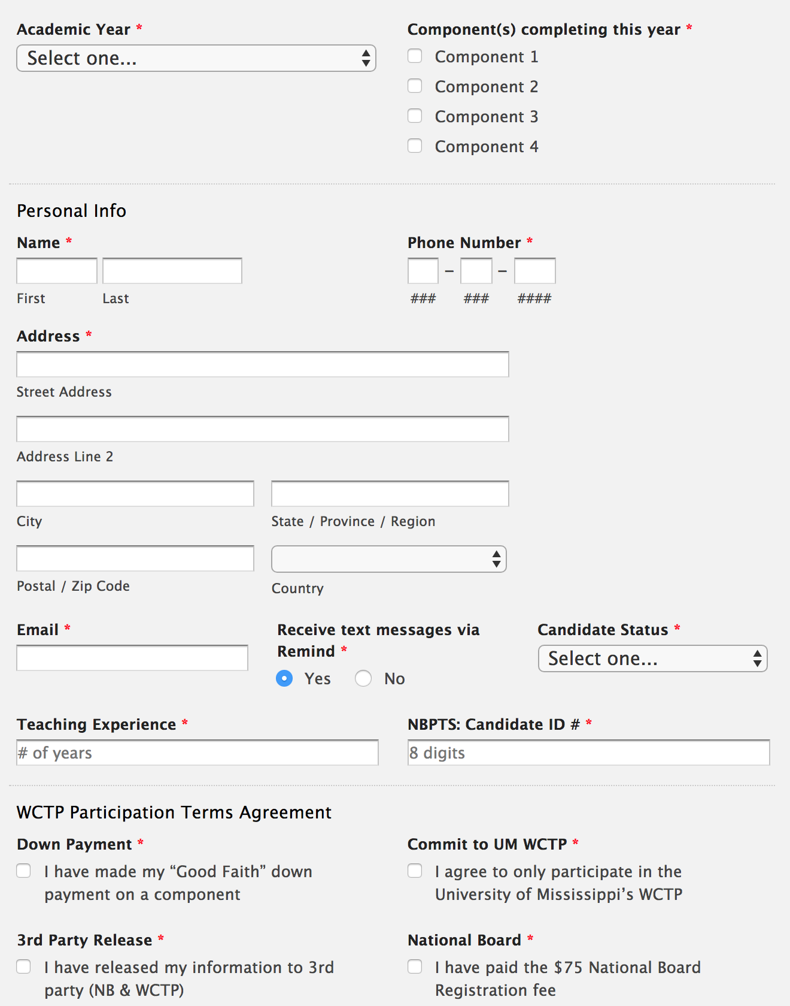
Online Application Only with Electronic Signature http://wctp.olemiss.edu
WCTP will still provide FREE candidate support, but all WCTP Participation Terms must be agreed to prior to receiving candidate support.

Slide 15
NO candidate can attend a mentoring session without completing this application. If they do, they will be considered a “pro-bono” candidate.

Slide 16
Communication
Remind worked well
Remind will continue to be used with mentors. Candidates will be enrolled next year.
Facebook, Ole Miss – World Class Teaching Program
New NB Survival Guide is being passed out to all candidates this summer.
We will email you your contracts and new W9s (if you need one) in the fall
I am ALWAYS available to you!!!

Slide 17
CEU’s
Website Link http://wctp.olemiss.edu
North Mississippi Consortium Change of Policy: CEUs must be purchased within 6 months of the training.
CEUs will be offered after each semester (fall and spring) rather than the end of the year
CEUs can be earned by using WCTP 601

Slide 18
Media Campaign

Slide 19
Candidate Feedback
5 to 15 times is the average number a mentor reads for a candidate
MOST (not all) ask the mentor to read for them
Attendance is pretty good
100% of the mentors had excellent communication.
93% of mentors provided feedback within a week. Candidates are begging for help with the Assessment Center (1/3)
57% did NOT attended a Summer Standard Workshop

Slide 20
#1 Candidate Request
Can the login process to WCTP 601 be made easier?
No, the login process cannot be changed or simplified. The entire University of Mississippi’s faculty, staff, and students follow the same protocol of updating their password every 90 days. It is simple and takes less than a minute. The WCTP cannot update passwords. Each individual associated with the university is responsible for keeping their own password updated. Here are the instructions: http://wctp.olemiss.edu/password-help/

Slide 21
WCTP 601 Changes
Components 2, 3, & 4 will be reorganized so that Forms, How To Instructions, and Assignments will be in the front of the module. Support material will follow.
A separate 10 minute video for Online and Face-to-Face Candidates on how to use the course
WCTP 601 at a Glance Document

Slide 22
Meet Cade

Slide 23
57% of candidates said their mentors did not prepare them for
the assessment center
So how should you do this?
When should you do this?
(Handout)

Slide 24
How Candidates Should Use WCTP 601
See Survival Guide
Face-to-Face
Online
http://wctp.olemiss.edu

Slide 25
Candidate Time Lines
Use WCTP 601
Discussion
Contribute items for your certificate page

Slide 30
Online Candidates
What will change
What cannot change
What has to change

Slide 31
Reorganized Modules
Assignments will be followed by instructions and explanations on how to complete the component.
Resources will follow the instructions
This should make the modules easier to navigate

Slide 32
What Can Not Change
Everyone could have an online candidate
Must use WCTP 601 (Revisions coming based on feedback)
Candidates MUST work their way through the outlined assignments AND submit them to you the way the course is outlined.
Reason: Any change to the structure of WCTP 601 for ONLINE candidates would reduce the level of candidate support, and their odds of certifying.
Reading commentaries sent by emails is not acceptable online candidate support

Slide 33
What Has to Change
Mentors must enforce that all work has to be submitted as outlined by the assignments in each Component Module
Do NOT provide feedback if candidates do not follow the instructions.
Send their work unread back to them.
All online candidates are made aware of this before they begin.
You’re welcome to say, it is WCTP Policy.
Reason: Any change to the structure of WCTP 601 for ONLINE candidates would reduce the level of candidate support, and their odds of certifying

Slide 39
Serving Electronic Candidates
Mentors will have a list of the electronic candidates
Candidates will submit everything via Email
Candidates will ONLY submit a set number of times
Candidates will submit predetermined materials as “Assignments”
Mentors will have a sheet to record the dates assignments are submitted
Mentors will be provided feedback forms (Word documents) to complete with each submitted assignment
Mentors may and are encouraged to use these feedback forms in face-to-face mentoring
Feedback forms were created based on discussions held with Jackie Parker and Dr. Cathy Stewart. (Melissa Luna)

Slide 40
…just a phone call away.
If you need me, CALL!
If you have any kind of question, call.
If a candidate is giving you problems, call.
If you need any other kind of resource, call.
If you have a suggestion, call!

Slide 41
Last thing…
Lesson Plan for first Face-to-Face meeting
Why? So we clearly communicate and share the important “stuff”
Set the stage for our expectations
Just a guideline of things to include
Not all inclusive

Slide 42
Suggestions for… First Meeting Lesson Plan NB Survival Guide WCTP 601 Tour WCTP 601, Module 1/Component 1 Tour

Slide 43
Have a GREAT Summer! (What’s left of it!)
!

