Slide 1
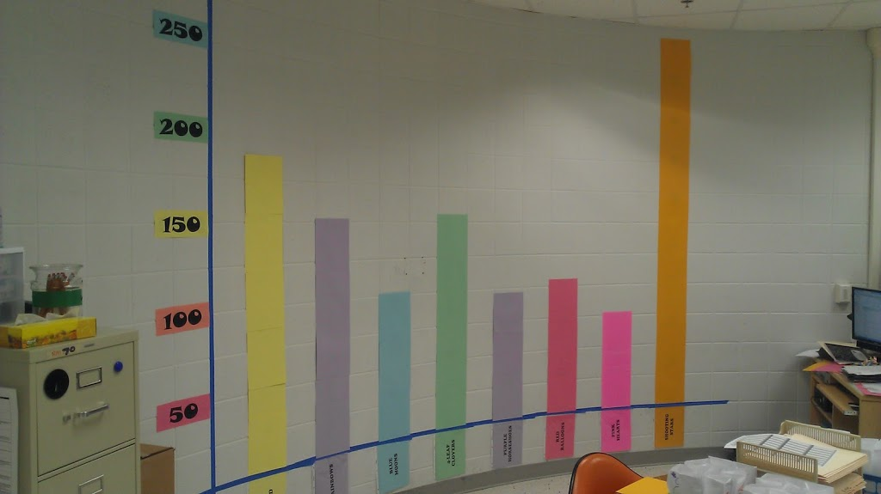
Using Data to Drive Instruction
Presented by Malisha Siders for MPE

Slide 2
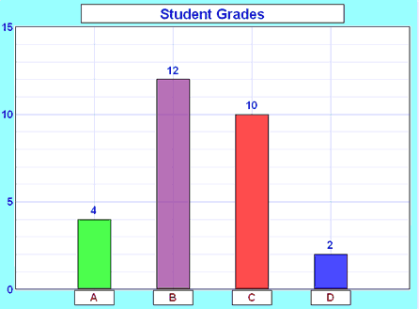
“Data, data everywhere, so much it's hard to think. Data, data everywhere if only it would link.” -James Turner
Notes:
Across America, educators, parents and students are swimming in an overload of data, much of which seems unrelated and difficult to use. The real trick is deciding what data is helpful, what data is useless, and how to use the data effectively.

Slide 3
Presentation Outline
What is Data?
The Importance of Data
Establishing Goals and Targets
Formative Assessments vs. Summative Assessments
Implementing the Data Driven Cycle
Effective Planning

Slide 4
What is Data?
According to the Merriam-Webster dictionary, data is defined as facts or information used to calculate, analyze, or plan something.

Slide 5
Six Methods to Put into Practice
Keep it simple. Use simple tools and techniques to collect data, such as clickers, response sticks, or exit tickets. They’ll provide a straightforward process for understanding learning outcomes.

Slide 6
Think small. Start with one class, and scale your efforts with the progress. For example, if you want to improve your questioning strategies, track the times you require students in one class to justify their responses.
Once you find instructional techniques that work, slowly apply them to all your classes.

Slide 7
Engage students. Involve students in setting goals and tracking progress to invest them in the process. This might be as simple as improving an opening routine or as complex as meeting large assessment goals. Likewise, encourage students to reflect upon their progress to help them determine what worked, what didn’t, and what should be done differently next time.

Slide 8
Analyze your efforts. Based on the data, reflect on whether the steps you’ve taken have had an impact. When you begin to see a difference in the students and their work, the extra effort will seem valuable.

Slide 9
Make progress visible. Track progress daily using a graph or chart. This will help students see their progress and, ultimately, be empowered. The size of the goal doesn’t matter; students need to see what they’re working toward and what they’ve accomplished.

Slide 10
Be Transparent with Class-wide Results. Follow pre-assessments tests, and communicate the results to students. You don’t have to single them out. Simply relay the outcomes, and explain how instruction will be adjusted based on the new information.
For example, you could say, “Based on the data from this quiz, we need to revisit phases of the cell cycle, so you’ll see questions on this topic in your warm-ups for the rest of the week.”

Slide 11
Responding to Students
When you reflect on student achievement and make adjustments, you are collecting data!
Notes:
Case scenarios with students

Slide 12
Why Spend Time on Data?
Data leads a teacher to:
Reflect on our own practices
Generate new strategies to reach students
Make practical educational decisions
Notes:
Unused data is useless data. When you look at data, reflecting on own practices helps you make decisions in the classroom. It also may lead you to do some research on new strategies to make decisions.

Slide 13
Meet the needs of individual student’s learning styles
Determine and reevaluate previous decisions for effectiveness
Be a more engaged, effective and productive educator
Gall, Joyce P. and M.D., Borg, Walter R. Applying Educational Research: A Practical Guide. NY: Longman, 1999.

Slide 14
Data Walls
What is the purpose of a data wall?
How are data walls beneficial?
How can you use the information from the data to adjust instruction?
What are challenges to creating effective data walls?
Can data walls be used in individual classrooms? If so, how?

Slide 16
https://www.teachingchannel.org/videos/differentiated-instruction-with-data-walls

Slide 19
“School data should be a springboard, not a scoreboard.”
– Ashley Martin

Slide 20
How does the cycle for data-driven instruction work?
There are three distinct steps described within the process of data-driven instruction.
Target strands where student achievement is low.
Focus on specific needs within those targeted areas.
Plan instruction to address those needs.

Slide 21
Where Do I Get the Data?
Informal Assessments
Teacher observations, conversations
Anecdotal records, portfolios
Formal Standardized Testing
Formal Classroom Testing
Reading program generated tests
Teacher-generated tests
Running Records
Notes:
While many people rely highly on formal assessments, informal data probably informs you more about the student as a whole child than formal data can. The trick with informal assessment is to make sure you gather both data that proves instructional need and data that shows growth.
Informal data is available right now.
Formal data takes longer to access. Certain types of formal data, like reading program tests, can help inform instruction as soon as the next day, but standardized testing normally takes quite a bit of time to access the data.

Slide 22
Formal and Informal Student Surveys
Student Interest Surveys
Classroom discussions
Learning Profiles
Teacher-child interviews

Slide 23
What is an Assessment?
The word assess comes from the Latin verb ‘assidere’ meaning ‘to sit with’.
In assessment one is supposed to sit with the learner.
This implies it is something we do ‘with’ and ‘for’ students and not ‘to’ students (Green, 1999).

Slide 24
Assessment and data in education is the process of gathering, interpreting, recording, and using information about pupils’ responses to an educational task.
(Harlen, Gipps, Broadfoot, Nuttal,1992)

Slide 25
The Garden Analogy
If we think of our children as plants …
Summative assessment of the plants is the process of simply measuring them. It might be interesting to compare and analyze measurements but, in themselves, these do not affect the growth of the plants.
Formative assessment is the equivalent of feeding and watering the plants appropriate to their needs - directly affecting their growth.

Slide 26
Summative Assessment
A process that focuses on final evaluation.
The summative evaluation concentrates on learner outcomes rather than only the program of instruction.
It is a means to determine a student’s mastery and understanding of information, skills, concepts, or processes.

Slide 27
What’s the Difference?
Formative Assessment (for learning)
Summative Assessment (of learning)
Assessments become formative assessments when the evidence is actually used to adapt the teaching to meet student needs.
Black and Wiliam, 1998

Slide 28
Assessment Cycle

Slide 29
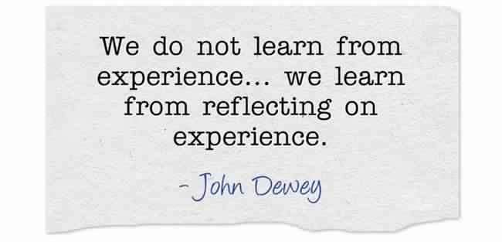

Slide 30
Formative Practices
Helps students know where to go
Where they are currently
How to close the learning gap

Slide 31
Formative or Summative?
Formative
Summative
Unit Test
District Test
Exit cards
Shared learning target
Mid-week quiz
Flexible grouping
Observation game
Self-reflection

Slide 32
Benefits of Data-led Instruction for Students
Understand what they are learning and why
Are clear about where they are in their learning
Know what they need to accomplish in order to be successful
Are motivated by evidence of their progress
Can practice without being penalized or graded
See improved achievement

Slide 33
Benefits for Teachers
Can make real-time adjustments to instruction
Work collaboratively with colleagues
Have shared expectations of what students should know and be able to do
Share a common language with parents when discussing student learning
See improved student achievement

Slide 34
“Students who can identify what they are learning significantly outscore those who cannot.”
-Robert Marzano

Slide 35
Clear Expectations and Feedback
Students are more successful with specific targets in place
Students move beyond
rote memorization

Slide 36
How do we create change in our classrooms? All Washed Up by Hyrum Grenny
http://www.youtube.com/watch?v=osUwukXSd0k

Slide 37
Student Feedback

Slide 38
“If students left the classroom before teachers have made adjustments to their teaching on the basis of what they have learned about students’ achievement, then they are already playing catch-up. If teachers do not make adjustments before students come back the next day, it is probably too late.”
-Dylan Wiliam, 2007

Slide 39
Appointment Clock Buddies

Slide 40
Student Grouping Method: Appointment Clock Buddies
Make an appointment with four (4) different people.
Be sure you both record the appointment on your respective clock at the appropriate time slot.
Only make one appointment per slot.

Slide 41
Data Carousels: The Practice and Benefits
https://www.teachingchannel.org/videos/data-carousels-improve-instruction

Slide 42
Key Research Findings
Effective feedback is timely. Delay in providing students feedback diminishes its value for learning. Banger-Drowns, Kulik, Kulik, & Morgan, 1991
Effective learning results from students providing their own feedback, monitoring their work against established criteria. Trammel, Schloss, & Alper, 1994; Wiggins, 1993

Slide 43
How Comfortable Am I with Feedback and Adjusting using Data?
Learning- My feedback describes strengths and weaknesses of my work
Ready to Learn- My feedback mostly points out weaknesses
Skilled- I provide feedback frequently and during the learning process
Practiced- My feedback describes strengths and points out corrections

Slide 44
Laundry Day Reflection
• Tide – More questions than confidence
• Xtra – Understand the basics, but are still confused on topics or have questions
• Gain – Fairly confident; still have questions or concerns
• All – Certain of success

Slide 45
Laundry Day Reflection: Access how your students are Learning (4 Corners Format)
Tide- Ready to Learn
Xtra- Learning
Gain- Practiced
All- Skilled

Slide 46
Student/Teacher Evaluation
It is critically important for students to reflect on their learning.
Taking ownership may assist with motivation, study habits and clear up misunderstandings.
Great documentation for conferences.

Slide 47
“Give a kid a grade and the learning process stops. Give a kid specific feedback and extending questions and the lerning goes much deeper.”
-Justin Tarte

Slide 48
Benefits of Small Group Instruction
Teachers are better able to observe, monitor, and attend to the needs of readers
Students are more comfortable taking learning risks in a small group
Students are afforded more opportunities to interact with one another
Instruction can be targeted and focused to meet the needs of the group members
(Strickland, Ganske, & Monroe, 2002)
Notes:
Students that often will not talk in whole group instruction will talk in small group discussion. It is much less daunting to make a mistake in front of 4 or 5 peers than in front of the entire class.
Not only can the instruction be targeted, it should be targeted. Small group instruction should not be set up where every group that works with the teacher does the same thing. That type of teaching is no more than round robin and does not meet the needs of the students.

Slide 49
Student Task Cards
Notes:
Use butcher paper square for responses

Slide 50
Data is. . .
about how teachers and students use assessment information.
included in both formal and informal processes.
about gathering evidence of student learning to improve it.
not new- it is a part of good teaching.

Slide 51
"Everyone can change tomorrow. Everyone solves problems tomorrow. But the only changes that matter are the ones I make today. Tomorrow is the easiest day I'll ever live. Today is the scary one, which is probably why I've spent so much time avoiding it."
-Josh Riebock

Slide 52
Exit Slips

Slide 53
