Slide 1
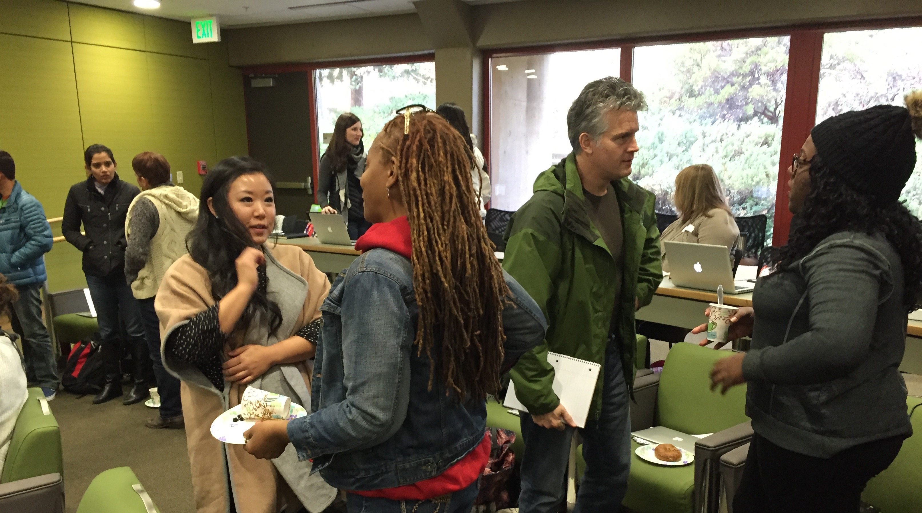
Component 4 Effective and Reflective Practitioner
© National Board Resource Center at Stanford University, April, 2017
Notes:
This material was co-created with Cindy Rockholt, Washington state.

Slide 2
Three Parts of this Powerpoint
1. Illustrating what parts of Component 4 must vs may go together.
Group profile, Instruct. Context, Cont. Info, and assessments must be this year, all related to your group
Professional Learning Need/ Student Need may be separate
2. Showing our thoughts as to what you show on your forms and what you concentrate on in your written commentary. Forms- describe Written commentary- analyze & reflect
3. Connecting rubric to the written commentary & forms

Slide 3
Some Parts of Component 4 Must Go Together
Contextual Information-school info this year
Group Info and Profile (Group Profile)- data, observational
data, at least two sources from families, colleagues, and others
who have worked with students.
Instructional Context- Unit description taught to group described in Group Profile, from which assessments were taken.
Formative assessment and three student self-reflections, linking Group Profile, Instructional Context
Summative Assessment- effectively measure student learning, aligns with all above
ALL FROM THIS SCHOOL YEAR!

Slide 4
Some Parts of Component 4 Can Go Together or Can Be Separate
Professional Learning Need
Student Need
Based on a student need
Demonstrate the impact on student learning. Provide evidence of how you met this need.
Student need must be from this year or two years before.
Professional learning must be within last year or this year.
You provided advocacy, collaboration,
and or leadership AND it impacted
student learning. Doesn’t have to be
the student need described in
Professional Learning Need.
Student need must be from last year
or this year.

Slide 5
Some Parts of Component 4 Can Go Together or Can Be Separate
Professional Learning Need
Student Need

Slide 6
Component Four Graphic Organizer- Three Areas Integrated
Instructional Context, Contextual Info, Group Info, Assessments,
Professional Learning Need
Student Need

Slide 7
Component Four Graphic Organizer- Two Areas Integrated
Instructional Context, Contextual Info, Group Info, Assessments,
Professional Learning Need
Student Need

Slide 8
Component Four Graphic Organizer- Two Areas Integrated
Instructional Context, Contextual Info, Group Info, Assessments,
Professional Learning Need
Student Need

Slide 9
Component Four Graphic Organizer- Two Areas Integrated
Instructional Context, Contextual Info, Group Info, Assessments,
Professional Learning Need
Student Need

Slide 10
Component Four Graphic Organizer: Three Areas Separated
Contextual Information-school info this year
Group Info and Profile- data, observational data, at least two
sources from families, colleagues, and others who have worked with students.
Instructional Context- Unit description taught to group in profile, from which assessments were taken.
Formative assessments-three student self reflections, linking Group Profile, Instr. Context
Summative Assessment- effectively measure student learning, aligns with all above
ALL FROM THIS SCHOOL YEAR
Professional Learning Need
Student Need
Based on a student need
from this year or up to two years
before. Your learning must have been this year or last year.
Demonstrate the impact on student learning. Provide evidence of how you met this need.
Students from this year or last year.
You provided advocacy, collaboration,
and or leadership AND it impacted
student learning. Doesn’t have to be
the student need described in
Professional Learning Need.

Slide 11
Connect Information DESCRIBE on forms ANALYZE/REFLECT on Written Commentary
Knowledge of Students
DESCRIBE: Group Profile and Info Form
Match Instructions on pg. 7: Knowledge of Students
ANALYZE/REFLECT: Commentary
Match Instructions pg. 11: Commentary section 1: Knowledge of Students

Slide 12
Connect Information DESCRIBE on forms ANALYZE/REFLECT on Written Commentary
Generation and Use of Assessment Data
DESCRIBE: Instructional Context Form Match Instructions
on pg. 7 and 8: Generation and Use of Assmt. Data
ANALYZE/REFLECT: Commentary: *Match Instructions pg. 11-12: Commentary section 2: Generation and Use of Assmt. Data
DESCRIBE: Formative & Summative Assessment Form *Match Instructions pg. 8: Generation and Use of Assmt. Data
ANALYZE/REFLECT: Commentary: *Match Instructions pg. 11-12: Commentary section 2: Generation and Use of Assmt. Data

Slide 13
Connect Information DESCRIBE on forms ANALYZE/REFLECT on Written Commentary
Participation in Learning Communities
DESCRIBE: Description of Professional Learning Need Form
*Match Instructions on pg. 9-10: Participation in Learning Communities
ANALYZE/REFLECT: Commentary:
*Match Instructions pg. 12 Commentary section 3: Participation in Learning Communities
DESCRIBE: Description of Student Need Forms
*Match Instructions pg. 8: Participation in Learning Communities
ANALYZE/REFLECT: Commentary:
*Match Instructions pg. 12: Commentary section 3: Participation in Learning Communities

Slide 14
The Literacy Level 4 performance provides clear, consistent, and convincing evidence the teacher:
collaborates effectively with families and caregivers, colleagues, and others to develop information about a group of students and insightfully evaluates the information for relevance and relative importance. (Group Profile, Student Need form)
The information gathered may be incomplete or superficial.
applies the in-depth knowledge gathered about the group of students in planning effective and fair instruction and assessment. (Written Commentary, Instructional Context, Assessment forms)
The connection between the gathered information about the students and the unit objectives, instruction, and/or assessments may be unclear or weak.
Notes:
Read your Level 4 rubric. Connect each bullet to the form and/or written commentary. By doing this you can better understand what evidence you must show.
In this rubric, the words underlined only appear in the Level 4 rubric, they do not appear in Level 2.
Italicized words in red only appear in the Level 2 rubric.

Slide 15
○ helps students effectively apply feedback from assessments in ways that positively impact the students’ learning, skillfully enabling students to use assessment as a tool to take responsibility for their own learning. (Assessment forms, Written commentary)
○ actively encourages, guides, and supports student self-assessment to help students become active participants in their education and to evaluate and think critically about their performance. (Formative Assessment form,Written commentary)
○ systematically and insightfully reflects on ways to improve his/her instructional and assessment practices that will lead to improvements in student learning and growth. (Written Commentary, Prof. Learning Need form, Student Need form)
○ methodically expands his/her own professional knowledge by participating in professional development and engaging in advocacy, collaborations with families and caregivers, colleagues, the community, or other learning communities, and/or leadership in order to contribute measurably to student learning and growth. (Prof. Learning Need, Student Learning Need)
Overall, there is clear, consistent, and convincing evidence the teacher develops and uses knowledge of students gathered from multiple sources to inform instruction and assessment; reflects on his or her own practice; and collaborates with families and caregivers, the community, colleagues, and others to create improvements that advance student learning and growth.
These bullets in the rubric are what you must show as your evidence. Can you see how each bullet goes with a form or written commentary? This helped me to better understand that the assessments must improve student learning and must address needs discussed in the group profile, which is data and info collected from collaboration as well as district data.
understands that assessment is a recursive process that involves setting initial learning goals, administering assessments that are appropriate to measure students’ progress toward those goals, evaluating student progress, and, based on the analysis of results and knowledge of students, setting new learning goals to improve student learning. (Written commentary, Assessment forms, Instructional Context)
selects or creates assessments that measure what he/she intends to measure and understands how to use assessments for formative and summative purposes to gain information about student progress and to inform and modify instruction.
(Assessment forms, Written commentary)
The assessments may be inappropriate or ineffective for the intended purpose.

Slide 16
○ helps students effectively apply feedback from assessments in ways that positively impact the students’ learning, skillfully enabling students to use assessment as a tool to take responsibility for their own learning. (Assessment forms, Written commentary)
○ actively encourages, guides, and supports student self-assessment to help students become active participants in their education and to evaluate and think critically about their performance. (Formative Assessment form,Written commentary)
○ systematically and insightfully reflects on ways to improve his/her instructional and assessment practices that will lead to improvements in student learning and growth. (Written Commentary, Prof. Learning Need form, Student Need form)
○ methodically expands his/her own professional knowledge by participating in professional development and engaging in advocacy, collaborations with families and caregivers, colleagues, the community, or other learning communities, and/or leadership in order to contribute measurably to student learning and growth. (Prof. Learning Need, Student Learning Need)
Overall, there is clear, consistent, and convincing evidence the teacher develops and uses knowledge of students gathered from multiple sources to inform instruction and assessment; reflects on his or her own practice; and collaborates with families and caregivers, the community, colleagues, and others to create improvements that advance student learning and growth.
These bullets in the rubric are what you must show as your evidence. Can you see how each bullet goes with a form or written commentary? This helped me to better understand that the assessments must improve student learning and must address needs discussed in the group profile, which is data and info collected from collaboration as well as district data.
collects, analyzes, and compares data to identify trends and patterns and uses that information to design, evaluate, and modify instruction and assessment practices to meet students’ needs. (Group Profile, Assessment Forms, Written commentary)
helps students effectively apply feedback from assessments in ways that positively impact the students’ learning, skillfully enabling students to use assessment as a tool to take responsibility for their own learning. (Assessment forms, Written commentary)

Slide 17
actively encourages, guides, and supports student self-assessment to help students become active participants in their education and to evaluate and think critically about their performance. (Formative Assessment form, Written commentary)
systematically and insightfully reflects on ways to improve his/her instructional and assessment practices that will lead to improvements in student learning and growth. (Written Commentary, Prof. Learning Need form, Student Need form)

Slide 18
methodically expands his/her own professional knowledge by participating in professional development and engaging in advocacy, collaborations with families and caregivers, colleagues, the community, or other learning communities, and/or leadership in order to contribute measurably to student learning and growth. (Prof. Learning Need, Student Learning Need)
The link between activities for expanding one’s professional knowledge and the impact on student learning and growth may be unclear or weak.
Notes:
Refer to the Evaluation Checklist

Slide 19
Don’t Forget!
Make sure you have set up your electronic submission account
Watch the eSubmission module
Start uploading now

