Slide 1
Introduction to Assessment
Achievement Assessment and Instruction

Slide 2
Reference
Material used to create this Powerpoint was taken in part from the textbook Assessment of Student Achievement by Waugh & Gronlaund, 10th Edition, Pearson Education

Slide 3
When you hear the word assessment, what comes to mind?
?

Slide 4
Assessment
Allow policymakers to evaluate the effectiveness of programs
Assistant Administrators in making instruction decisions
Why Assess?
Improve Teacher Instruction
Monitor Student Learning

Slide 5
Purpose of Assessment for Educators
Provide feedback to teachers
Evaluate a curriculum/unit’s strength and weakness
Improve teaching
Monitor standards over time

Slide 6
Assessment Can Be…
Diagnostic (Pretest)
Formative (During Instruction)
Summative (End of Instruction)

Slide 7
Common Types of Assessments
Performance – requires students to “perform” as task to demonstrate their understanding: write a story, give a speech, conduct an experiment…etc.
Alternative – prove an alternative to traditional paper and pencil tests (may be performance based)
Authentic – “real life” tasks: solving problems that exist in the real world.

Slide 8
Assessments should…
…be used to improve learning rather than threaten or label students
Discuss, do you think teacher spend as much time as they should on the assessment process?

Slide 9
What Is Measurement?
The process of assigning numbers to individuals or their characteristics
Commonly provided to the students as a grade

Slide 10
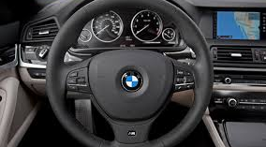
Assessment DRIVES Instruction

Slide 11
Assessment in the
Instructional Process
Assessment is a recursive process
Assessment is fully integrated with instruction
Plans for assessment should be made during the planning for instruction

Slide 12
Questions to Ask
What are the intended outcomes? (Content Standards/Objectives/Goals)
How will you know whether the students achieved the learning outcomes? (discuss)

Slide 13
Assessment in the Instructional Process
Planning of Instruction
  Define the intended learning outcomes of instruction
  Specify how student achievement of learning outcomes will be determined

Slide 14
Assessment in the Instructional Process (continued)
Beginning of Instruction
(Placement/Pretest Assessment)
  Purpose:
    To determine if students have the prerequisite skills
    To determine if students have already achieved intended outcomes

Slide 15
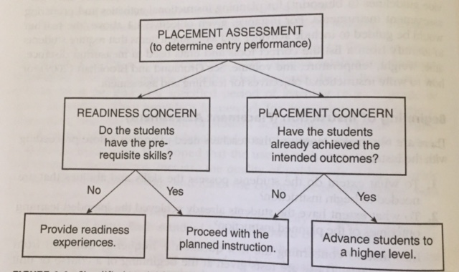
Before Instruction

Slide 16
Assessment in the Instructional Process (continued)
During Instruction
(Formative and Diagnostic Assessment)
  Purpose:
    To determine which learning tasks the students are progressing satisfactorily (Formative)
    To determine which students need remedial work in particular material (Diagnostic)
    Used to adapt goals/objectives (Formative)

Slide 17
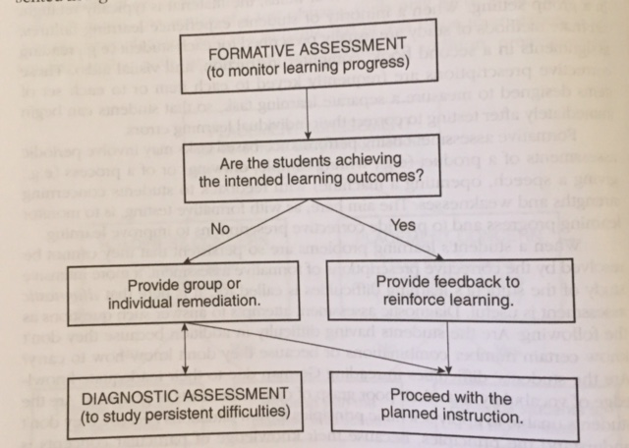
During Instruction

Slide 18
Assessment in the Instructional Process (continued)
End of Instruction
  Summative Assessment
    Purpose:
      To determine which students have mastered material and should move on to next course
      To determine what grade should be assigned to each student
      Predict future success

Slide 19
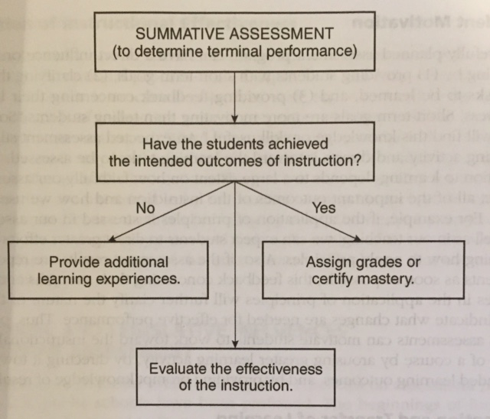
After Instruction

Slide 20
Other Ways Assessment Can Aid Learning
To increase student motivation
To increase retention and transfer of learning
Provides student self-assessment
Provides feedback concerning needed changes to curriculum

Slide 21
Student Self-Assessment
Enables students to better understand themselves, develops self-awareness
Identifies misconceptions that need correcting
Sometimes students “think” they know material when they do not

Slide 22
Other Points to Ponder
Students should not be surprised by the format of the assessment

