Slide 1
February Component 4
Presented By: Ritamarie Theiler, NBCT
And Andrea Quintana, NBCT

Slide 2
Planning Your Entry
You can brainstorm ideas if needed at your table
Take 15 minutes to begin filling out this

Slide 3
Road Map to Component 4
Use this to make sure you are making connections

Slide 4
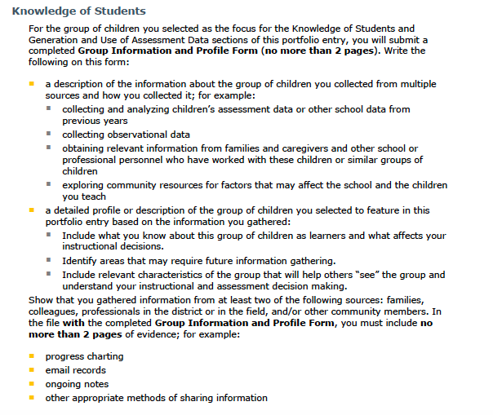
Knowledge of Students
Find in your component directions page 9

Slide 5
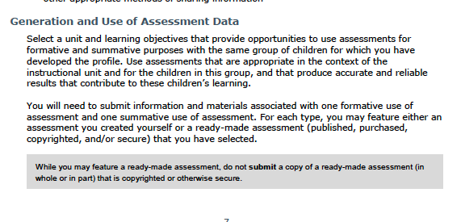
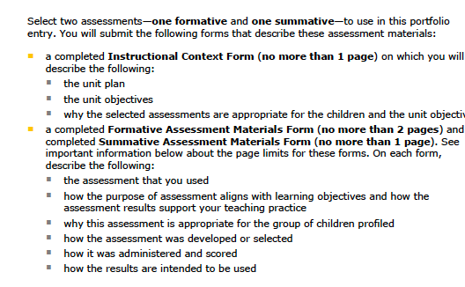
Formative/Summative
1. Share your assessments at your table
2. Decide if they are Formative or Summative

Slide 6
Self Assessments
Take 15-20 minutes to share at your table group your ideas
of Self Assessments. How did you create them, how did they impact student learning, how did you use the results?

