Slide 1
World Class Teaching Program
National Board Certification for Professional Teaching Standards
An Introduction
by Tammy Kirkland

Slide 2
Curious About National Boards?
Unraveling the Mystery of
National Board Certification

Slide 3
Part I:
The National Board Process: What is it?

Slide 4
What is The National Boards Certification Process?
Created by teachers, for teachers, National Board Certification is the profession’s mark of accomplished teaching it is: Built upon the National Board Standards and the Five Core Propositions, rigorous and performance-based, based on multiple measure, peer-reviewed, voluntary, valid and reliable

Slide 5
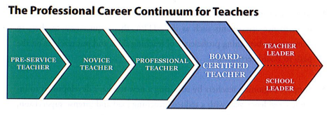
The Professional Career Continuum

Slide 6
The Mission of NBPTS
Maintain high and rigorous standards for what accomplished teachers should know and be able to do.
Provide a national voluntary system certifying teachers who meet these standards.
Advocate related education reforms to integrate National Board Certification in American education and capitalize on the expertise of National Board Certified Teachers.

Slide 7

At the Center of it All:
Improved Student Learning

Slide 8
How Can National Board Certification®
Help Teachers ?
The highest acknowledgement of accomplished teaching
An opportunity to grow and be challenged as a professional
An opportunity for teachers to affirm that they are accomplished teachers

Slide 9
Eligibility Prerequisites
The Candidate must:
Possess a baccalaureate degree from an accredited institution.
Have completed three years of successful teaching at one or more early childhood, elementary, middle or secondary school(s).
Hold a valid state teaching license for each of these three years.

Slide 10
25 Certificate Areas
Elementary
Middle
High School
Specific Developmental Ages

Slide 11
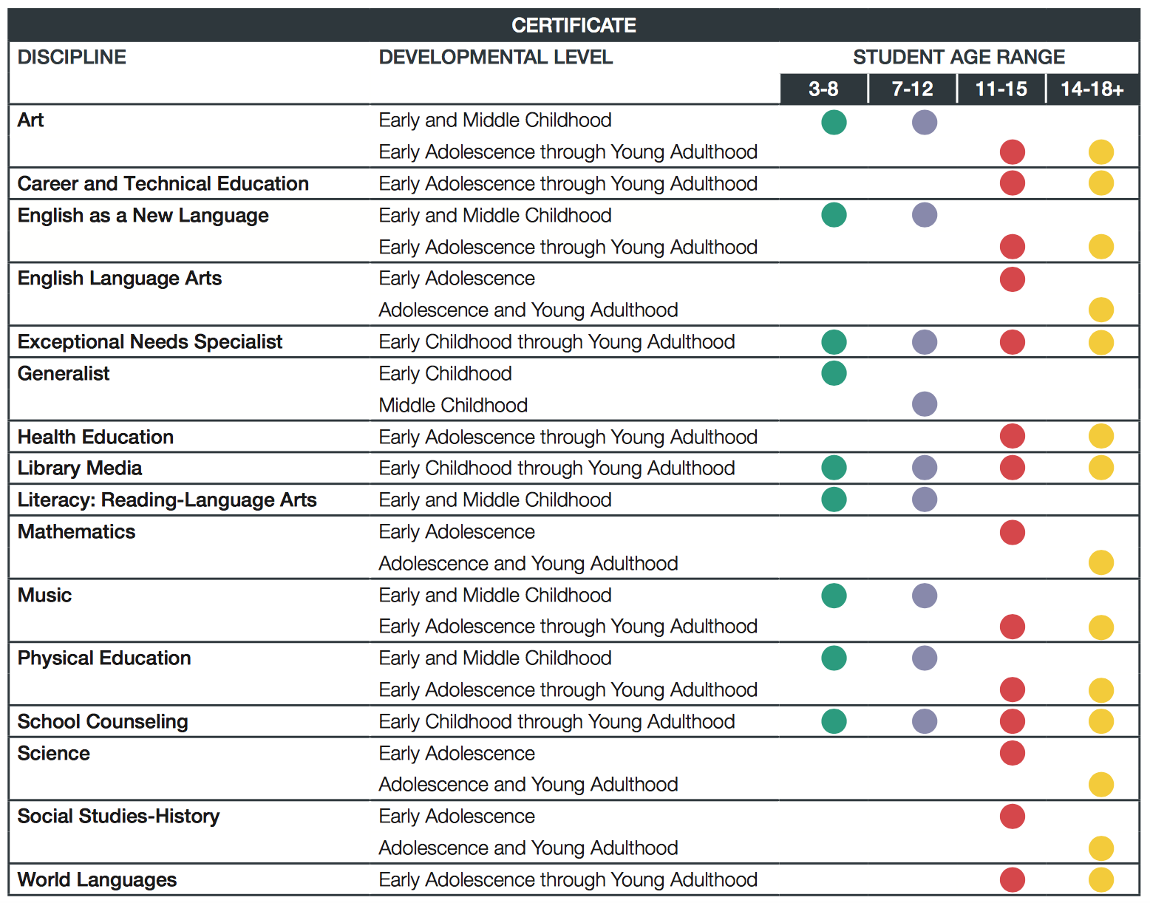

Slide 12

This year, you will have the the ability to choose which Components you complete.

Slide 13
The Rollout is OUT!
You may complete the process in
one, two, or three years
Your choice
Your pace

Slide 14
What is the process?
You do NOT have to go in order of 1, 2, 3, 4
C1: Content Knowledge
C2: Differentiation in Instruction
C3: Teaching Practice and Learning Environment
C4: Effective and Reflective Practitioner

Slide 15
The Five Core Propositions
Teachers…
Are committed to students and their learning.
Know the subjects they teach and how to teach those subjects to students.
Are responsible for managing and monitoring student learning.
Think systematically about their practice and learn from experience.
Are members of learning communities.

Slide 16
The General Cadence
Deadlines for 2015-16
Application deadline: January 31, 2017
Full payment due: January 31, 2017
Withdrawal and refund deadline: January 31, 2017
ePortfolio window: April – May, 2017
Assessment center window: April – June, 2017
Scores released: On or before December 31, 2017

Slide 17

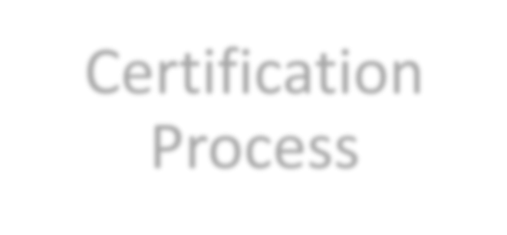



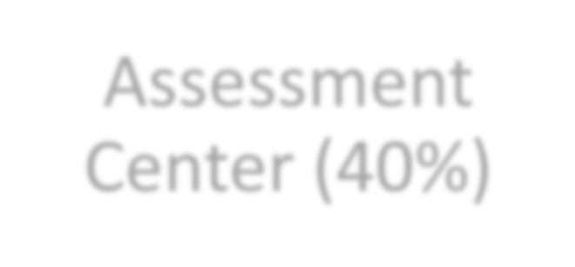
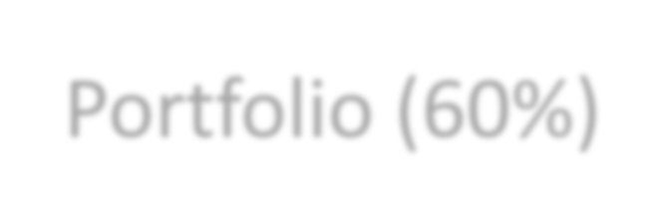

Certification
Process
Assessment
Center (40%)
Portfolio (60%)
Performance based and peer-reviewed!

Slide 18
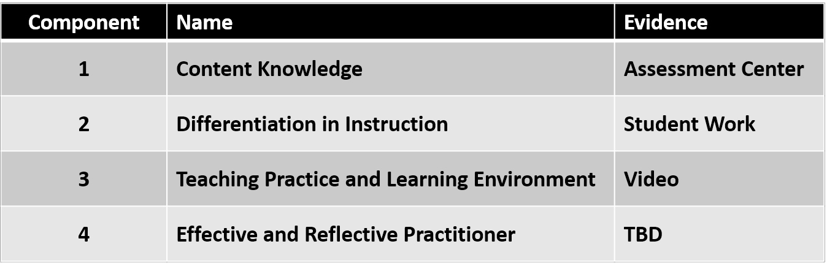
Common Names Across ALL Four Components

Slide 19
COST
The total cost of certification decreased from $2500 to
$1,900, with each of the four components costing $475.
Important price points
$475 for each component
$75 annual registration fee

Slide 20
Financial Help and Assistance
Mississippi will reimburse EVERY candidate after they complete components.
Candidates submit in May and receive scores the following fall. The state will reimburse once candidates receive a score report.
State reimbursement is provided whether certification is achieved or not.

Slide 21
Other Avenues of Financial Support
Local Banks: assistance varies by bank. Visit your local bank and talk to your personal banker.
National Board Scholarships: are often awarded in the fall. They are presented on first come first served basis sometimes to specific certificates. Candidates must be registered to be eligible for a scholarship.

Slide 22
The Components
There are four
Three portfolio entries (Components 2, 3, and 4)
One assessment (Component 1)
Each Component requires the integration of identified standards.
No single Component requires the integration of all the certificate standards

Slide 23
The Standards
Each certificate has its own standards, typically 10 to 13
National Board Candidates teach to their certificate’s standards and their state standards
The standards are detailed descriptions (examples) of what accomplished teaching looks like
Evidence = Standards
All the rubrics align with the standards identified in that component
ARE VERY IMPORTANT!!

Slide 24
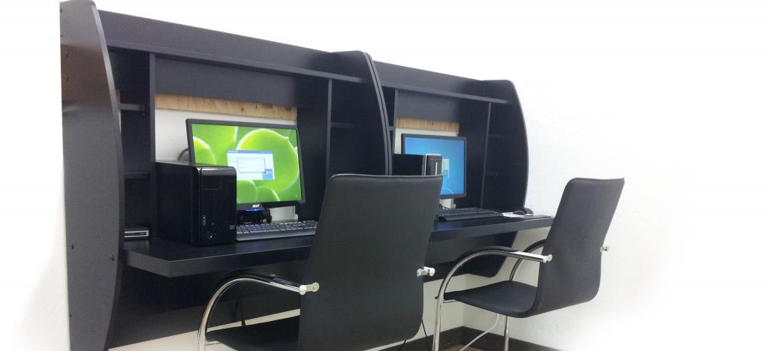
Component 1: Content Knowledge
A computer-based assessment to demonstrate knowledge and pedagogical practices for their certificate area.
3 constructed response exercises
Approximately 45 selected response items (SRIs)

Slide 25
Time Limits for Component 1: SRI Section
•National Board judiciously considered the issue of adequate time limits when developing Component 1: Content Knowledge.
•RESULT: 15 minutes were added to the original 60 minutes (total of 75 minutes) for the section of 45 selected response items for six certificate areas:
–EA/ & AYA/ELA
–EA/ & AYA/MATH
–AYA/Sci-Chemistry, and AYA/Sci-Physics
Constructed response item time limits remain unchanged.

Slide 26
Component 2: Differentiation in Instruction
This classroom-based portfolio entry is primarily comprised of samples of student work and an accompanying written commentary. You will submit selected work samples that demonstrate the students’ growth over time and a written commentary that analyzes your instructional choices.

Slide 27
Component 3:
This is a classroom-based portfolio entry that requires video recordings of interactions between you and your students. A written commentary in which you describe, analyze and reflect on your teaching and interactions will also be submitted. Both the video and the written commentary should demonstrate how you engage students and impact their learning.

Slide 28
Coming Attraction: Component 4
Component 4: Effective and Reflective Practitioner will be released fall 2016 , late October or early November.
This is a portfolio entry provides you with the opportunity to highlight your abilities an an effective and reflective practitioner in developing and applying your knowledge of your students.
Focus: data driven instruction and decision making to impact student learning

Slide 29
Floor Score
In addition to meeting an overall cut score, a floor average score of 1.75 will be required on the Assessment Center (Component 1) and Portfolio (Components 2, 3 and 4) sections.
The value of 1.75 sends the message to candidates and
policymakers that:
National Board values both assessment center and
portfolio aspects of teaching, and
candidates cannot demonstrate little or no evidence of what each section measures to earn certification.

Slide 30
Weighting
Though the weights across the Assessment Center (40%) and Portfolio (60%) Sections remain the same, the weights for the individual components were necessarily revised to reflect the new composition of these sections:
Assessment Center (Component 1) – 40%
  split equally between CRI and SRI
Portfolio (Components 2, 3, and 4) – 60%
  Differentiation in Instruction (C2) – 25%
  Teaching Practice and Learning Environment (C3) – 50%
  Reflective and Effective Practitioner (C4) – 25%

Slide 31
Completing National Board – 1 to 5 years
You must attempt each of the four components within the first three years of your candidacy.
There is no minimum or maximum score requirement to retake a component. However, once you achieve National Board Certification, retake attempts are no longer available.
You have up to two retake attempts for each component and you can retake at any time during the five-year window; retake years do not have to be concurrent or consecutive.
You can have a year when you take no components; however, it does not extend your five year window.
The highest score received for an individual component will always be used for total score calculation.

Slide 32
What has changed?
Maintenance of Certification
The National Board recently revised its policy for maintenance of certification, and will require Board- certified teachers to demonstrate their knowledge and skills every five years. (Adopted February 2015)
This new policy is aligned with the movement of 40 state licensure systems to a five-year renewal period, but also reflects efforts to make certification more affordable and efficient for all teachers, so that that it can become the norm in the profession.

Slide 33
Part II:
The World Class Teaching Program:
How Can We Help You?

Slide 35
Who are we?
The World Class Teaching Program at the University of Mississippi is a candidate support program that assists teachers in understanding National Board Certification and provides high quality candidate support mentors and resources to aid candidates in their certification journey.

Slide 36
World Class Teacher Program
A Candidate Support System
The University of Mississippi *
Delta State University
Mississippi State University
Alcorn State University
Jackson State University
The University of Southern Mississippi

Slide 37
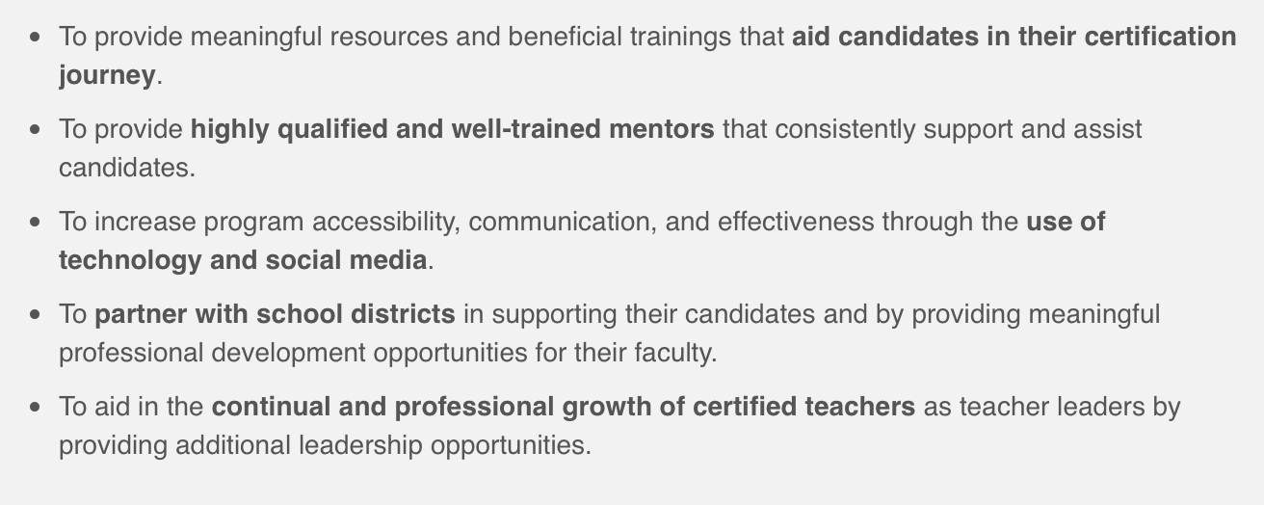
The Mission of the WCTP

Slide 38

You don’t want to do this alone!

Slide 39
Mentoring – Three Types
Traditional, Face–to–Face
Meets twice a month on Tuesdays from 5:00 to 7:00 p.m.
Available at Tupelo, Oxford, DeSoto, and Grenada
2. Online, Utilizing Edmodo and Zoom
Meets weekly for an hour. Days and time varies
Available in select certificates: EC Gen, MC Gen, Literacy, Exceptional Needs, and Math (AYA & EA)
3. * NEW * Non-Credited Canvas Independent Course
Includes modules w/videos for all four components,
syllabus and course outline, assignments will be submitted electronically to an NBCT mentor for feedback.

Slide 40
Resources, Resources, Resources!
The WCTP at the University of Mississippi actively pursues top quality resources from all over the state to use with it’s mentors and candidates.
This year’s NEW resources come from Stanford University and New Mexico’s National Board Network.

Slide 41
Cost of mentoring is
FREE at the University of Mississippi!

Slide 42
Coming Fall 2016
New mentoring resources from Stanford University
Response/Work sheets that correspond with each component
New independent mentoring course

Slide 43
Part III:
I’m in! Now What?

Slide 44
What Next? Now What?
Watch the introduction video on the WCTP to find out how to register for National Boards and the WCTP.
Register for National Boards AND the WCTP
Create a notebook. Include: your standards, components, and the general portfolio instructions. Familiarize yourself with your standards and components.
Read over your material that you were given today: The PowerPoint, Guide to National Board Certification (dates, deadlines…etc.)
Check out the resources on the WCTP webpage http://wctp.olemiss.edu
You will hear from a mentor by mid-September.
Relax. The WCTP is here to help you!!

Slide 45
Contact Information
Tammy Kirkland, NBCT
Email: kirkland@olemiss.edu (Best Method)
Phone: 662-507-9869
Fax: 662-915-3790
Facebook: Ole Miss – World Class Teaching Program

