Slide 1
National Board Certification:
What is the Same? What has changed?
Updated April 2015

Slide 2
How will the revised assessment roll-out?
National Board Certification will rollout over the course of three cycles:
2014-15
2015-16
2016-17
C1: Content Knowledge
C1: Content Knowledge*
C1: Content Knowledge
C2: Differentiation in Instruction
C2: Differentiation in Instruction**
C2: Differentiation in Instruction
C3: Teaching Practice and Learning Environment**
C3: Teaching Practice and Learning Environment
*The Content Knowledge component will be delayed for World Languages (WL) until 2016-17.
**Due to ongoing revision of the Career and Technical Education (CTE) certificate, the Differentiation in Instruction and Teaching Practice and Learning Environment components will be delayed for CTE until 2016-17.
C4: Effective and Reflective Practitioner

Slide 3
What is the same?

Slide 4
What is the same?
Our Mission
Maintaining high and rigorous standards for what accomplished teachers should know and be able to do;
Providing a national voluntary system certifying teachers who meet these standards; and
Advocating related education reforms to integrate National Board Certification in American education and to capitalize on the expertise of National Board Certified Teachers.

Slide 5
What is the same?
The Five Core Propositions
Teachers…
Are committed to students and their learning.
Know the subjects they teach and how to teach those subjects to students.
Are responsible for managing and monitoring student learning.
Think systematically about their practice and learn from experience.
Are members of learning communities.

Slide 6
What is staying the same?

Slide 7
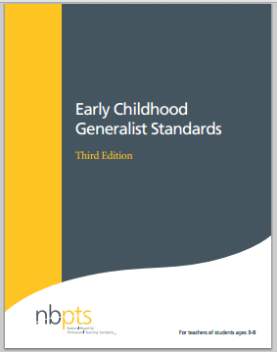
What is the same?
The Standards
With a few exceptions!
CTE – revised March 2015
2014-15 Release
English Language Arts
Science
Physical Education

Slide 8
What is the same?
The General Cadence
Deadlines for 2015-16
Application deadline: January 31, 2016
Full payment due: January 31, 2016
Withdrawal and refund deadline: January 31, 2016
ePortfolio window: April 1 – May 18, 2016
Assessment center window: March – June 15, 2016
Scores released: On or before December 31, 2016

Slide 9
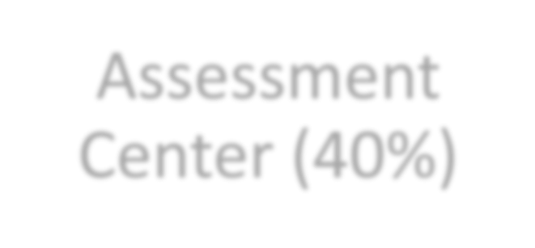
What is the same?
Certification
Process
Assessment
Center (40%)
Portfolio (60%)
Performance based and peer-reviewed!

Slide 10
What has changed?

Slide 11
What has changed?
Revised Standards
Effective 2014-15
Science
English Language Arts
Physical Education
Effective 2015-16
Career and Technical Education

Slide 12
What has changed?
Common Names Across Four Components

Slide 13
What has changed?
Flexibility
While teachers can complete the entire process in one year once it is fully implemented, some may choose to do so over several years if that fits better with other demands on their time.
All four components must be completed in 3 years
Candidates still have two opportunities to retake
(highest score policy will continue to apply)

Slide 14
What has changed?
Affordability
The total cost of certification will decrease from $2500 to
$1,900, with each of the four components costing $475.
Important price points
$475 for each component
$75 annual registration fee

Slide 15
What has changed?
Component 1: Content Knowledge
A computer-based assessment to demonstrate knowledge and pedagogical practices for their certificate area.
3 constructed response exercises
Approximately 45 selected response items (SRIs)

Slide 16
What has changed?
Time Limits for Component 1: SRI Section
•National Board judiciously considered the issue of adequate time limits when developing Component 1: Content Knowledge.
•RESULT: 15 minutes were added to the original 60 minutes (total of 75 minutes) for the section of 45 selected response items for six certificate areas:
–EA/ & AYA/ELA
–EA/ & AYA/MATH
–AYA/Sci-Chemistry, and AYA/Sci-Physics
Constructed response item time limits remain unchanged.

Slide 17
What has changed?
Component 2: Differentiation in Instruction
The instructions have been updated to:
more succinctly explain the evidence to develop and submit;
provide links to templates which allow candidates to enter information electronically for evidence;
include the scoring rubric, which has been revised as necessary to ensure that it describes aspects of performance that are directly observable and measurable through the submitted evidence and written commentary; and
add or emphasize language that clearly calls attention to this entry's focus on using knowledge of individual students to differentiate instruction

Slide 18
What has changed?
Component 3: Teaching Practice and
Learning Environment
Combined two video-based portfolio entries into one to form the more streamlined Component 3.
By reducing the length of the videos and by decreasing the length of the written commentaries, Component 3 is able to target significant aspects of teaching practice more effectively than before.
With greater efficiency comes greater focus on the evaluation of classroom instruction and its impact on student learning in different educational contexts.

Slide 19
What has changed?
Coming Attraction: Component 4
Component 4: Effective and Reflective Practitioner is still in the design stage.
Field testing for Component 4 will occur in Spring 2016.
Registration for Component 4 will be open with
the 2016-17 candidate cycle.

Slide 20
What has changed?
Floor Score
In addition to meeting an overall cut score (which is TBD), a floor average score of 1.75 will be required on the Assessment Center (Component 1) and Portfolio (Components 2, 3 and 4) sections.
The value of 1.75 sends the message to candidates and
policymakers that:
National Board values both assessment center and
portfolio aspects of teaching, and
candidates cannot demonstrate little or no evidence of what each section measures to earn certification.

Slide 21
What has changed?
Floor Score
Specifically, the floor score requirements are:
Candidates must earn a minimum average score of 1.75 on Component 1: Content Knowledge, which is also referred to as the Assessment Center Section. The average score for the Assessment Center Section is based on averaging the scores from the three constructed response exercises and the selected response section.
Candidates must earn a minimum average score of 1.75 on Components 2, 3, and 4, which is also known as the Portfolio Section. The average score for the Portfolio Section is based on averaging the scores from the three referenced components.

Slide 22
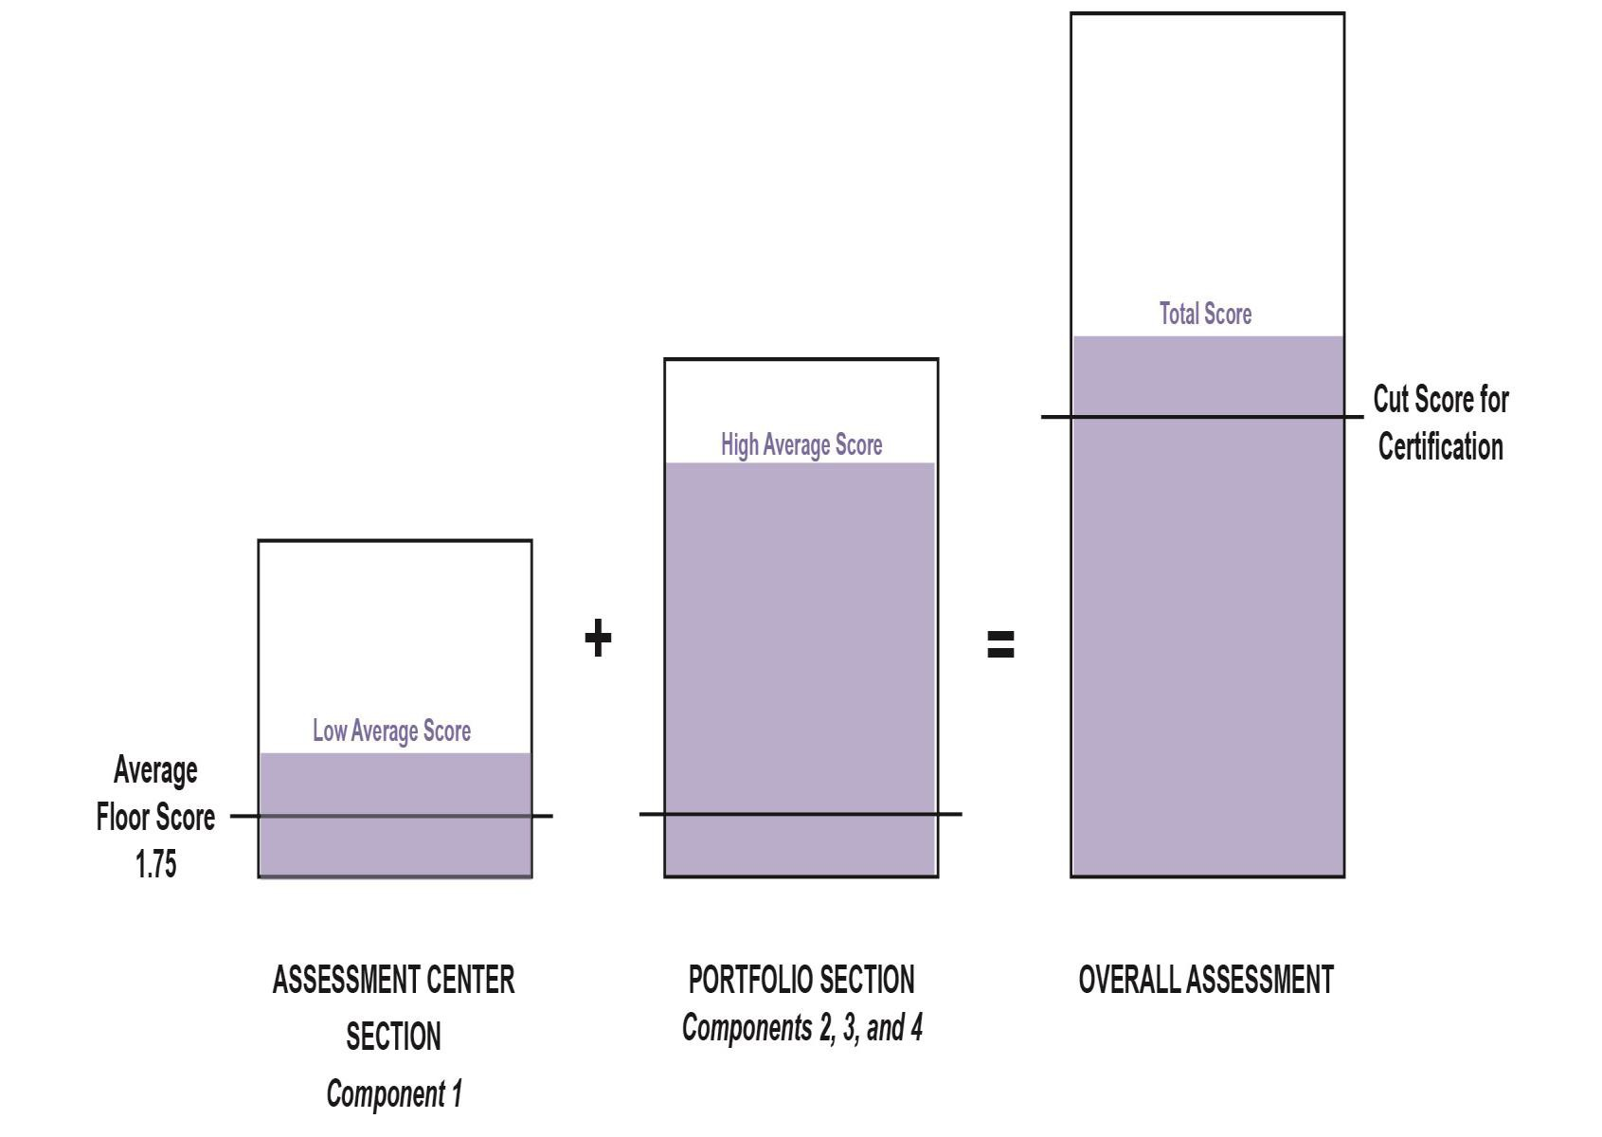
What has changed?
Floor Score

Slide 23
What has changed?
Weighting
Though the weights across the Assessment Center (40%) and Portfolio (60%) Sections remain the same, the weights for the individual components were necessarily revised to reflect the new composition of these sections:
Assessment Center (Component 1) – 40%
split equally between CRI and SRI
Portfolio (Components 2, 3, and 4) – 60%
Differentiation in Instruction (C2) – 25%
Teaching Practice and Learning Environment (C3) – 50%
Reflective and Effective Practitioner (C4) – 25%

Slide 24
What has changed?
Retake Policy
Beginning with the 2014-15 cycle, first-time candidates will be allowed to retake a component, regardless of previous score earned.
Previous policy did not allow retakes if the candidate score was 2.75 or higher. Note that candidates best score (not most recent score) is used in calculating total score.

Slide 25
What has changed?
MORE Coming Attractions!
Currently being revised and to be available later
this year:
Draft design for the new score report
Guide to Understanding and Interpreting Your
Scores
Online calculator for all candidates

Slide 26
What has changed?
Maintenance of Certification
The National Board recently revised its policy for maintenance of certification, and will require Board- certified teachers to demonstrate their knowledge and skills every five years. (Adopted February 2015)
This new policy is aligned with the movement of 40 state licensure systems to a five-year renewal period, but also reflects efforts to make certification more affordable and efficient for all teachers, so that that it can become the norm in the profession.

Slide 27
What has changed?
Maintenance of Certification
Development of the maintenance of certification has not yet started.
It will not be the same as the current renewal process (PPG).
The aim is to keep it similar in price and process to completion of a single component of the certification process every five years.
For additional information, including the rollout schedule:
boardcertifiedteachers.org/maintenance-of-certification

Slide 28
Where can you find
additional information?

Slide 29
www.boardcertifiedteachers.org
Candidate application for revised certification
State-specific
information
Resources for…
candidates
support providers

Slide 30
www.boardcertifiedteachers.org/resources
Helpful resources for
candidate support providers!
Videos
Informational Prezi
Flyers
Cert Revision PPT
Component instructions
Guide to NBC
Third-party Payer Guide

Slide 31
Wanted: Field Test Participants!
Immediate focus:
Content Knowledge
Teaching Practice and Learning Environment
2016: Reflective and Effective Practitioner
Information available at www.boardcertifiedteachers.org

