Slide 1
Translating the Neuroscience of Early Brain and Child Development to Public Policy
Graduate Center for the Study of Early Learning
University of Mississippi
Jackson, MS
February 6, 2018
PAT LEVITT, PH.D.
SIMMS/MANN CHAIR IN DEVELOPMENTAL NEUROGENETICS
CHILDREN’S HOSPITAL LOS ANGELES
WM KECK PROVOST PROFESSOR OF NEUROGENETICS
UNIVERSITY OF SOUTHERN CALIFORNIA
CO-SCIENTIFIC DIRECTOR, NATIONAL SCIENTIFIC COUNCIL FOR THE DEVELOPING CHILD
SENIOR FELLOW, CENTER FOR THE DEVELOPING CHILD, HARVARD UNIVERSITY
plevitt@med.usc.edu
http://www.developingchild.harvard.edu

Slide 2
Presentation
A primer of brain development and the power of early experience on mental and physical health for a lifetime
Toxic Stress -what’s it all about
Two key brain and health targets for success
  Executive Function
  Resilience
Notes:
The issues we are talking about are not just about children, but about broader societal issues.
Also, this is not about “other people’s children” -- what happens to other people’s children affects all of society.

Slide 3
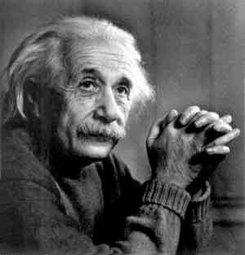
Albert Einstein Got It Right
  “If you always do what you always did, you will always get what you always got.”
Shonkoff, Center for the Developing Child, Harvard

Slide 4

Policy Changes - What Can They Mean?
Reduce special needs populations; increase emotionally sound, learning-ready children with sound Executive Function
Invest Early
Major increase in human capital via ready workforce
It’s
Patriotic
Notes:
The implications of the science of early child development are far-reaching, so I’ll touch on just a few. These implications are drawn not from single studies, but from decades of research that have led to widely accepted, broad principles that we can apply to policy and practice.

Slide 5
States with low child achievement are falling off the education and economic cliff

Slide 6
The Core Story
#1 - Child development is the foundation of prosperous communities
#2 - Brains are built over time, from the bottom up (skill begets skill)
#3 - Genes and experiences together build brains (serve and return relationships)
#4 - Cognitive, social and emotion development are inextricably intertwined
#5 - Toxic stress damages brain architecture
#6 - Resilience is not an internal character strength, but rather is built through combined impact of genes and experiences of a child
#7 - For many functions, the brain’s capacity for change decreases over time (cost-effectiveness factor) - but not all functions are impacted equally
Notes:
The implications of the science of early child development are far-reaching, so I’ll touch on just a few. These implications are drawn not from single studies, but from decades of research that have led to widely accepted, broad principles that we can apply to policy and practice.

Slide 7




Common Misconceptions of Development
Children are………..
80% of brain development occurs by………
Bad stuff happens………you just have to be…….
Ready to learn is all about…….

Slide 8
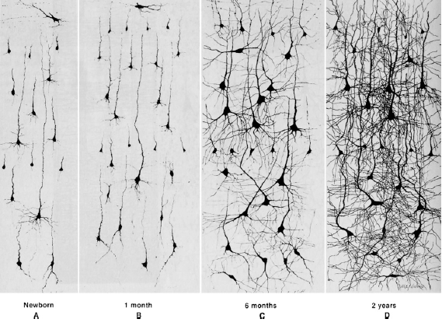
Dramatic Growth of Neuronal Architecture - Birth - 2 yrs
(1 million synapses formed per second in the early years)
Courchesne et al, Neuron 56, 2007
Notes:
As you can see, during childhood and adolescence these neural connections are reduced through experience (which is necessary; even if our entire hereditary makeup were devoted . . . ).
This helps to ensure that the neural connections that are most useful to the developing mind are retained. “Use it or lose it.”
But this is a double-edged sword. On the one hand, positive, healthy, growth-promoting experiences help to develop brains that are efficient and sophisticated (language, sight, movement in gravity). But for some young children, their developing brains are incorporating experiences that are abusive or profoundly neglectful, and these alter the brain’s processing sometimes for life (Seth Pollock’s work on sensitivity to anger expressions). These influences begin early, even prenatally.

Slide 9
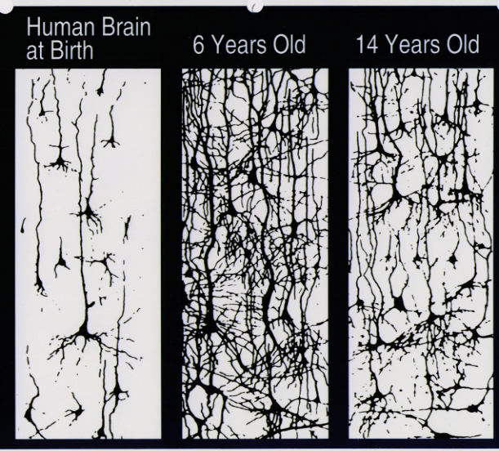
Experience Shapes Brain Architecture by Over-Production Followed by Pruning Through Childhood
birth 6 years 14 years
Notes:
As you can see, during childhood and adolescence these neural connections are reduced through experience (which is necessary; even if our entire hereditary makeup were devoted . . . ).
This helps to ensure that the neural connections that are most useful to the developing mind are retained. “Use it or lose it.”
But this is a double-edged sword. On the one hand, positive, healthy, growth-promoting experiences help to develop brains that are efficient and sophisticated (language, sight, movement in gravity). But for some young children, their developing brains are incorporating experiences that are abusive or profoundly neglectful, and these alter the brain’s processing sometimes for life (Seth Pollock’s work on sensitivity to anger expressions). These influences begin early, even prenatally.

Slide 10

Early Experience Builds Healthy Brain Architecture
Notes:
The issues we are talking about are not just about children, but about broader societal issues.
Also, this is not about “other people’s children” -- what happens to other people’s children affects all of society.

Slide 11
Remember…….
Development is not a blank slate
Skill begets skill
Notes:
The issues we are talking about are not just about children, but about broader societal issues.
Also, this is not about “other people’s children” -- what happens to other people’s children affects all of society.

Slide 12
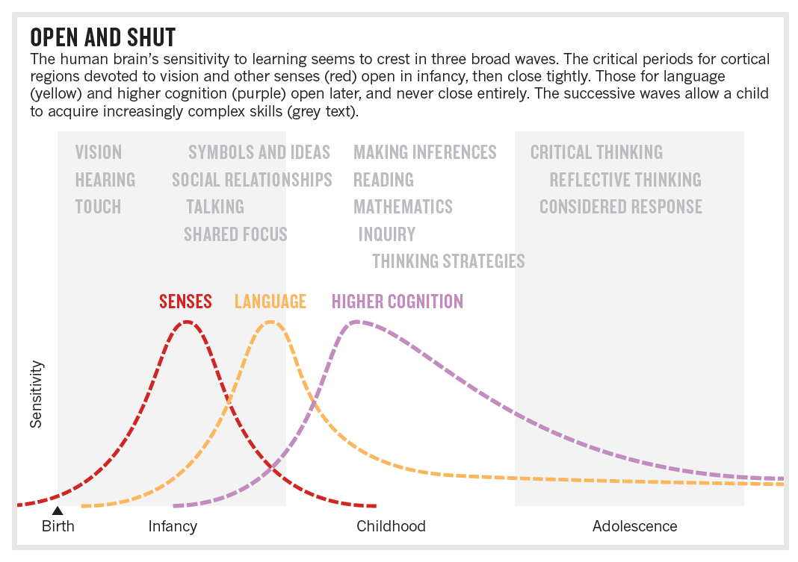
Open and Shut - Critical Periods of Brain and Child Development
When do most U.S. school systems start to teach foreign language?
Bardin et al, Nature 2012

Slide 13
The Ability to Change Brains Decreases Over Time
Normal Brain Plasticity Influenced by Experience
Physiological “Effort” Required to Enhance Neural Connections
Birth
10
20
30
40
50
60
70
Age (Years)
Source: Levitt (2009)
Notes:
As the maturing brain becomes more specialized to assume more complex functions, it is less capable of reorganizing and adapting. For example, by the first year, the parts of the brain that differentiate vocal sounds are becoming specialized to the language the baby has been exposed to and are already starting to lose the ability to recognize important sound distinctions found in other languages. As the brain prunes away the circuits that are not used, those that are used become stronger and increasingly difficult to alter over time. Declining plasticity means it’s easier and more effective to influence a baby’s developing brain architecture than it is to rewire parts of its circuitry in the adult years. In other words, we can invest now by ensuring positive conditions for healthy development, or pay more later in the form of costly remediation, health care, mental health services, and increased rates of incarceration. Graph Source: Pat Levitt (2009)

Slide 14
Powerful experiences,
no matter what kind (+/-), matter
Notes:
Differences in development appear very early -- in this instance, differences in vocabulary growth between children in low socio-economic households and high socio-economic households begin to appear as early as 18 months. And as the children grow toward school age, and enter school, the differences only get larger in the absence of intervention.

Slide 15
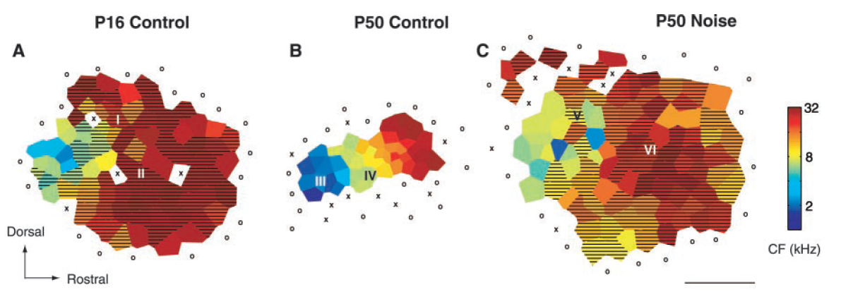
Extreme Early Experiences Can Dramatically Disrupt the Precision of Sensory Information Processing
50 days: exposed to early noise
16 days
50 days
Source: Chang & Merzenich (2003)
Notes:
We know that early experience influences brain architecture and function for a lifetime. Our ability to detect different frequency sounds, which is essential for language development, occurs gradually over time. In the rat, at postnatal day 16, mostly higher frequency sounds are detected in the neocortex, the region of the brain that processes complex information. By postnatal day 50, which is like a teenage rat—in the middle, with normal hearing experience—all frequencies are represented and the region of the cortex is finely tuned. Exposing the animals for a few weeks of mostly one frequency tone (right panel) results in an auditory map that never matures, and in fact, the animals have the high frequency over-represented. They will be unable to decipher lower frequency sounds for the rest of their life, because the early experience of hearing that one tone was sufficient to tune the architecture and connections forever.

Slide 16
Exposure to Complex Language Repertoire Begets Complex Language Repertoire
1200
1000
College Educated Parents
800
Working Class Parents
Cumulative Vocabulary (Words)
600
Public Assistance
Parents
400
200
16 mos.
24 mos.
36 mos.
Child’s Age (Months)
Source: Hart & Risley (1995)
Fernald et al 2012
Notes:
Differences in development appear very early -- in this instance, differences in vocabulary growth between children in low socio-economic households and high socio-economic households begin to appear as early as 18 months. And as the children grow toward school age, and enter school, the differences only get larger in the absence of intervention.

Slide 17
Interaction as Serve and Return

Slide 18

1200
1000
College Educated Parents
800
Working Class Parents
Cumulative Vocabulary (Words)
600
Public Assistance
Parents
400
200
16 mos.
24 mos.
36 mos.
Child’s Age (Months)

Slide 19
Powerful experiences,
no matter what kind (+/-), matter
Notes:
Differences in development appear very early -- in this instance, differences in vocabulary growth between children in low socio-economic households and high socio-economic households begin to appear as early as 18 months. And as the children grow toward school age, and enter school, the differences only get larger in the absence of intervention.

Slide 20
Toxic Stress Impact on Brain and Child Development

Slide 21
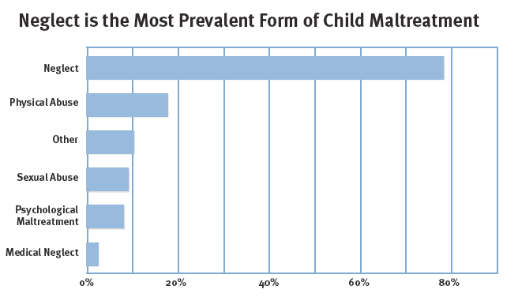
We know that:
U.S. Dept. Health and Human Services, 2010

Slide 22
Neglect is an Early Life Stressor

Slide 23
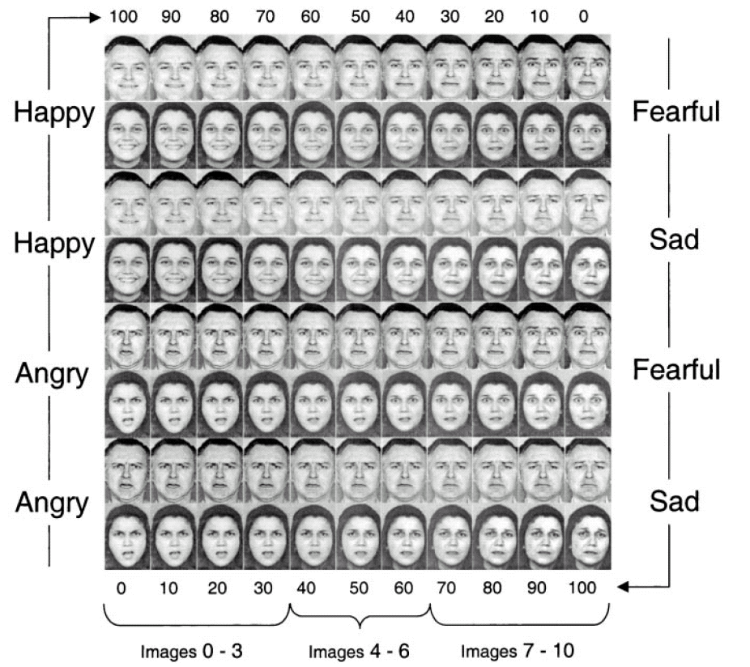
Source: Pollok &
Kistler (2002)
Notes:
Pollak and colleagues examined how young children who experienced harsh physical abuse perceived the world around them. We all become expert early in detecting emotions in faces, which allows to respond in social situations, like school or out community, in an appropriate way. Pollak used morphed facial expressions and showed that non-abused children are able to distinguish emotions normally, transitioning about half-way across the series of faces. That is shown by the green arrow. Abused children can do this with emotions that do not involve anger. However, when the emotion morphs from anger to another emotion, the children routinely are mistaken in reading anger into faces that are either neutral or reflect another emotion. That is shown by the red arrow. Imagine how these children view the world of adult and child faces around them.
Therefore it’s no mystery why victims of physical abuse in early childhood show increased perception of anger and inability to stop paying attention to ‘angry’ cues.
But toxic stress is not only about abuse — severe neglect is just as powerful and disrupts development in other ways. Victims of severe neglect show a decreased ability to perceive emotional states and decreased ability to discriminate specific emotions.

Slide 24
Abuse - difficulty in distinguishing anger from other emotions, and difficulty disengaging
Neglect - difficulty in distinguishing between any emotions, and poor face processing
Pollok &
Kistler PNAS (2002)

Slide 25
What Matters?
Children need to grow up in an environment of relationships that promote critical skill-building

Slide 26
Social-Emotional and Cognitive Skill Building are Interconnected

Slide 27

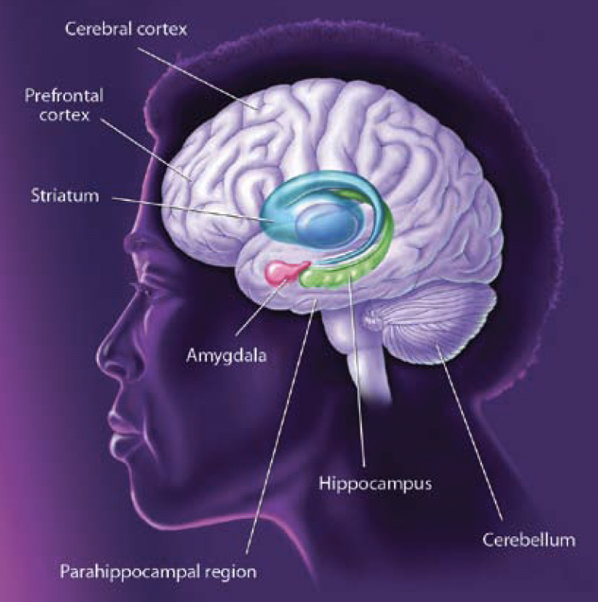
Weaving the Social, Emotional and Cognitive Skill Ropes - Executive Functioning

Slide 28

FRAMEWORKS INSTITUTE
Skills Development Depends Upon Addressing the Whole Child

Slide 29
A Major Challenge:
ELS Can Have an Impact Across Generations

Slide 30



The Epigenome – Regulating Gene Activity
Slides from Michael Meaney

Slide 31
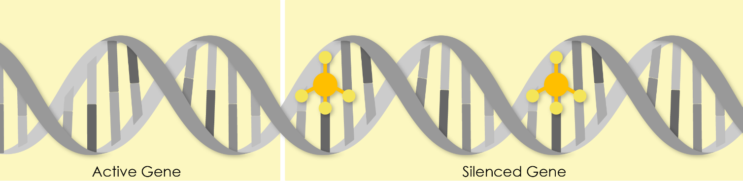
DNA Methylation
M
M
Slides from Michael Meaney

Slide 32

Multiple phenotypes from a common genotype
Fred
Phil
Every cell in your body has the same nuclear genes, but…?
Slides from Michael Meaney

Slide 33
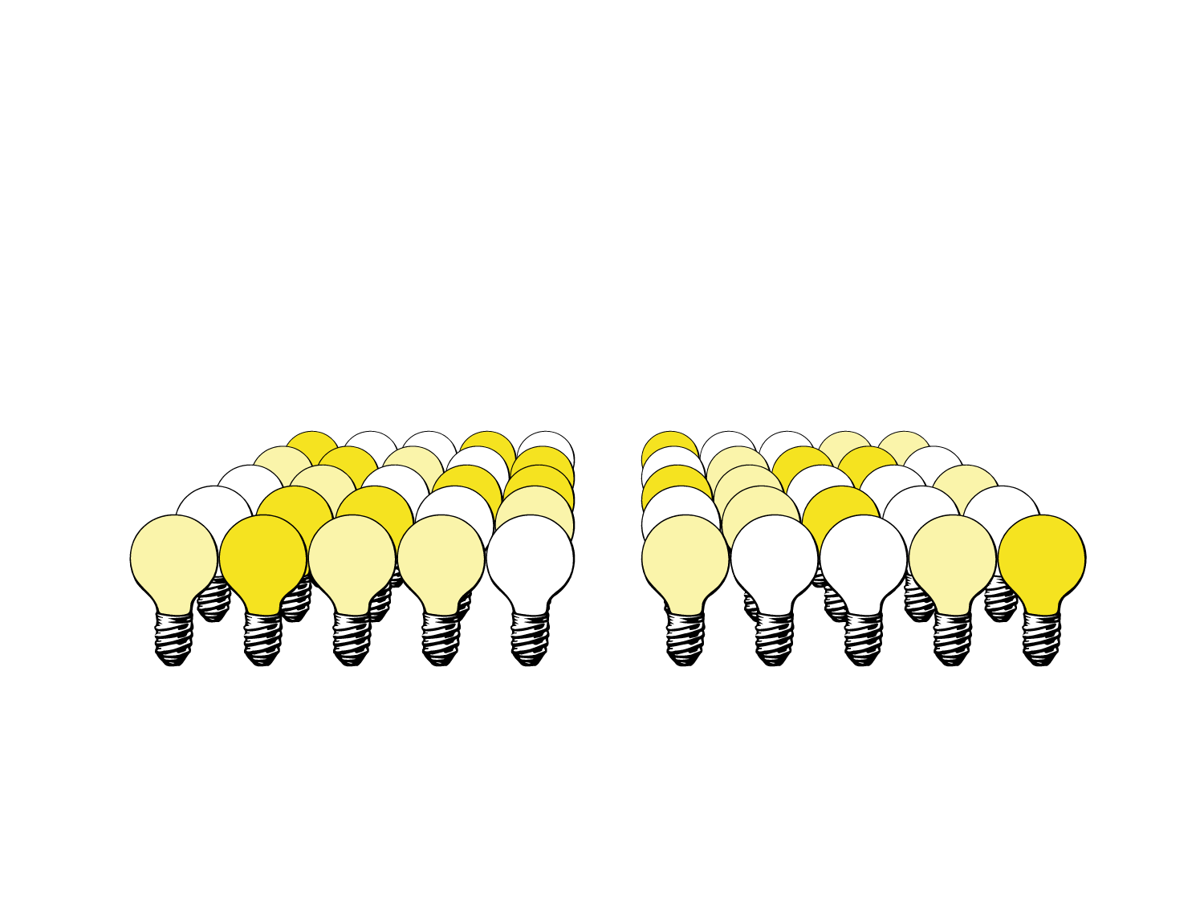
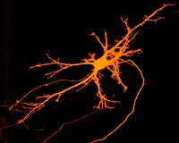



Fred
Phil
Slides from Michael Meaney

Slide 34
Adversity
Typical
Genes involved in activation of stress responses
Slides from Michael Meaney

Slide 35
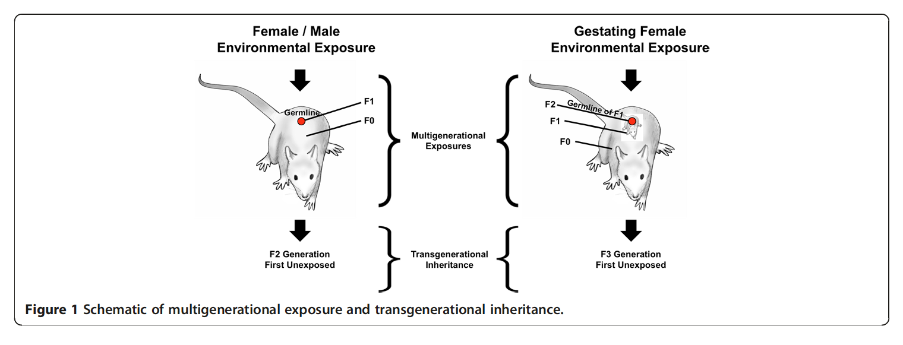
Preconception and Prenatal Origins of Health Disturbances – Generational Implications Due to Impact on Germ Cells

Slide 36
Factors that alter DNA methylation signals in children
Resource access (e.g. maternal prenatal/child postnatal nutrition) - What else????
Prematurity
Maternal emotional status (depression/anxiety)
Paternal stress
Preconception paternal and maternal environmental/drug exposures
Metabolism, oxidative stress
# of early life stress events (ACES)

Slide 37
Yet, even with early adversity, there is a neural system that is key to social-emotional and cognitive resilience…….

Slide 38
Executive Function: What is it?

Slide 39
How Do We Test Executive Function
“Say the name of the color that the word is printed in”

Slide 40
Red

Slide 41
Green

Slide 42
Black

Slide 43
Blue

Slide 44

You do EF Tasks Everyday…….

Slide 45
A remarkable example of developing EF

Slide 46

Pink Tower - Great Example of Executive Function

Slide 47
REMINDER: Part of Executive Function Skill Development Is Building Capacity for Emotional Regulation and Sound Early Mental Health………

Slide 48
The early markers of EF that reveal later problems

Slide 49



Low education achievement
Signs of Early EF Disruption
Undercontrolled behavior
Nicotine
dependence
Alcohol
dependence
Mental Illness
Low persistence
Liability to behavioral disinhibition
Chidhood
Disruptive
Disorders
Externalizing Behaviors
Aggressive
Impulsive
Physical Illness
CVD, Cancer, Obesity, Diabetes
Drug Use
inattention
Incarceration
after Iacono et al, Ann. Rev. Clin. Psych., 2008
Moffitt et al PNAS 2011

Slide 50
Fact: 20% of the children in the study accounted for…….
36% of injury insurance claims
40% of adult obesity
54% of smoking
57% of hospital ER visits
66% of welfare benefits
77% of fatherless child-rearing
78% of prescription drug fills
Caspi et al, Nature Human Behavior, 2016

Slide 51
“But I know someone who was ok after a traumatic childhood…….”

Slide 52
FRAMEWORKS INSTITUTE

Slide 53
So what is neuroscience telling us?

Slide 54
Investment Strategies That Work
Plan from pregnancy and look beyond education and health care - target reducing stress in lives of children and families
Invest in the training and retention of a skilled workforce
Make sure that vulnerable children have access to stable, supportive relationships with adults -as early and consistently as possible
Targeting Executive Function in children AND caregivers - BIG bang for the buck -these are core life skills

Slide 55
Building Resilience is a Team Sport

Slide 56
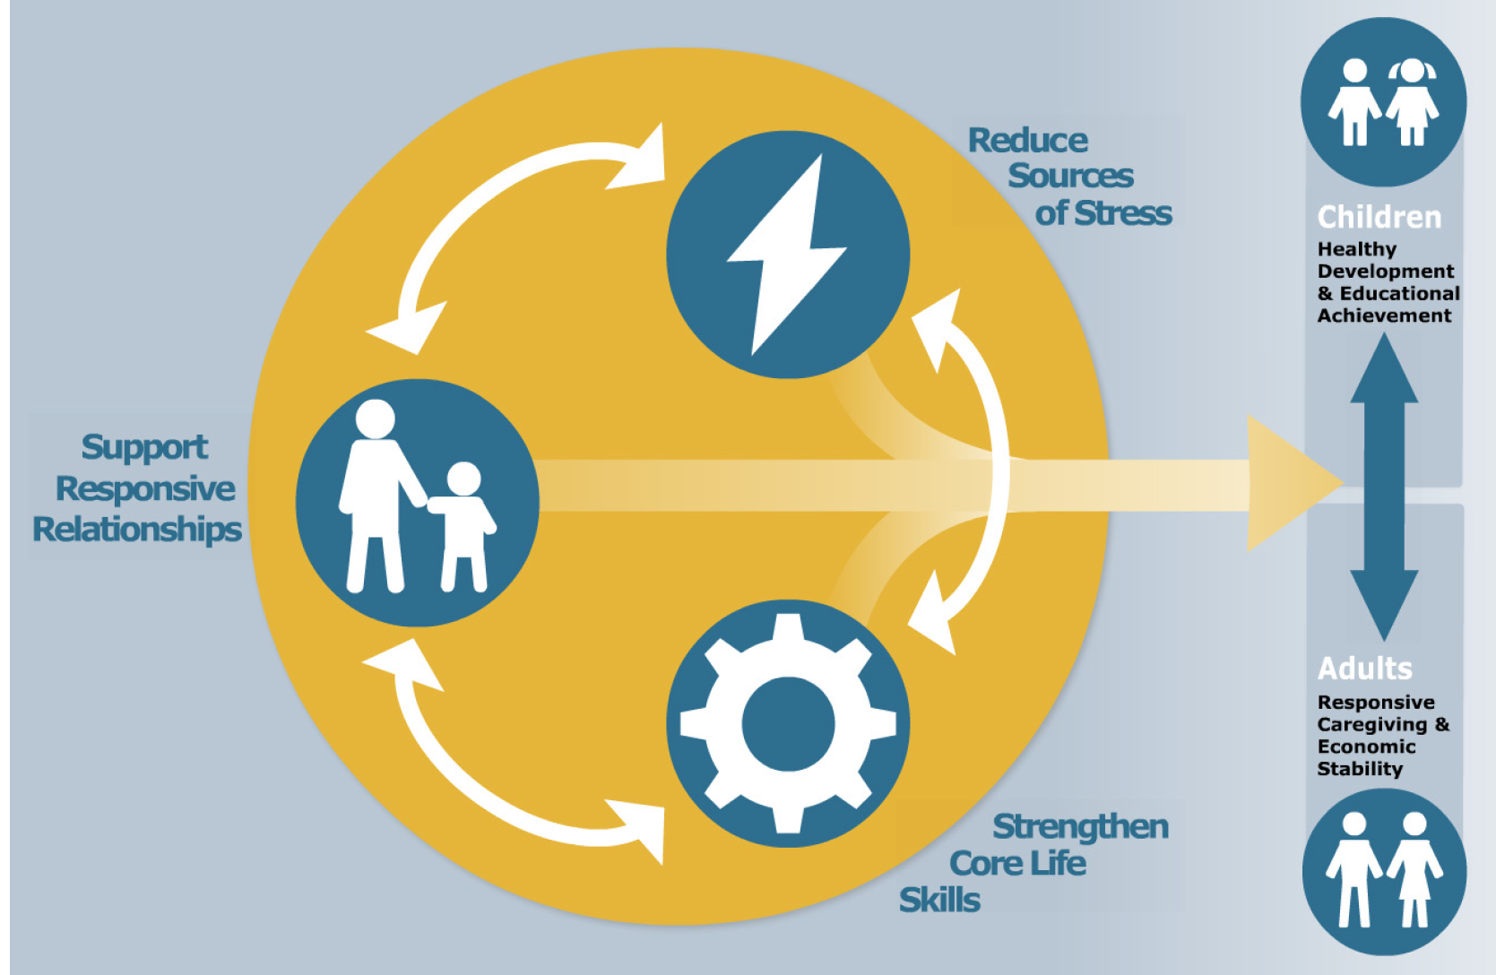
The 3 Principle Ingredients to Improve Outcomes

Slide 57
Early Executive Function Disruption - Long Term Impact
The Dunedin Study (New Zealand)
740
700
Credit Rating Score
660
620
580
low ‘EF’
high ‘EF’
Moffitt et al PNAS 2011
Notes:
The implications of the science of early child development are far-reaching, so I’ll touch on just a few. These implications are drawn not from single studies, but from decades of research that have led to widely accepted, broad principles that we can apply to policy and practice.

Slide 58
Early Executive Function Disruption - Long Term Impact
The Dunedin Study (New Zealand)
0.4
0.2
Adult Wealth Outcome
0.0
-0.2
-0.4
low ‘EF’
high ‘EF’
Moffitt et al PNAS 2011
Notes:
The implications of the science of early child development are far-reaching, so I’ll touch on just a few. These implications are drawn not from single studies, but from decades of research that have led to widely accepted, broad principles that we can apply to policy and practice.

Slide 59
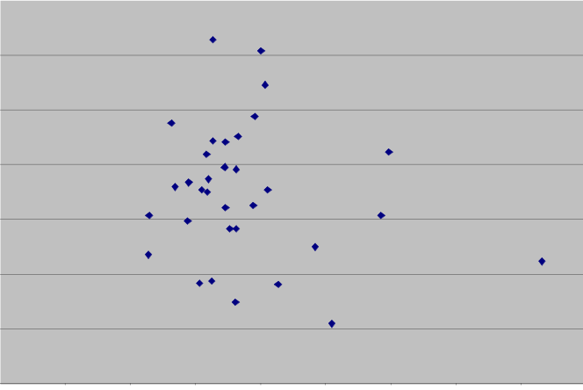
The Key to Larger Impacts at Scale: Greater Specificity About What Works for Whom and Why
What We Should Ask
Why did this work so well for these children and families?
Current Approach
Mean effect qualifies as an evidence-based program
0
Why did this work so poorly for these children and families?

Slide 60
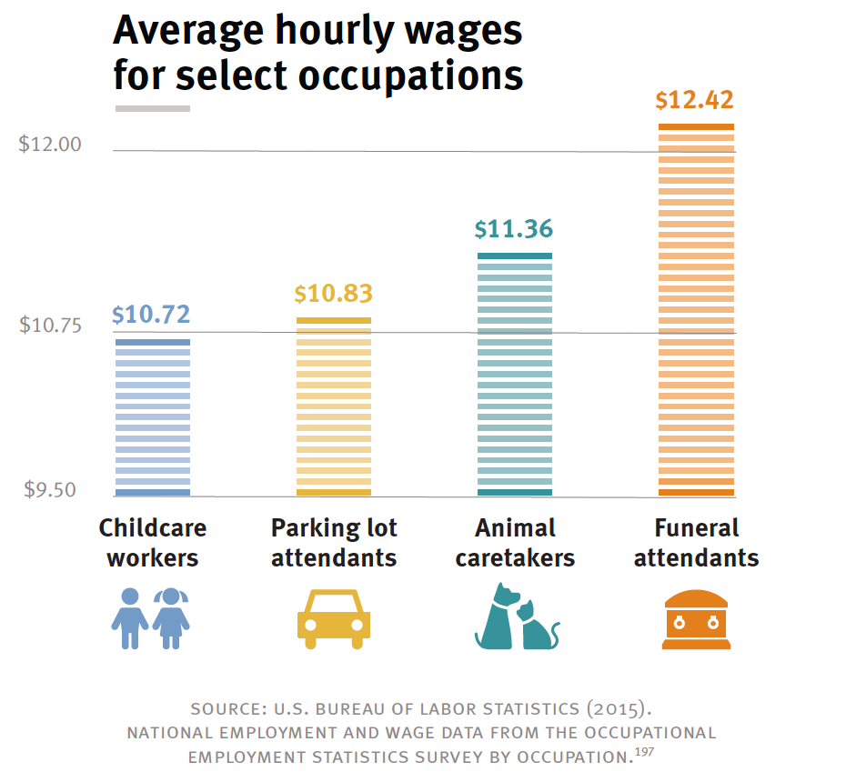
Shonkoff, Center for the Developing Child, Harvard

Slide 61

Thank You!
plevitt@med.usc.edu
http://www.developingchild.harvard.edu

