Slide 1
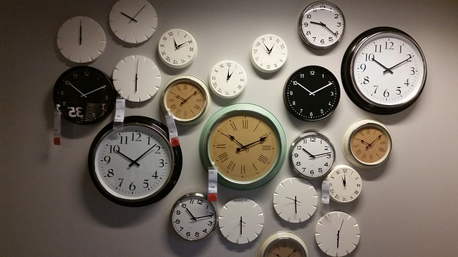
WHAT TIME IS IT?
PRIORITY ADVISING TIME!!!

